Slide 1
POSTPARTUM MANAGEMENT OF THE HYPERTENSIVE DISORDERS OF PREGNANCY (HDP) A systematic review and meta-analysis
I Tol, A Khalil, A E Cairns, R J McManus, J N Bone, P von Dadelszen, L A Magee
Am J Obstet Gynecol 2025

Slide 2
Introduction and aims
With postnatal blood pressure (BP) peaking on days 3-6 postpartum, there is significant maternal morbidity and postnatal hospital readmission associated with hypertensive disorders of pregnancy.
Management strategies that have been explored postpartum include pharmacological and surgical interventions, as well as models of care.
Our review aimed to assess the efficacy and safety of these different interventions on BP management postpartum, to better inform clinical practice, guidelines and future research.
Am J Obstet Gynecol 2025

Slide 3
METHODS
Am J Obstet Gynecol 2025

Slide 4
Search strategy
Prospectively registered, peer reviewed and published by the Cochrane editorial process.
Initial search strategy in collaboration with Cochrane Pregnancy and Childbirth’s Trial register, with updates in September 2024 and September 2025.
We included all randomized controlled trials, assessing participants with postpartum HDP, using an intervention aimed to reduce maternal BP. These encompassed:
Diuretics
Antihypertensives
Uterine curettage
Models of care
Am J Obstet Gynecol 2025
Notes:
Postpartum hypertension defined as systolic >140 and DBP >90 from 0-6 weeks postpartum.

Slide 5
Outcomes assessed
BP control (defined as poor BP control, or as BP values)
Need for additional antihypertensive
Maternal mortality and morbidity
Breastfeeding at hospital discharge
Postnatal length of hospital stay
Postnatal readmission to secondary care
Longer term cardiovascular (CV) outcomes (>6 weeks postpartum)
Patient satisfaction with care
Am J Obstet Gynecol 2025

Slide 6
Data extraction and analysis
Screened and extracted by 2 independent authors.
Risk of bias using the Cochrane risk-of-bias assessment.
Certainty of evidence evaluated using GRADE.
Random effects meta-analysis for combining data.
Am J Obstet Gynecol 2025
Notes:
Heterogeneity was deemed substantial if I2 >30% and Tau2 >0 or p<0.10 in Chi-square test.
Post-hoc network meta-analysis performed for pharmacological interventions.

Slide 7
RESULTS
Am J Obstet Gynecol 2025

Slide 8
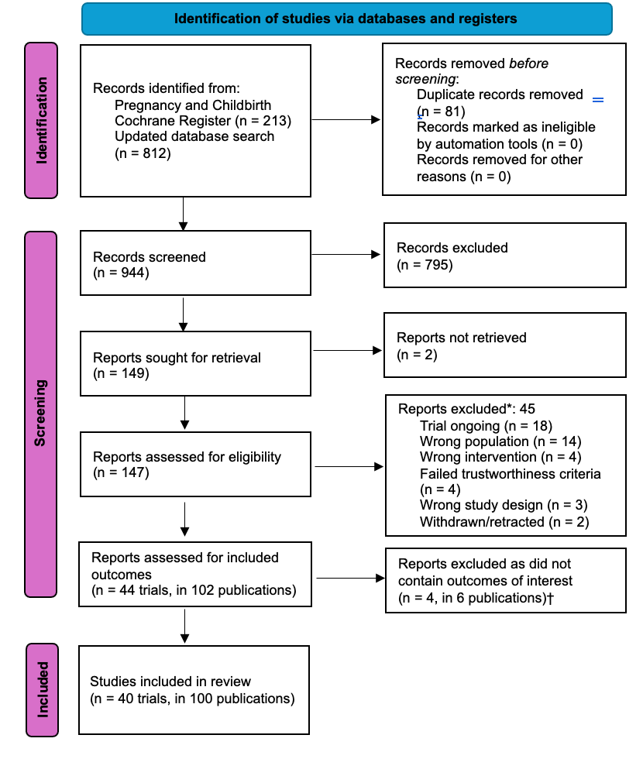
Study selection
Am J Obstet Gynecol 2025

Slide 9
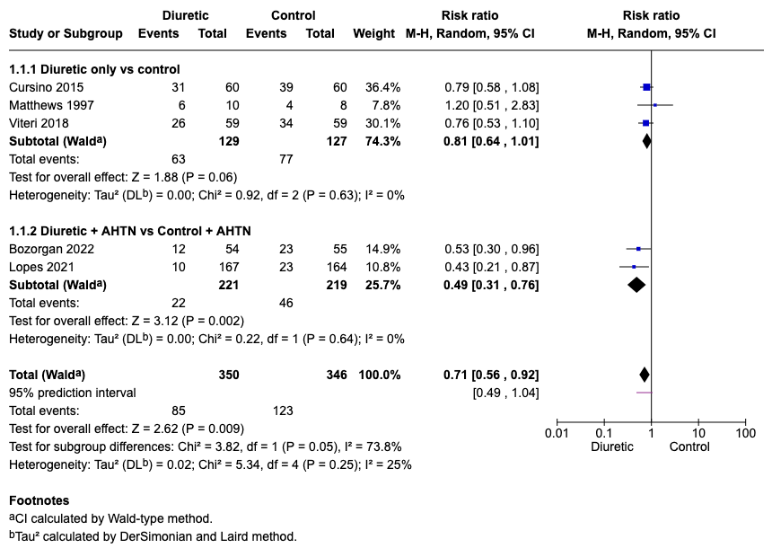
Diuretics (+/- antihypertensive) vs no therapy (+/- antihypertensive)
7 trials
BP control was better with diuretics, but heterogeneity was related to trials that administered antihypertensives to both groups.
BP control did not differ between groups when diuretics were compared with placebo/no therapy.
Am J Obstet Gynecol 2025

Slide 10
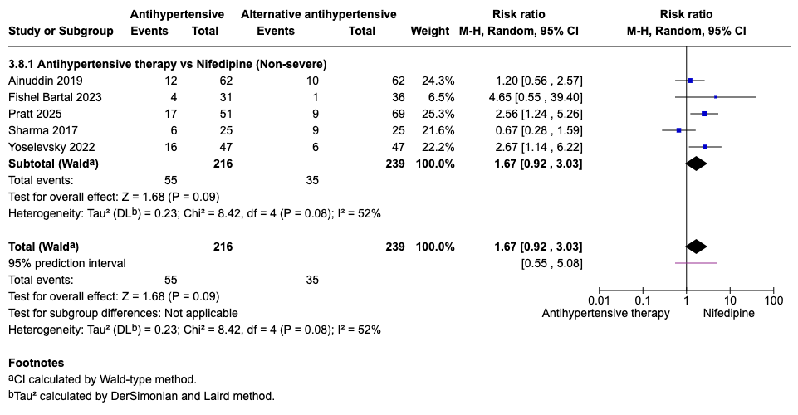
Antihypertensive vs alternative antihypertensive (non-severe HTN)
9 trials.
No difference in need for additional antihypertensive when various antihypertensives (labetalol, HCTZ+lisinopril, amlodipine, enalapril) were compared with nifedipine, but there was significant between-trial heterogeneity.
Am J Obstet Gynecol 2025
Notes:
If sharma excluded, between trial heterogeneity decreases and you see less need for additional antihypertensive with nifedipine (RR 2.07, 1.32-3.27)

Slide 11
Antihypertensive vs alternative antihypertensive (non-severe HTN)
Heterogeneity appeared to arise from ACE inhibitors (enalapril, lisinopril+HCTZ) vs. nifedipine trials, in which ACE inhibitors were inferior to nifedipine with regards to BP control.
No difference in other outcomes evaluated:
Maternal adverse events
Postnatal length of stay
Postnatal readmission
Am J Obstet Gynecol 2025
Notes:
If sharma excluded, between trial heterogeneity decreases and you see less need for additional antihypertensive with nifedipine (RR 2.07, 1.32-3.27)

Slide 12
Antihypertensive vs alternative antihypertensive (severe HTN)
8 trials.
BP control did not differ between IV labetalol vs IV hydralazine when reported results were pooled.
Need for additional antihypertensives were not different when nifedipine compared to other antihypertensives.
No difference in other outcomes reported:
Postpartum length of stay
Maternal adverse events
Am J Obstet Gynecol 2025

Slide 13
Uterine curettage
4 trials
Mean arterial BP (MAP) was the only reported outcome of BP control and was not different between curettage and usual care when pooled.
No mortality or uterine perforation reported.
Some small potential improvements in pre-eclampsia related laboratory values at 24 hours of uncertain clinical significance.
Am J Obstet Gynecol 2025
Notes:
However substantial, unexplained heterogeneity was identified for MAP.
Lower uric acid, AST and ALT in curettage group

Slide 14
Models of care
9 trials evaluating:
Self-monitoring of BP (n=6)
Nutrition and CV exercise (n=1)
Tight vs liberal control of BP (n=1)
Neonatal sleep (n=1)
All vs usual care
Am J Obstet Gynecol 2025

Slide 15
Models of care
Diastolic BP and MAP were lower with improved neonatal sleep (MD -4mmHg [-7.33 to -0.67]).
Self-monitoring of BP with subsequent up- or down-titration of antihypertensive medication resulted in no short-term difference in BP control (vs usual care) or postnatal readmission, but BP was lower at 6 weeks postpartum (longer-term CV outcomes).
No difference in maternal adverse events in any study.
Am J Obstet Gynecol 2025

Slide 16
CONCLUSIONS
Am J Obstet Gynecol 2025

Slide 17
40 RCTs were identified with the aim of lowering BP postpartum.
Primarily very low quality evidence, with single trials informing most outcomes.
While diuretics may aid in postpartum management, they cannot be recommended as monotherapy.
There is insufficient evidence to recommend one antihypertensive over another, but individual trials of nifedipine vs. amlodipine or angiotensin converting enzyme inhibitors (with/without thiazide diuretic) suggest nifedipine is more effective.
ACE inhibitors warrant further study postpartum.
Uterine curettage does not improve BP control and is of uncertain safety.
Lifestyle change and BP self-measurement/management appear promising in reducing longer-term CV outcomes.
Am J Obstet Gynecol 2025

