Slide 1




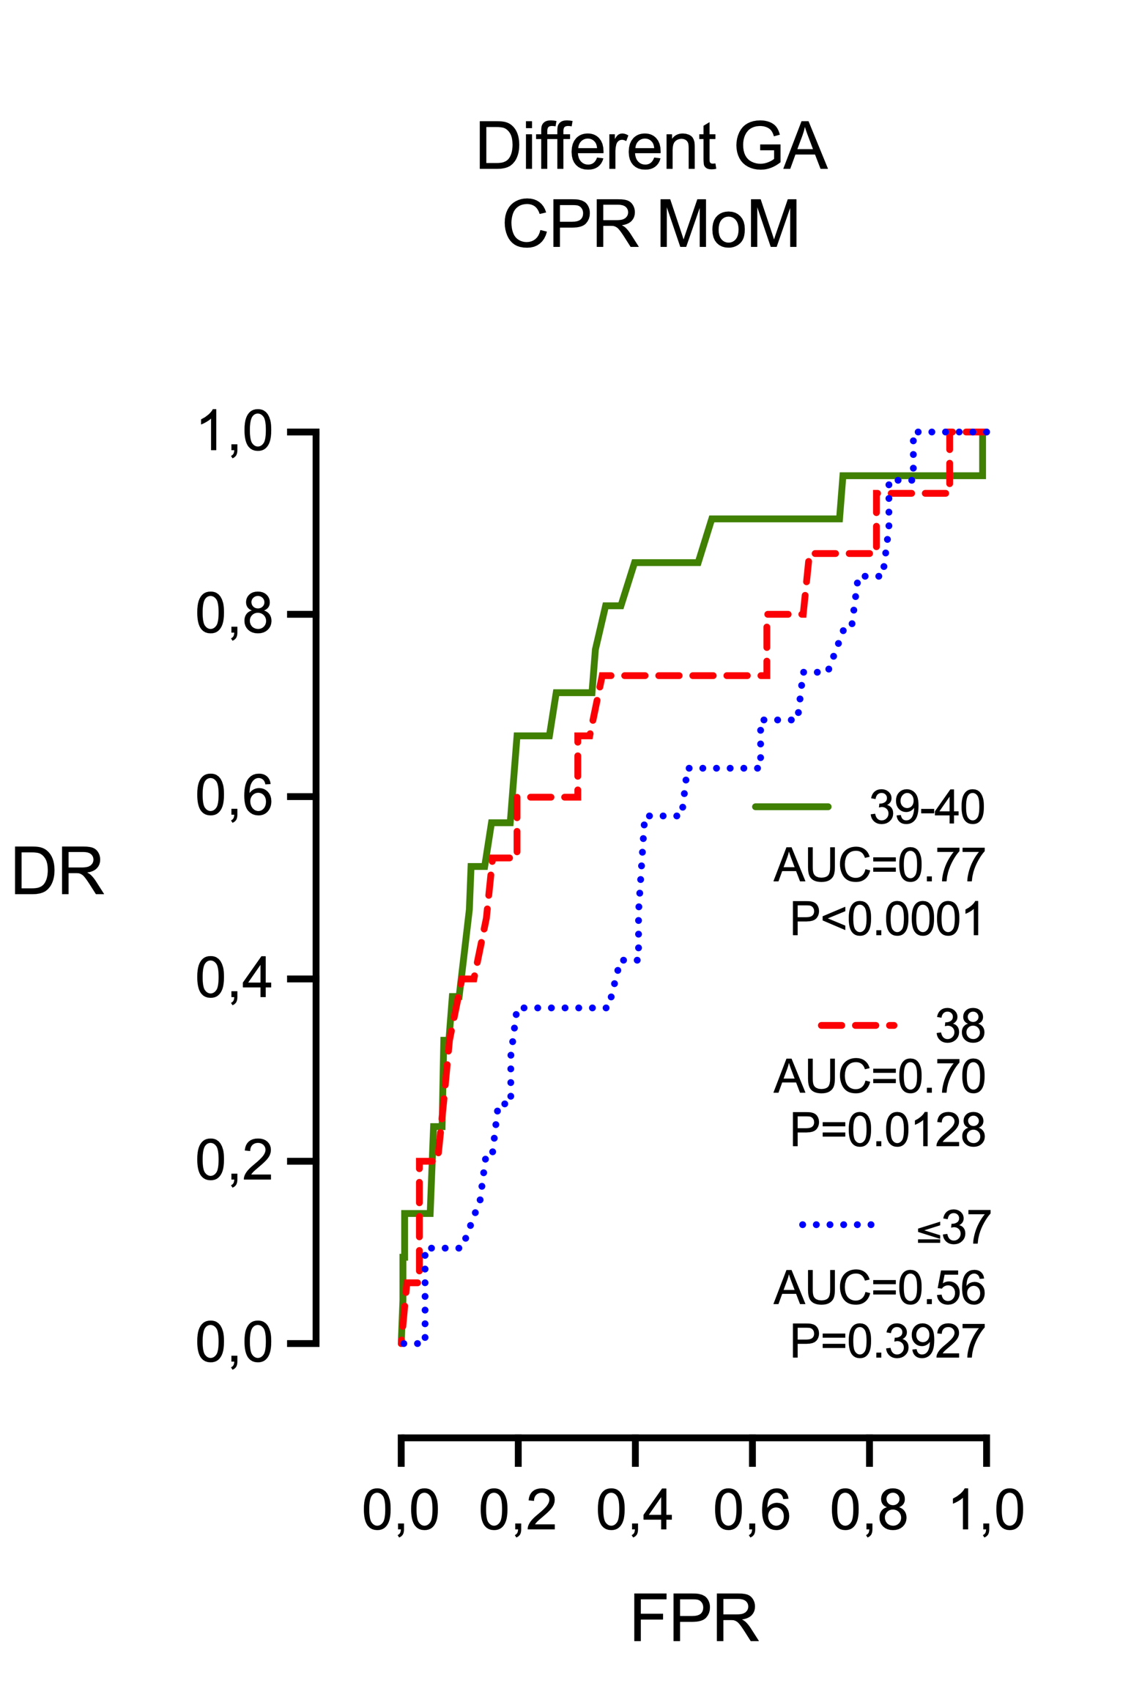
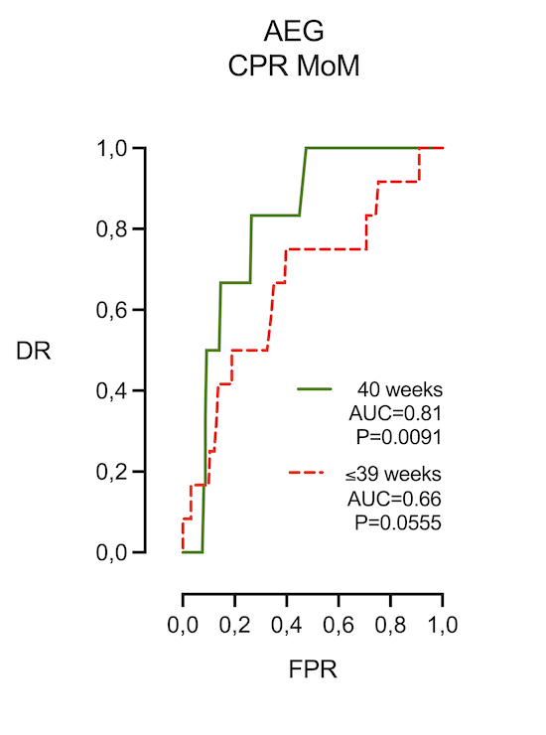
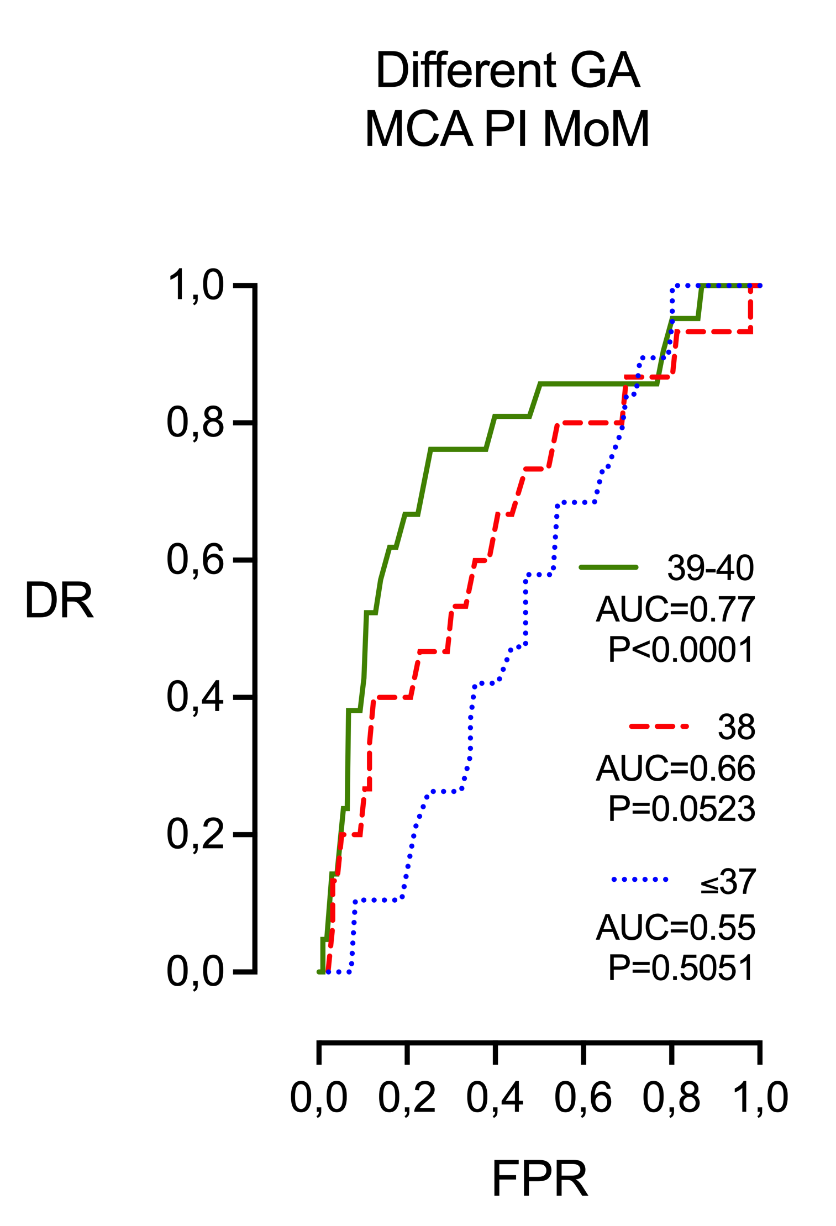
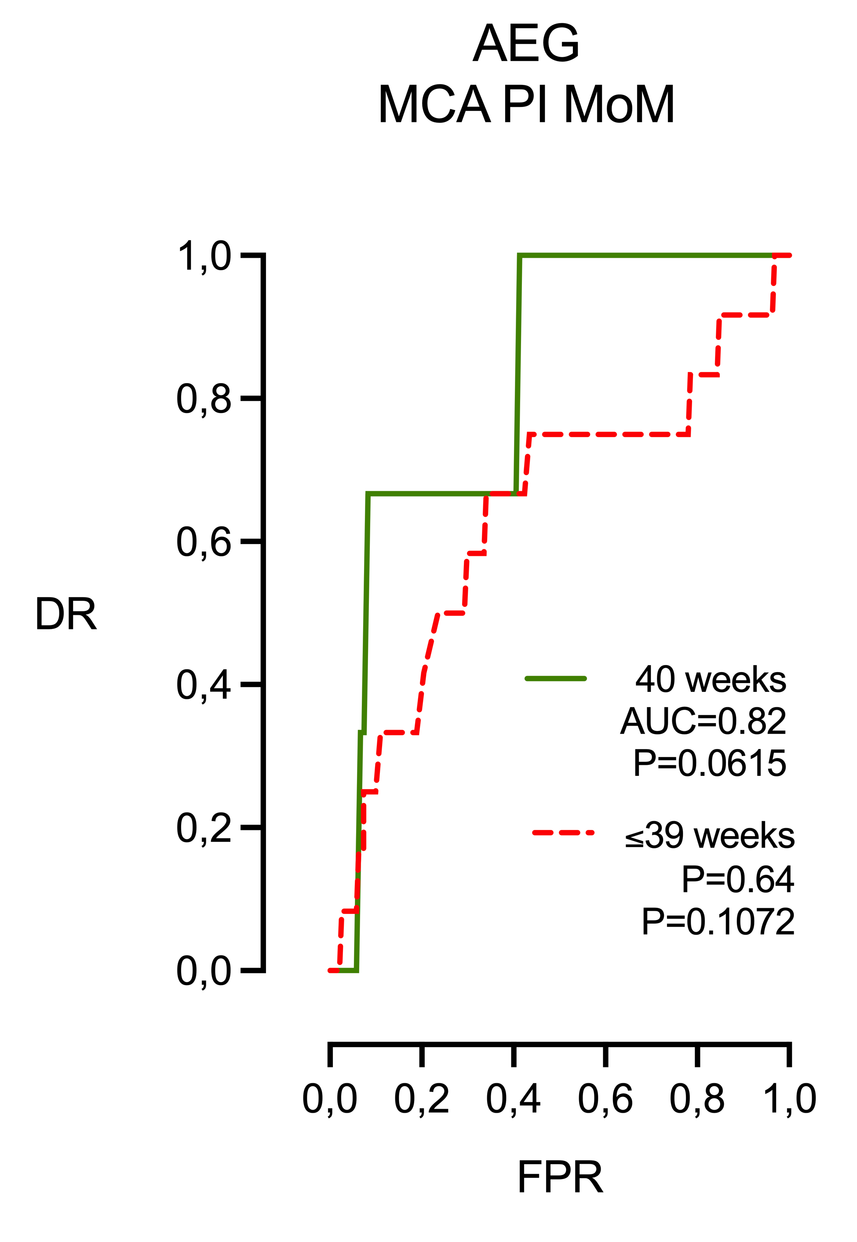
Does gestational age influence the predictive accuracy
of the CPR for intrapartum fetal compromise?
José Morales-Roselló, Asma Khalil, Silvia Buongiorno, Maia Brik§, Manel Mendoza, Carolina Di Fabrizio, Elisa Scarinci, Silvia Salvi
Objective. We investigated whether the ability of the cerebroplacental ratio (CPR) and other Doppler ultrasound parameters to predict intrapartum fetal compromise (IFC), leading to cesarean delivery, changes with advancing gestational age in late-term pregnancies.
Results. CPR and middle cerebral artery pulsatility index (MCA PI) emerged as the most accurate Doppler predictors of cesarean delivery for IFC. Their accuracy improved further when combined with estimated fetal weight centile (EFWc), fetal sex, and the mode of labor onset.
The predictive performance of CPR and MCA PI increased steadily with advancing gestational age, reaching its peak at 39–40 weeks. This effect was not observed for umbilical artery PI or EFW, and it remained significant when analyses were limited to fetuses appropriate for gestational age (AGA).
Conclusion. This study strengthens the evidence that cerebral Doppler indices, particularly CPR and MCA PI, are the most robust sonographic markers for predicting IFC. Importantly, it shows that their predictive value improves with advancing gestation, especially at 39–40 weeks. These findings underscore the critical role of timing in Doppler interpretation and support the integration of cerebral Doppler into third-trimester surveillance strategies, even in otherwise low-risk pregnancies.

