Slide 1
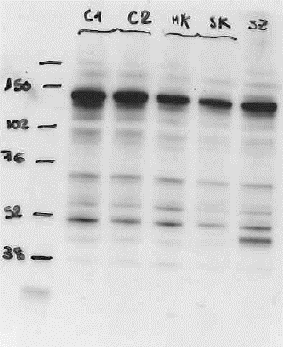
Full unedited gel for Figure 2C
Ctrl_1
Ctrl_2
F2-II.1
F1-II.1
F2-I.2
EG5
β actin
Full unedited gel for Figure 2D
Ctrl_1
Ctrl_2
F2-II.1
F1-II.1
F2-I.2
EG5

Slide 2
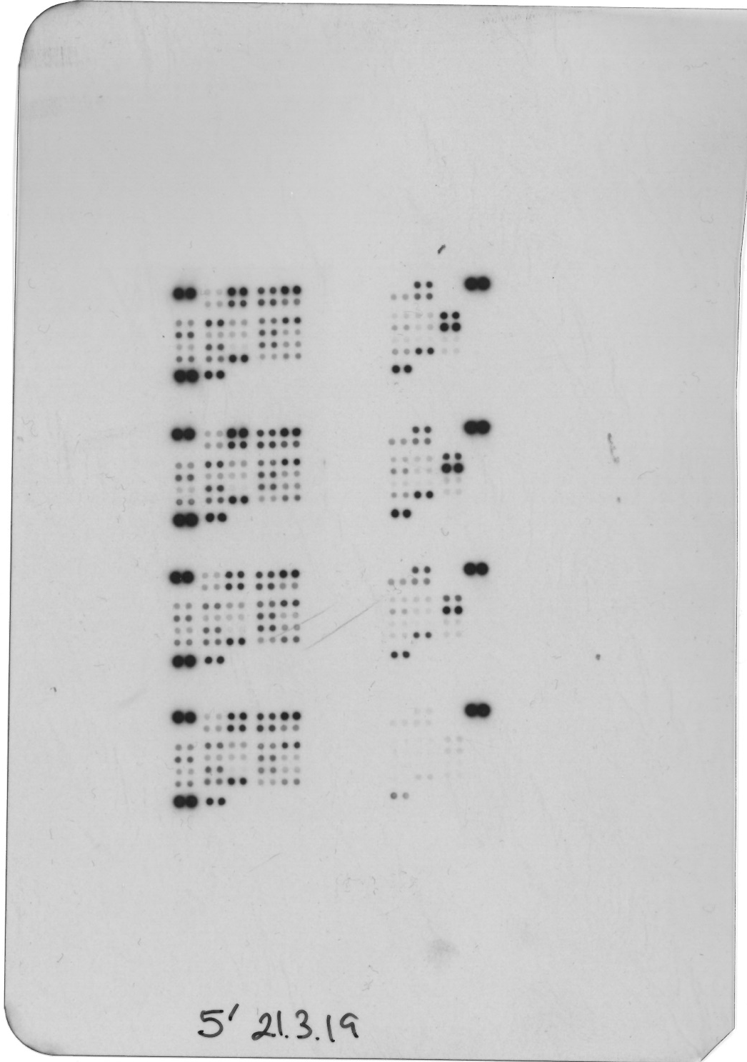
Full unedited gel for Figure 8A
siRNA KIF11
siRNA Ctrl

Slide 3
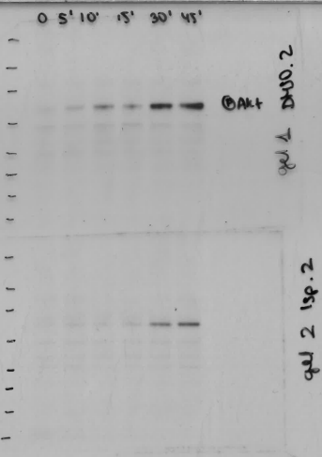
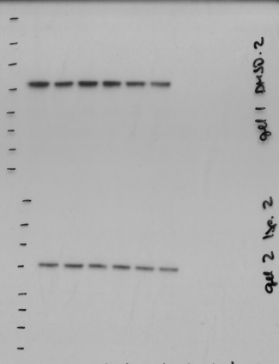
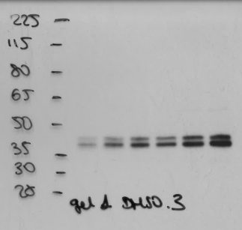
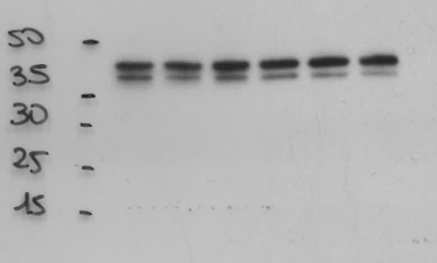
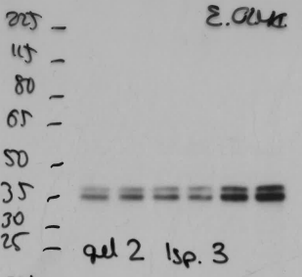
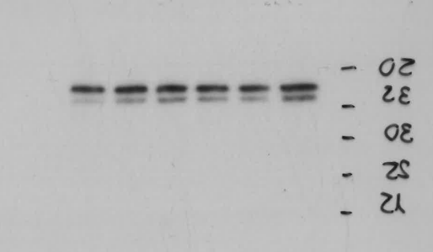
Full unedited gel for Figure 8C
0 5 10 15 30 45
0 5 10 15 30 45
DMSO-p-AKT-S473
DMSO-AKT
0 5 10 15 30 45
0 5 10 15 30 45
Ispinesib 50 nM-p-AKT-S473
Ispinesib 50 nM-AKT
0 5 10 15 30 45
0 5 10 15 30 45
DMSO-p44/42 MAPK
DMSO-MAPK
Ispinesib 50 nM-p44/42 MAPK
0 5 10 15 30 45
0 5 10 15 30 45
Ispinesib 50 nM-MAPK

Slide 4
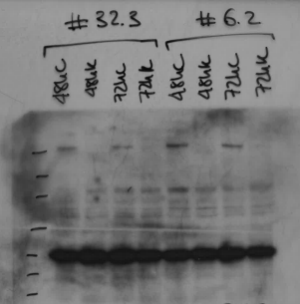
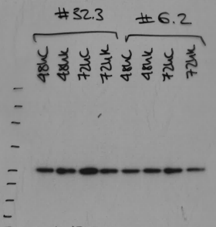
Full unedited gel for Figure 8E
siRNA KIF11
siRNA Ctrl
siRNA KIF11
siRNA Ctrl
EG5
GAPDH

Slide 5
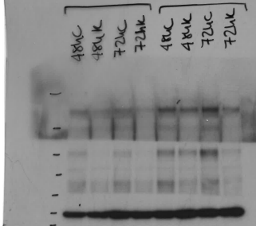
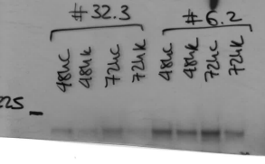
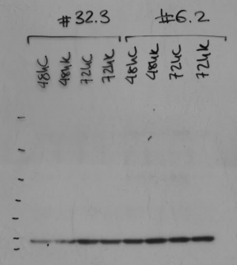
Full unedited gel for Figure 8E
siRNA KIF11
siRNA Ctrl
siRNA KIF11
siRNA Ctrl
PROX1
VEGFR3
GAPDH

Slide 6
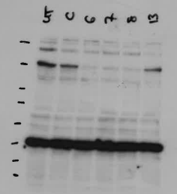
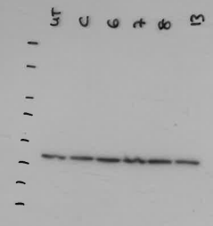
Full unedited gel for Figure S4A
siRNA KIF11 #6
siRNA Ctrl
siRNA KIF11 #7
EG5
GAPDH

