Slide 1
The ratio of soluble fms–like tyrosine kinase 1 to placental growth factor predicts time to delivery and mode of birth in patients with suspected preeclampsia - a secondary analysis of the INSPIRE trial
Catarina R. PALMA DOS REIS, Joe O’SULLIVAN, Eric O. OHUMA, Tim JAMES, Aris T. PAPAGEORGHIOU, Manu VATISH, Ana Sofia CERDEIRA

Slide 2
introduction
The sFLT1/PlGF ratio correlates with adverse pregnancy outcomes associated with impaired placentation:
Preeclampsia
Fetal growth restriction
Preterm delivery
Ratio categorization into high risk (≥85), intermediate risk (38-85), and low-risk groups (≤38) affords accurate stratification for the occurrence of fetal and maternal adverse outcomes
Palma dos Reis et al. Am J Obstet Gynecol. 2024

Slide 3
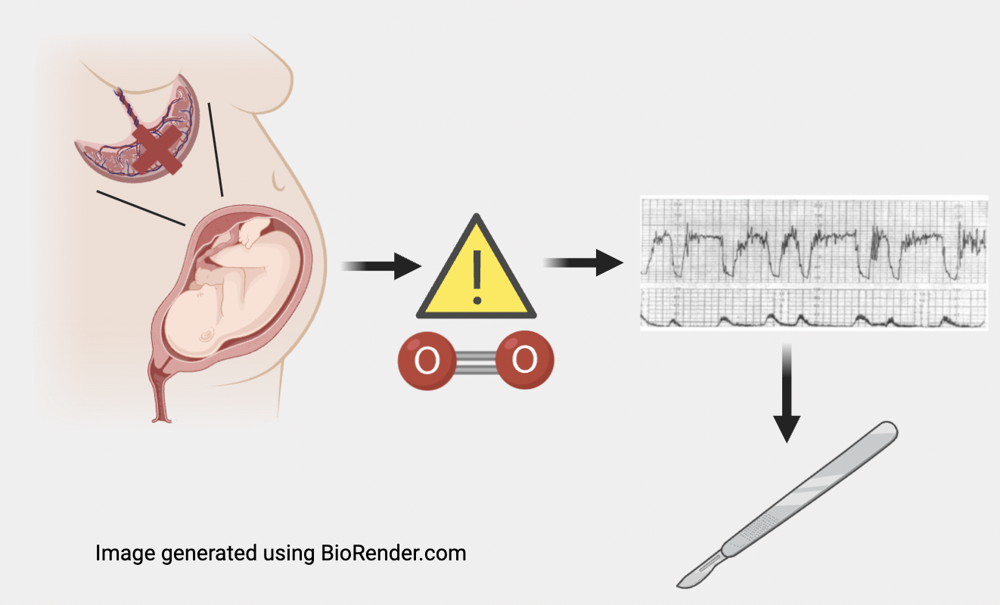
introduction
It has been postulated that the sFLT1/PlGF ratio could have important implications for risk stratification around birth
Risk stratification
Prediction
0₂
Palma dos Reis et al. Am J Obstet Gynecol. 2024
Palma dos Reis et al. Am J Obstet Gynecol. 2024

Slide 4
hypothesis
There is an association between the sFLT1/PLGF RATIO and DELIVERY OUTCOMES
Time from ratio determination to delivery
Need for operative delivery or emergency cesarean section
Palma dos Reis et al. Am J Obstet Gynecol. 2024
Palma dos Reis et al. Am J Obstet Gynecol. 2024

Slide 5
Materials and methods
Secondary analysis of the INSPIRE Trial
Randomized interventional study on prediction of developing preeclampsia or eclampsia in women with suspected preeclampsia (ISRCTN87470468)
n=186
n=184
n= 370 women
Palma dos Reis et al. Am J Obstet Gynecol. 2024
Palma dos Reis et al. Am J Obstet Gynecol. 2024

Slide 6
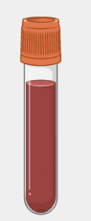
Materials and methods
Ratio category 1
≤ 38
sFLT1/PLGF ratio
Ratio category 2
> 38 and < 85
Ratio category 3
≥ 85
Palma dos Reis et al. Am J Obstet Gynecol. 2024
Palma dos Reis et al. Am J Obstet Gynecol. 2024

Slide 7
Materials and methods
Primary outcome: time from ratio sampling to delivery
Secondary outcomes: mode of delivery, classification of cesarean section, fetal distress leading to operative delivery or cesarean section, induction of labor, birthweight, birthweight z-score and SGA
Outcome | Definition
Cesarean section category 1 | Immediate threat to maternal or fetal life
Cesarean section category 2 | Maternal or fetal compromise that is not immediately life-threatening
Cesarean section category 3 | No maternal or fetal compromise but early birth is necessary
Cesarean section category 4 | Birth scheduled to suit the mother and healthcare provider
Emergency cesarean section | Cesarean sections category 1-3
Planned cesarean section | Cesarean sections category 4
Small for gestational age | Birth weight < 10th centile for gestational age adjusted for newborn sex
Palma dos Reis et al. Am J Obstet Gynecol. 2024
Palma dos Reis et al. Am J Obstet Gynecol. 2024

Slide 8
Materials and methods
Kaplan-Meier survival curves
ROC analysis for prediction of delivery in the 2 following weeks
Primary outcome
Secondary outcomes
Multivariable logistic/linear model controlling for trial arm and gestational age at ratio determination
Women with preeclampsia; in women with no preeclampsia, who had spontaneous onset of labor; and participants in the non-reveal arm
Logarithmic transformation of the sFLT1/PlGF ratio
Sub-analyses
Palma dos Reis et al. Am J Obstet Gynecol. 2024
Palma dos Reis et al. Am J Obstet Gynecol. 2024

Slide 9
results
Population characteristics | sFLT1/PLGF ≤ 38 (n=257) | sFLT1/PLGF 38 - 85 (n=60) | sFLT1/PLGF ≥ 85 (n=53) | Statistical significance p value
GA at recruitment (weeks) Median (IQR) | 33.6 (30.6; 35.6) | 35.7 (34.6; 36.4) | 34.9 (32.7; 35.9) | p# <0.001* p$ =0.06
Maternal age at recruitment (years) Median (IQR) | 30.5 (26.7; 34.8) | 32.0 (28.8; 37.0) | 31.6 (28.2; 35.8) | p# =0.098 p$ =0.400
BMI Median (IQR) | 27.6 (24.1; 32.4) | 26.1 (22.6; 31.6) | 26.5 (24; 31.3) | p# =0.514 p$ =0.247
Parity n (%) Nulliparous Multiparous | 102 (39.7%) 155 (60.3%) | 36 (60%) 24 (40%) | 42 (79.2%) 11 (20.8%) | p$ <0.001*
Smoking status n (%) Current smoker Never smoker Previous smoker | 28 (10.9%) 150 (58.3%) 79 (30.7%) | 2 (3.3%) 39 (65%) 19 (31.7%) | 3 (5.7%) 36 (67.9%) 14 (26.4%) | p=0.283
370 women were recruited
Reveal arm: 186
Non-reveal arm: 184
Palma dos Reis et al. Am J Obstet Gynecol. 2024
Palma dos Reis et al. Am J Obstet Gynecol. 2024

Slide 10
results
Population characteristics | sFLT1/PLGF ≤ 38 (n=257) | sFLT1/PLGF 38 - 85 (n=60) | sFLT1/PLGF ≥ 85 (n=53) | Statistical significance p value
Highest systolic BP at presentation Median (IQR) | 128.5 (118; 140) | 142 (130; 157) | 145 (131; 160) | p# <0.001* p$ <0.001*
Highest diastolic BP at presentation Median (IQR) | 79 (70; 90) | 90 (85; 97) | 92 (86; 100) | p# <0.001* p$ <0.001*
370 women were recruited
Reveal arm: 186
Non-reveal arm: 184
Palma dos Reis et al. Am J Obstet Gynecol. 2024
Palma dos Reis et al. Am J Obstet Gynecol. 2024

Slide 11
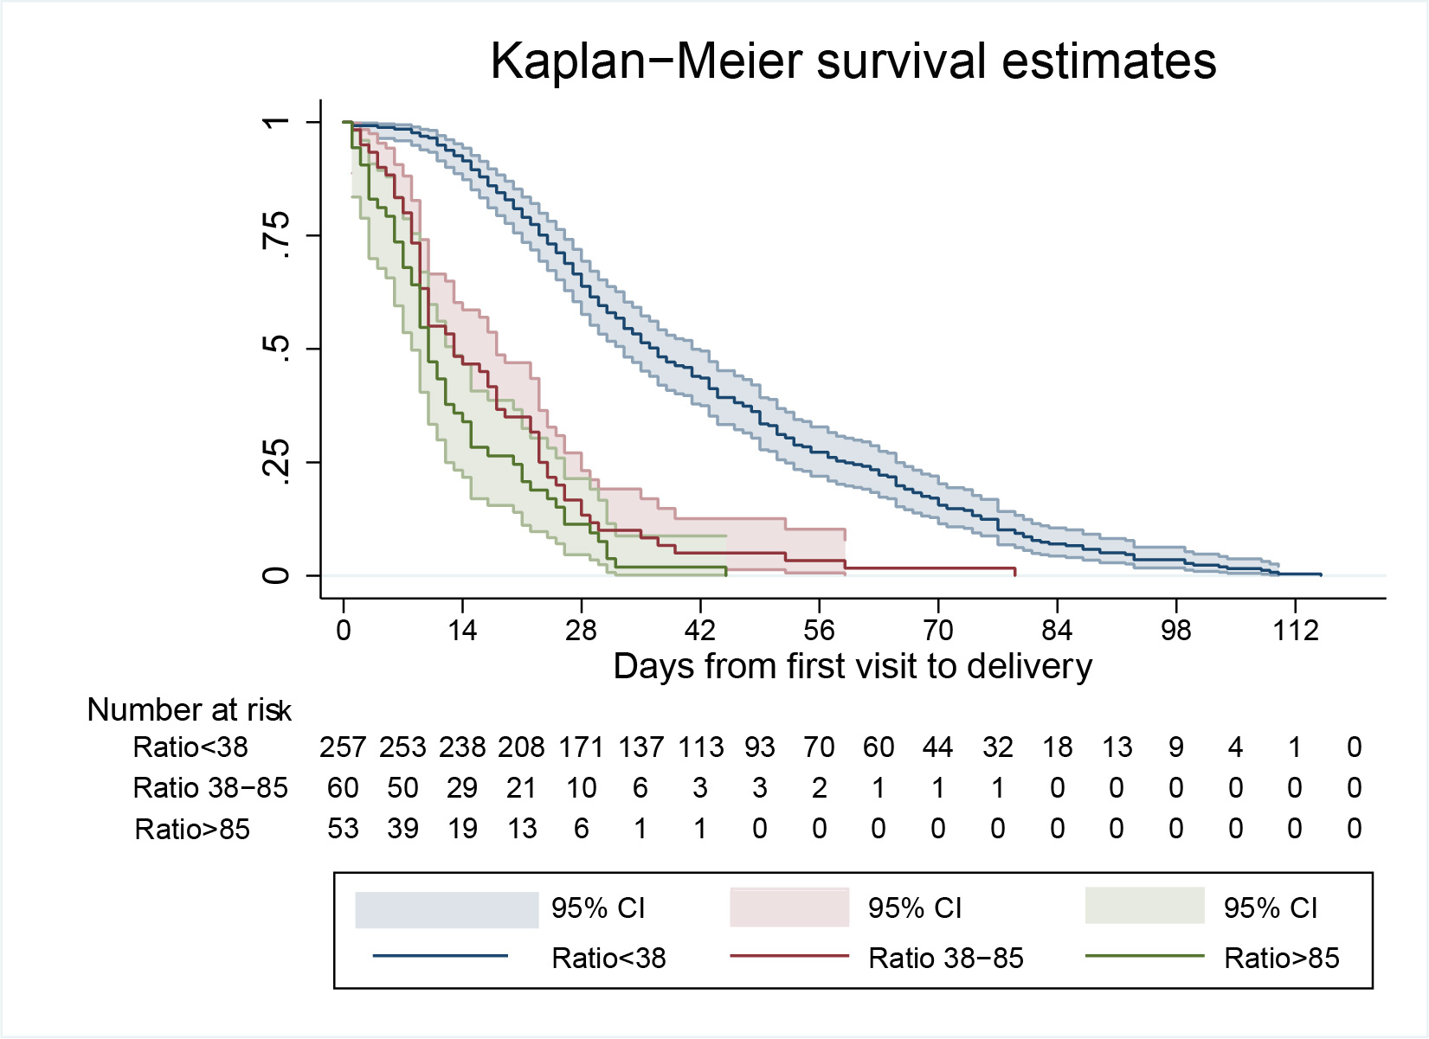
Results – time to delivery
Time to delivery
After controlling for gestational age at sampling and trial arm:
Ratio category 2 HR 1.99 (95%CI 1.47; 2.71, p<0.001*)
Ratio category 3 HR 5.64 (95%CI 4.06; 7.84, p<0.001*)
Palma dos Reis et al. Am J Obstet Gynecol. 2024
Palma dos Reis et al. Am J Obstet Gynecol. 2024

Slide 12
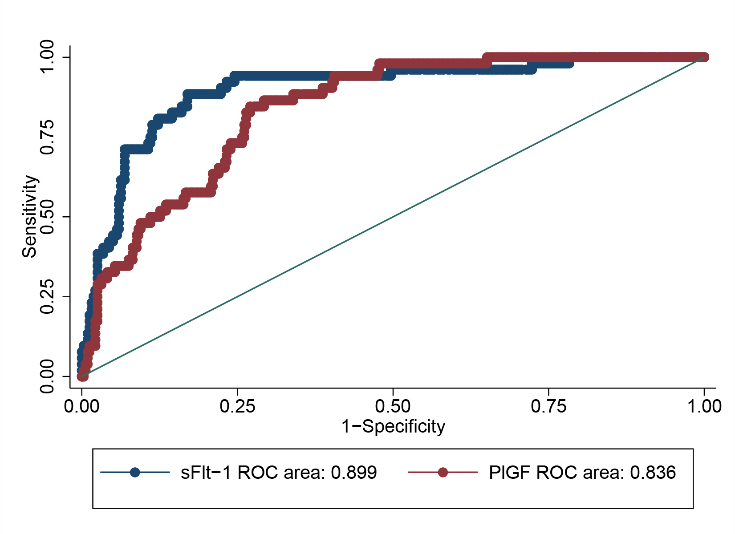
Results – time to delivery
Prediction of preeclampsia-indicated delivery in 2 weeks
sFLT1 alone was superior to PlGF alone (AUC 0.899 vs AUC 0.836, p=0.01) and similar to the sFLT1/PLGF ratio (AUC 0.899 vs AUC 0.896, p=0.772)
Palma dos Reis et al. Am J Obstet Gynecol. 2024
Palma dos Reis et al. Am J Obstet Gynecol. 2024

Slide 13
Results – time to delivery
Prediction of preeclampsia-indicated delivery in 2 weeks
sFLT1/PLGF ratio category 3 (≥ 85):
Sensitivity 54.72% (95% confidence interval, 41.3-69.5)
Specificity 92.74% (95% confidence interval, 89.0-95.1)
AUC=0.73 (95% confidence interval, 0.67-0.81)
Compared to patients with ratios ≤38, risk ratio 35.2 (95% confidence interval, 12.9 – 95.8)].
Palma dos Reis et al. Am J Obstet Gynecol. 2024
Palma dos Reis et al. Am J Obstet Gynecol. 2024

Slide 14
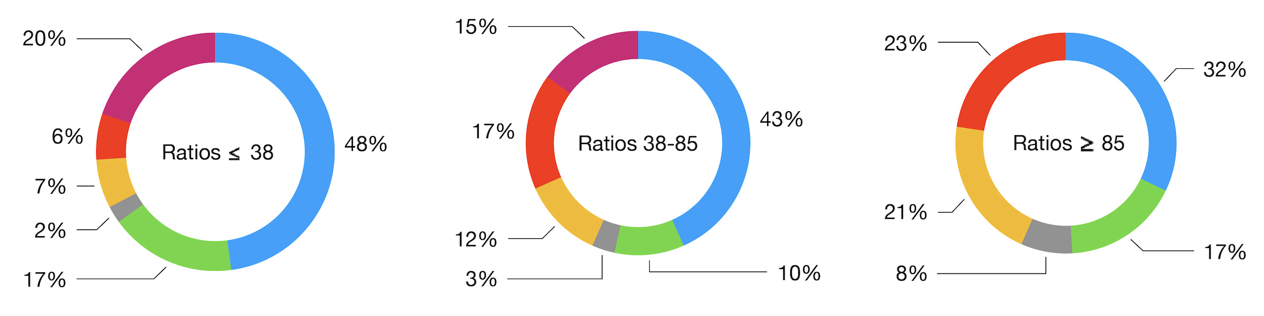
Results – MODe of delivery
sFLT1/PLGF ratio category 3 (≥ 85):
Emergency cesarean section (cat 1-3): aOR 5.89 (95% CI 3.05; 11.21)
Planned cesarean section (cat 4): aOR 0.08 (95% CI 0.01; 0.59)
Spontaneous vaginal delivery (SVD): aOR 0.47 (95% CI 0.25; 0.89)
SVD
C/S 2
Operative vaginal delivery
C/S 3
C/S 1
C/S 4
Palma dos Reis et al. Am J Obstet Gynecol. 2024
Palma dos Reis et al. Am J Obstet Gynecol. 2024

Slide 15
Results – fetal distress
sFLT1/PLGF ratio category 3 (≥ 85): aOR 2.77 (95% CI 1.30-5.87)
Palma dos Reis et al. Am J Obstet Gynecol. 2024
Palma dos Reis et al. Am J Obstet Gynecol. 2024

Slide 16
Results – induction of labor
sFLT1/PLGF ratio category 2 (> 38 and < 85): aOR 2.20 (95% CI 1.02; 4.76)
sFLT1/PLGF ratio category 3 (≥ 85): aOR 6.0 (95% CI 2.01;17.93)
Palma dos Reis et al. Am J Obstet Gynecol. 2024
Palma dos Reis et al. Am J Obstet Gynecol. 2024

Slide 17
Results - birthweight
sFLT1/PLGF ratio category 2 (> 38 and < 85): β -0.70 (95% CI -1.09; -0.30)
sFLT1/PLGF ratio category 3 (≥ 85): β -1.51 (95% CI -1.91; -1.11)
Palma dos Reis et al. Am J Obstet Gynecol. 2024
Palma dos Reis et al. Am J Obstet Gynecol. 2024

Slide 18
Results - subanalyses
 | NO PE, SPONTANEOUS ONSET OF LABOR (n=91)
Type of delivery | n (%) | Log sFLT1/PLGF difference of means | Statistical significance for t-test with log sFLT1/PLGF p value
Spontaneous vaginal delivery | 62 (68.1%) | 1.3 ± 0.2 | p<0.001*
Intrapartum fetal distress leading to instrumental delivery or C-section | 12 (13.3%) | 1.8 ± 0.15 | p<0.001*
Failure to progress leading to instrumental delivery or C-section | 10 (11%) | 1.8 ± 0.15 | p<0.001*
Palma dos Reis et al. Am J Obstet Gynecol. 2024
Palma dos Reis et al. Am J Obstet Gynecol. 2024

Slide 19
Results - subanalyses
 | PATIENTS WITH PE (n=85)
Type of delivery | n (%) | Log sFLT1/PLGF difference of means | Statistical significance for t-test with log sFLT1/PLGF p value
Spontaneous vaginal delivery | 27 (31.8%) | 3.6 ± 0.18 | p<0.001*
Intrapartum fetal distress leading to instrumental delivery or C-section | 18 (21.7%) | 3.7 ± 0.18 | p<0.001*
Failure to progress leading to instrumental delivery or C-section | 10 (11.8%) | 3.8 ± 0.17 | p<0.001*
Palma dos Reis et al. Am J Obstet Gynecol. 2024
Palma dos Reis et al. Am J Obstet Gynecol. 2024

Slide 20
Results - subanalyses
 | PATIENTS IN THE NON-REVEAL ARM (n=184)
Type of delivery | n (%) | Log sFLT1/PLGF difference of means | Statistical significance for t-test with log sFLT1/PLGF p value
Spontaneous vaginal delivery | 72 (39%) | 2.2 ± 0.12 | p<0.001*
Intrapartum fetal distress leading to instrumental delivery or C-section | 31 (17%) | 2.4 ± 0.12 | p<0.001*
Failure to progress leading to instrumental delivery or C-section | 19 (10%) | 2.5 ± 0.12 | p<0.001*
Palma dos Reis et al. Am J Obstet Gynecol. 2024
Palma dos Reis et al. Am J Obstet Gynecol. 2024

Slide 21
Principal findings
In patients with suspected preeclampsia, higher ratios are associated with:
Shorter latency to delivery
Lower odds of spontaneous vaginal delivery
Higher odds of emergency cesarean section
Greater incidence of intrapartum fetal distress leading to instrumental delivery or cesarean section
Earlier gestational age at delivery
Lower median neonatal birthweight and birthweight z-score
These associations remained significant after adjusting for potential confounders
Palma dos Reis et al. Am J Obstet Gynecol. 2024
Palma dos Reis et al. Am J Obstet Gynecol. 2024

Slide 22
Strenghts and limitations
STRENGHTS | LIMITATIONS
Sample size | Difficulty in extrapolating findings to the general population
Prospective patient recruitment | Some wide confidence intervals
Statistical analysis controlled for gestational age at ratio sampling and trial arm
Palma dos Reis et al. Am J Obstet Gynecol. 2024
Palma dos Reis et al. Am J Obstet Gynecol. 2024

Slide 23
conclusion
In women with suspected preeclampsia the sFLT1/PLGF ratio might be helpful in risk-stratification regarding clinical deterioration (latency to delivery), intrapartum fetal distress and mode of delivery (increased risk of intervention). This finding is independent of the diagnosis of preeclampsia and might help clinicians tailor antepartum and intrapartum care in this population
Palma dos Reis et al. Am J Obstet Gynecol. 2024
Palma dos Reis et al. Am J Obstet Gynecol. 2024

Slide 24
acknowledgments
Ana Sofia CERDEIRA
Manu VATISH
Joe O’SULLIVAN
Eric O. OHUMA
Tim JAMES
Aris T. PAPAGEORGHIOU
Participants and collaborators in the INSPIRE trial
Palma dos Reis et al. Am J Obstet Gynecol. 2024
Palma dos Reis et al. Am J Obstet Gynecol. 2024

