Slide 1
The ratio of soluble fms–like tyrosine kinase 1 to placental growth factor predicts time to delivery and mode of birth in patients with suspected preeclampsia - a secondary analysis of the INSPIRE trial
Catarina R. PALMA DOS REIS, Joe O’SULLIVAN, Eric O. OHUMA, Tim JAMES, Aris T. PAPAGEORGHIOU, Manu VATISH, Ana Sofia CERDEIRA

Slide 2
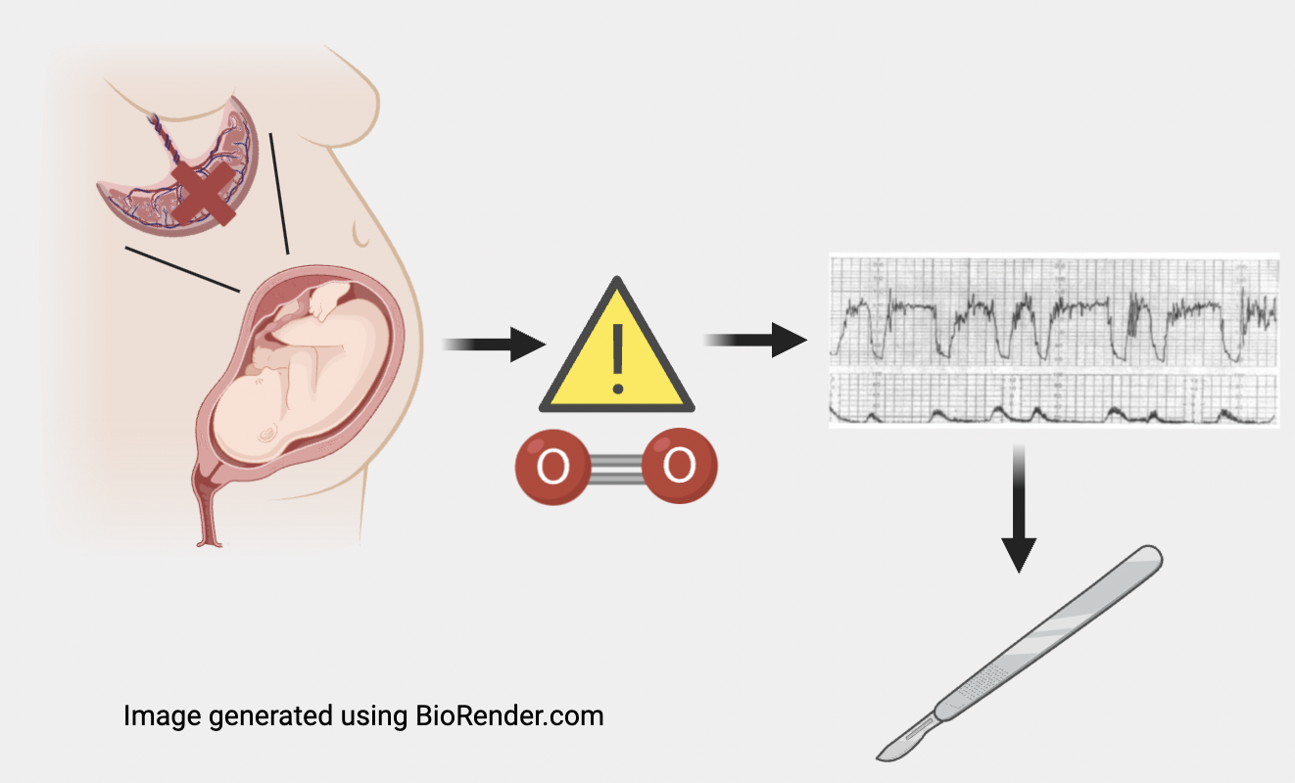
introduction
It has been postulated that the sFLT1/PlGF ratio could have important implications for risk stratification around birth
Risk stratification
Prediction
0₂
Palma dos Reis et al. Am J Obstet Gynecol. 2024
Palma dos Reis et al. Am J Obstet Gynecol. 2024

Slide 3
hypothesis
There is an association between the sFLT1/PLGF RATIO and DELIVERY OUTCOMES
Time from ratio determination to delivery
Need for operative delivery or emergency cesarean section
Palma dos Reis et al. Am J Obstet Gynecol. 2024
Palma dos Reis et al. Am J Obstet Gynecol. 2024

Slide 4
Materials and methods
Secondary analysis of the INSPIRE Trial
Randomized interventional study on prediction of developing preeclampsia or eclampsia in women with suspected preeclampsia (ISRCTN87470468)
n=186
n=184
n= 370 women
Palma dos Reis et al. Am J Obstet Gynecol. 2024
Palma dos Reis et al. Am J Obstet Gynecol. 2024

Slide 5
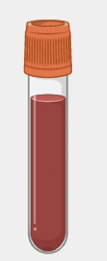
Materials and methods
Ratio category 1
≤ 38
sFLT1/PLGF ratio
Ratio category 2
> 38 and < 85
Ratio category 3
≥ 85
Palma dos Reis et al. Am J Obstet Gynecol. 2024
Palma dos Reis et al. Am J Obstet Gynecol. 2024

Slide 6
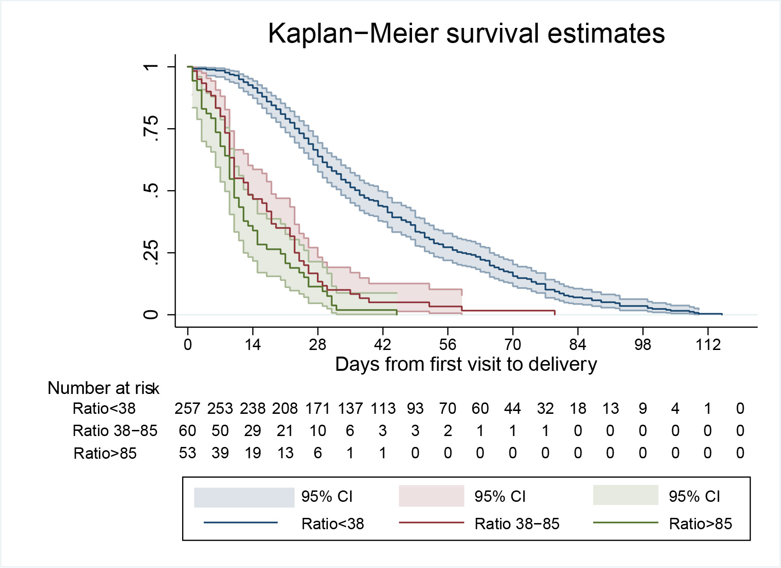
Results – time to delivery
Time to delivery
After controlling for gestational age at sampling and trial arm:
Ratio category 2 HR 1.99 (95%CI 1.47; 2.71, p<0.001*)
Ratio category 3 HR 5.64 (95%CI 4.06; 7.84, p<0.001*)
Palma dos Reis et al. Am J Obstet Gynecol. 2024
Palma dos Reis et al. Am J Obstet Gynecol. 2024

Slide 7
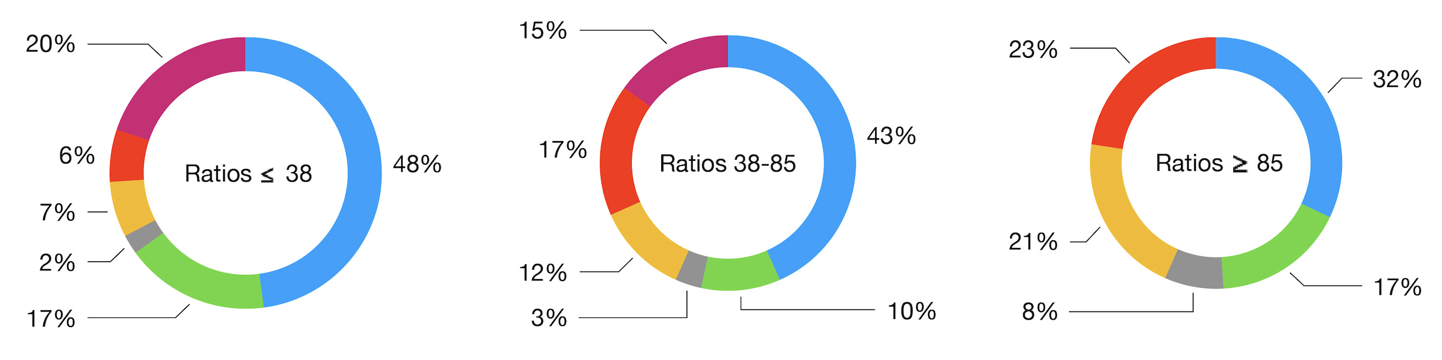
Results – MODe of delivery
sFLT1/PLGF ratio category 3 (≥ 85):
Emergency cesarean section (cat 1-3): aOR 5.89 (95% CI 3.05; 11.21)
Planned cesarean section (cat 4): aOR 0.08 (95% CI 0.01; 0.59)
Spontaneous vaginal delivery (SVD): aOR 0.47 (95% CI 0.25; 0.89)
SVD
C/S 2
Operative vaginal delivery
C/S 3
C/S 1
C/S 4
Palma dos Reis et al. Am J Obstet Gynecol. 2024
Palma dos Reis et al. Am J Obstet Gynecol. 2024

Slide 8
Results – fetal distress
sFLT1/PLGF ratio category 3 (≥ 85):
Higher odds of fetal distress aOR 2.77 (95% CI 1.30-5.87)
Higher odds of induction of labor aOR 6.0 (95% CI 2.01;17.93)
Lower birthweight and birthweight z-score β -1.51 (95% CI -1.91; -1.11)
Palma dos Reis et al. Am J Obstet Gynecol. 2024
Palma dos Reis et al. Am J Obstet Gynecol. 2024

Slide 9
Results - subanalyses
Women with preeclampsia
Women with no preeclampsia, spontaneous onset of labor
Non-reveal arm
Findings similar to the general population
Palma dos Reis et al. Am J Obstet Gynecol. 2024
Palma dos Reis et al. Am J Obstet Gynecol. 2024

Slide 10
conclusion
In women with suspected preeclampsia the sFLT1/PLGF ratio might be helpful in risk-stratification regarding clinical deterioration (latency to delivery), intrapartum fetal distress and mode of delivery (increased risk of intervention). This finding is independent of the diagnosis of preeclampsia and might help clinicians tailor antepartum and intrapartum care in this population
Palma dos Reis et al. Am J Obstet Gynecol. 2024
Palma dos Reis et al. Am J Obstet Gynecol. 2024

