Slide 1


Slide 2
Longitudinal Twin Growth Discordance Patterns and Adverse Perinatal Outcomes
Smriti Prasad^{1#}, Isil Ayhan, MD^{1#}, Doaa Mohammed¹, Erkan Kalafat², Asma Khalil^{1,3,4,5}
¹ Fetal Medicine Unit, St George's University Hospitals NHS Foundation Trust, London, UK, ²Department of Obstetrics and Gynecology, Koc University Hospital, Istanbul, Turkey, ³Vascular Biology Research Centre, Molecular and Clinical Sciences Research Institute, St George's University of London, London, United Kingdom, ⁴Twin and Multiple Pregnancy Centre for Research and Clinical Excellence, St George's University Hospital, St George's University of London, London, UK, ⁵Fetal Medicine Unit, Liverpool Women’s Hospital, Liverpool, United Kingdom
# Contributed equally to the work

Slide 3
Objective
Conduct a longitudinal assessment of inter-twin growth and Doppler discordance, to identify possible distinct patterns, and to investigate the predictive value of longitudinal discordance patterns for adverse perinatal outcomes in twin pregnancies
Prasad S, Ayhan I, Mohammed D, Kalafat E, Khalil A. AJOG 2025

Slide 4
Methods
Study design:
Retrospective cohort study of twin pregnancies with at least 3 ultrasound assessments >18 weeks and delivery >34 weeks’ gestation
Inclusion criteria:
Twin pregnancies followed and delivered at a 3ry University Hospital in London between 2010 and 2023
Exclusion criteria:
MCMA twin pregnancies
TTTS
Genetic or structural abnormalities
Incomplete data
Prasad S, Ayhan I, Mohammed D, Kalafat E, Khalil A. AJOG 2025

Slide 5
Study outcomes
Primary outcome:
Composite of perinatal mortality and neonatal morbidity
Perinatal mortality: IUD >20 weeks’ gestation or NND in the first week of life
Perinatal morbidity: Need for mechanical ventilation, sepsis, interventricular/periventricular hemorrhage, RDS and NEC
Data collection
Maternal characteristics
Obstetric and neonatal outcomes
Ultrasound variables:
  Chorionicity
  Biometry, EFW discordance
  Doppler assessment: umbilical artery, MCA, CPR
Prasad S, Ayhan I, Mohammed D, Kalafat E, Khalil A. AJOG 2025

Slide 6
Statistical analysis
Multilevel mixed-effects regression models and unsupervised machine learning algorithms, specifically k-means clustering, to identify distinct patterns of inter-twin discordance and their predictive value.
Predictive models were compared using AUROC, calibration intercept, and slope, validated with repeated cross-validation.
Prasad S, Ayhan I, Mohammed D, Kalafat E, Khalil A. AJOG 2025

Slide 7
Results (823 twin pregnancies (647 DC, 176 MC)
30.0
High stable
Mild increasing
Low increasing
Mild decreasing
Low stable
27.5
25.0
30
22.5
20.0
25
17.5
Estimated fetal weight discordance ()
20
15.0
12.5
15
10.0
10
7.5
5.0
10.4
23
21
20.8
24.8
5
2.5
0
18-22 weeks
23-26 weeks
27-30 weeks
31-34 weeks
34 weeks
High
stable
Mild
increasing
Low
increasing
Mild
decreasing
Low
stable
Gestational age
Prasad S, Ayhan I, Mohammed D, Kalafat E, Khalil A. AJOG 2025

Slide 8
Results
High stable
46.5
9.3
48.8
Mild increasing
19
1.19
24.9
Low increasing
12.1
0
19.1
Mild decreasing
4.7
0
9.9
Low stable
1.5
0
6.4
0
10
20
30
40
50
0
2
4
6
8
10
0
10
20
30
40
50
60
Perinatal morbidity (%)
Perinatal mortality (%)
Admission to neonatal unit (%)

Slide 9
Results – Regression analysis
OR (95%CI)
Adjusted OR (95% CI)
Monochorionicity
1.61 (1.02-2.50)
Discordance: Low increasing
9.26 (3.12-39.70)
10.59 (3.52-45.81)
Discordance: Mild increasing
16.86 (5.96-70.71)
18.06 (6.31-76.27)
Discordance: High stable
70.19 (24.18-299.03)
76.44 (25.39-333.02)
Umbilical PI Discordance
1.03 (1.01-1.04)
MCA PI Discordance
1.03 (1.01-1.05)
CPR Discordance
11.64 (4.56-29.82)
Prasad S, Ayhan I, Mohammed D, Kalafat E, Khalil A. AJOG 2025

Slide 10
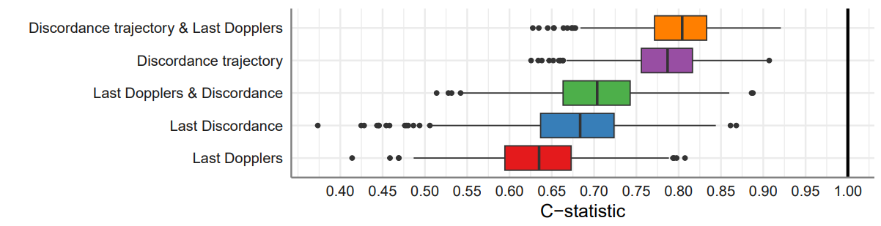
Results
Composite adverse perinatal outcome
Last
CPR
Discordance
Last EFW discordance
Last EFW discordance +
CPR Discordance
EFW discordance trajectory
EFW discordance trajectory + last CPR Discordance
P value
AUC
0.633
0.677
0.702
0.785
0.802
<0.001
95% CI
0.515-0.751
0.545-0.809
0.586-0.818
0.697-0.873
0.712-0.892
Prasad S, Ayhan I, Mohammed D, Kalafat E, Khalil A. AJOG 2025

Slide 11
Conclusions
Five distinct trajectories of inter-twin fetal growth discordance using an unsupervised machine learning algorithm
Consistent high discordance is associated with increased rates of adverse perinatal outcomes, with a dose-response relationship
A predictive model integrating discordance trajectory and CPR discordance at the last visit demonstrated superior predictive accuracy for predicting composite adverse perinatal outcomes, compared to either of these measurements alone or a single value of EFW discordance at the last ultrasound prior to delivery
Prasad S, Ayhan I, Mohammed D, Kalafat E, Khalil A. AJOG 2025

