Slide 1
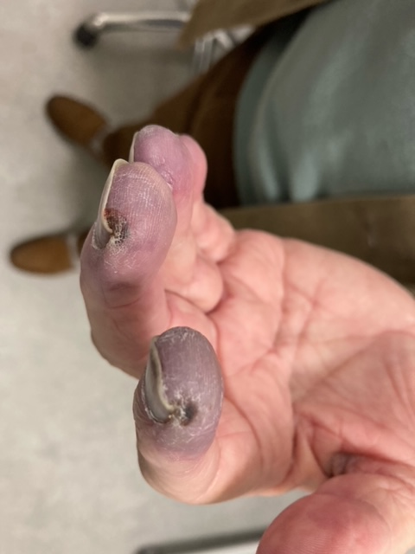
Ischaemia from tumour antigen-antibody complex deposition in the small vessels of the digits
Acquired prothrombotic coagulation abnormalities secondary to underlying cancer
Paraneoplastic acrocyanosis
Tumour or lymph node infiltration into the cervical plexus leading to the release of vasoactive substances
Release of vasoactive substances by tumour cells
Direct endothelial infiltration by tumour cells
Thromboembolism of microfragments of the tumour

