Slide 1
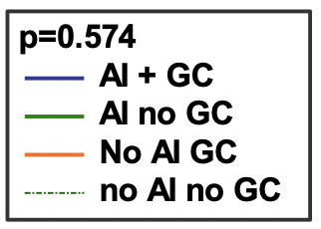
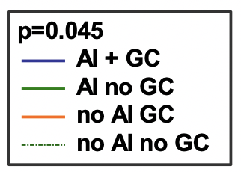
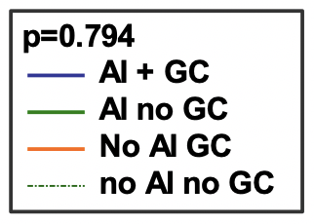
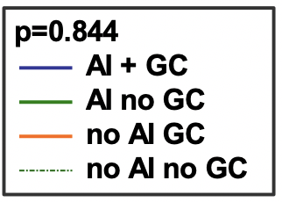
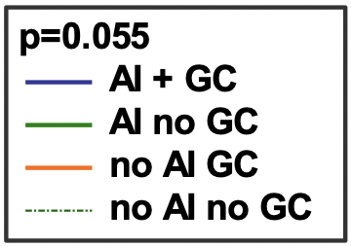
ALF
ACLF
A
Baseline cortisol < 275 nmol/L
B
Baseline cortisol < 275 nmol/L
n = 23 n = 5
n = 2 n = 3 n = 9 n = 14
n = 1 n = 4 n = 12 n = 16
n = 28 n = 5
Baseline cortisol < 414 nmol/L
Baseline cortisol < 414 nmol/L
n = 14 n = 14
n = 3 n = 11 n = 8 n = 6
n = 18 n = 15
n = 4 n = 11 n = 9 n = 9
C
Peak cortisol < 550 nmol/L
D
Peak cortisol < 550 nmol/L
n = 2 n = 12 n = 14
n = 26 n = 2
n = 3 n = 4 n = 10 n = 16
n = 26 n = 7
Δ cortisol < 250 nmol/L and baseline cortisol > 275 nmol/L
Δ cortisol < 250 nmol/L and baseline cortisol > 275 nmol/L
n = 3 n = 2 n = 8 n = 15
n = 6 n = 7 n = 7 n = 13
n = 23 n = 5
n = 20 n = 13
Δ cortisol < 250 nmol/L and baseline cortisol > 414 nmol/L
Δ cortisol < 250 nmol/L and baseline cortisol > 414 nmol/L
n = 26 n = 2
n = 2 n = 9 n = 17
n = 28 n = 6
n = 3 n = 3 n = 10 n = 18

