Slide 1
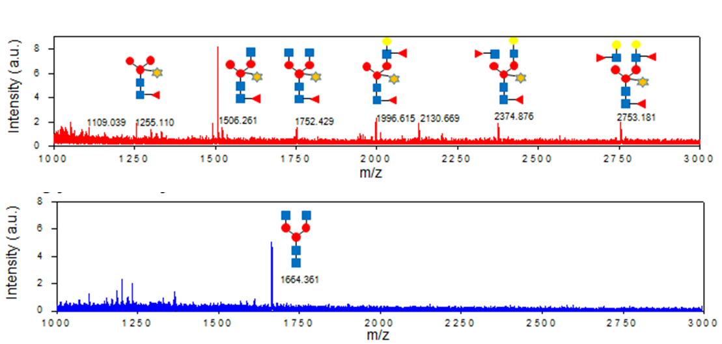
a
b
c
Figure 1.
Notes:
Figure 1. Construction and characterization of CRISPR-Cas9 based glyco-engineered rice cell lines. (A) The diagram of pPM101. The multiplex CRISPR-Cas9 vector that expresses Polycistronic single guide RNAs (sgRNAs) targeted into 8 genes involved in plant-specific N-glycosylation pathway was was constructed. The two expression cassettes of polycistronic sgRNA sequences driven by rice U6 promoter were inserted into CRISPR-Cas9 vector, named pPM101. The detailed information of sgRNAs used was summarized in Table 1. (B) Summary of INDEL efficiencies occurred in 8 genes from final selected cell lines. pPM101 was integrated into rice genome via Agrobacterium-mediated transformation method. The cell lines (PMOsC1 and 2) were finally selected using callus line showing highest INDEL efficiency. The efficiency of genome-editing was analyzed by ICE tool (https://ice.synthego.com/#/). (C) N-glycan profile of PMOsC1, named PhytoRice. The N-glycan structures purified from total secreted proteins were analyzed using MALDI-TOF. In PhytoRice, GnGn form was detected, indicating entire elimination of plant-specific N-glycan (Bottom panel), whereas various N-glycan structures containing plant specific sugar such as β1,2-xylose, α1,3 or α1,4-fucose and β1,3-galactose were found in WT (Upper panel).

Slide 2
a
b
c
NC PC 1 2 3 4 5 6 7 8 9 10 11 12
kb
kDa
3 4 9 10 11 12 NC PC
1.0
245
0.8
180
0.6
135
d
e
kDa
D1 D2 D3 D5 D7 PC
D1 D2 D3 D5 D7 PC
245
180
135
100
75
48
Figure 2.
Notes:
Figure 2. Construction of TMab expression vector and screening of PhytoRice-based TMab-expressed rice cell lines. (A) The diagram of pPM102 expressing trastuzumab (TMab). Codon-optimized Trastuzumab (TMab) light chain (LC) and heavy chain (HC)-encoded genes were respectively inserted into the expression cassettes driven by rice amylase 3D (RAmy3D) gene promoter, thereby constructing TMab LC and HC co-expression vector, named pPM102. (B) genomic DNA (gDNA) PCR using primer set of TMab-LC gene. About 700 bp-sized bands were detected in phosphinothricin (PPT)-resistant callus lines. NC, WT callus (Dongjin); PC, pPM102 plasmid; lane 1~12, PPT-resistant callus lines. (C) Immunoblotting of transgenic lines selected by gDNA PCR. The lines were treated on induction media subtracting sucrose for 7 days and then cell lysate prepared from them was separated under non-reducing condition in 7.5% SDS/PAGE (left panel), and immunoblotting was performed using rabbit anti-human IgG (right panel). The TMab was detected using rabbit α-human IgG-HRP (diluted factor 1:5,000). Arrow head indicates 150 kDa-sized TMab. NC, WT callus (Dongjin); PC, Herceptin (5 ng was loaded). (D) The induction of TMab using secretory-Phyto101 suspension cell expression system. Cell well-grown under suspension cell cultivation were inoculated into induction liquid media and then incubated for 7 days. The spent media sampled was separated under non-reducing condition in SDS/PAGE. D indicates day after induction and arrow head indicates TMab. PC is Herceptin.

Slide 3
a
b
c
kDa
1 2
kDa
1 2
245
180
140
100
75
75
60
50
40
35
25
Figure 3.
Notes:
Figure 3. Purification and structural characterization of Hergreen from Phyto101. (A) Hergreen purified by 3-step method. Hergreen produced in the Phyto101 platform was sequentially purified using Protein A, anion exchange, and hydroxyapatite column method. The purified Hergreen was separated under both non-reducing (left panel) and reducing (right panel) conditions on 7-15% gradient SDS/PAGE. Lane 1, Hergreen; Lane 2, Herceptin. (B-C) The conformational features of Hergreen examined by Circular Dichroism (CD) analysis. Secondary (B) and tertiary (C) structures of P-TMab (blue line) and TMab (orange line) were determined by Far-UV (195~250 nm) and near-UV (250~350 nm) CD absorption spectra.

Slide 4
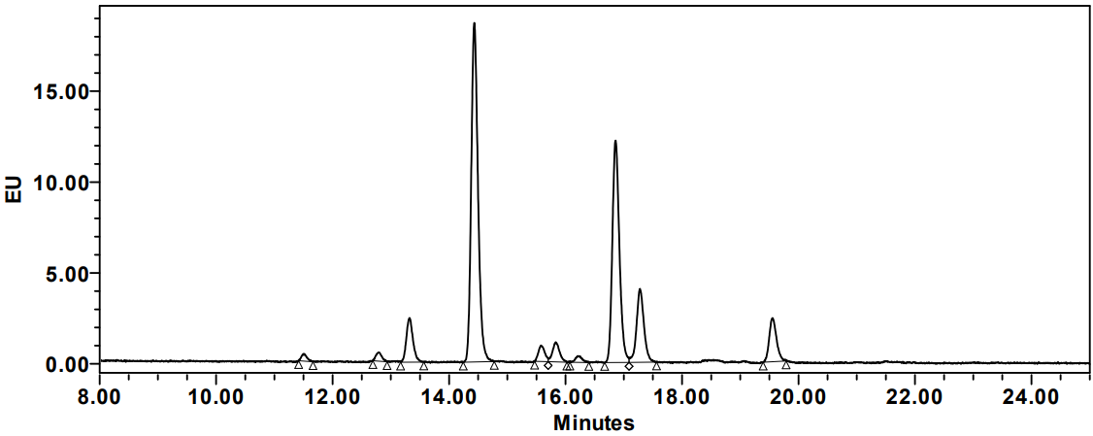
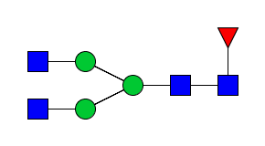
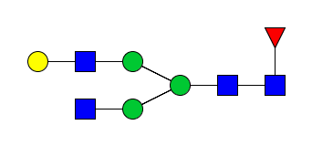
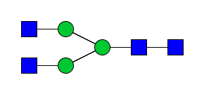
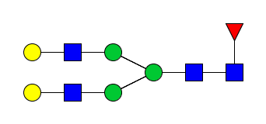
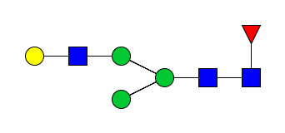
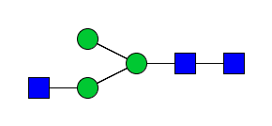
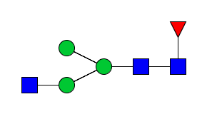
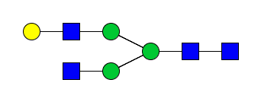
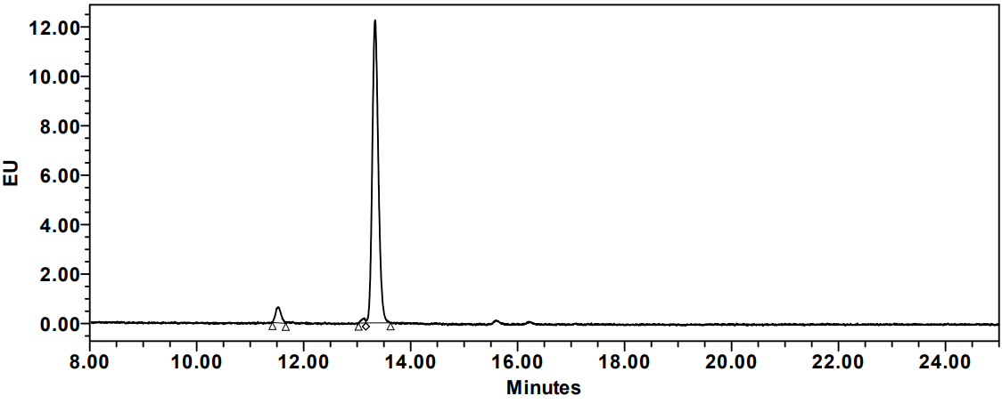
TＭab
P-TMab
Figure 4.
Notes:
Figure 4. The analysis of N-glycan attached to Hergreen. N-glycans purified from Hergreen anfd Herceptin were separated using UPLC-FLD method. GnGn (G0) form was exclusively found in Hergreen (bottom panel) whereas heterogeous N-glycan forms were detected in Herceptin (upper panel).

Slide 5
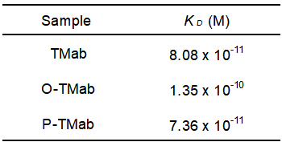
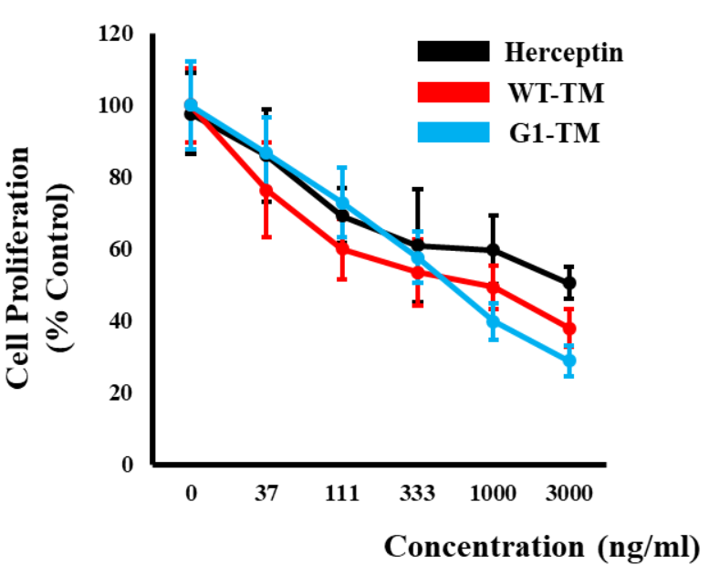
A
B
TMab
O-TMab
P-TMab
Figure 5.
Notes:
Figure 4. (A) HER2-binding affinity and HER2-specific anti-proliferative effect of Hergreen. Using Bio-layer interferometry (BLI), the binding affinity to HER2 was measured and compared between Hergreen and Herceptin. The equilibrium dissociation constant (K_{D}) values of Hergreen (left panel) and Herceptin (right panel) were found to be 0.07 nM and 0.08 nM, respectively. (B) Anti proliferation assay

Slide 6
A
P-TMab - FcγRIIIa (F158)
B
TMab - FcγRIIIa (F158)
P-TMab - FcγRIIIa (V158)
EC₅₀ | ng/mL | Log10(g/ml)
TMab | 45 | -7.344
P-TMab | 17 | -7.759
TMab - FcγRIIIa (V158)
Figure 6.

Slide 7
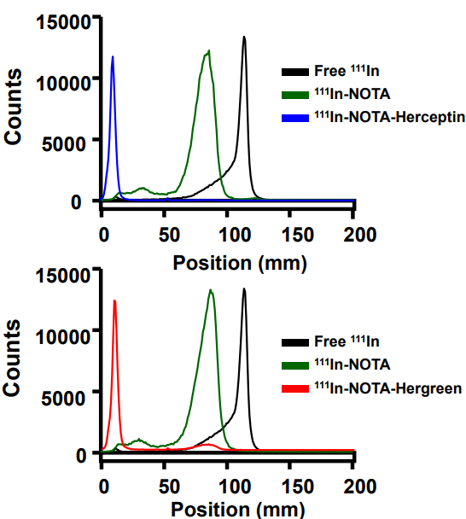
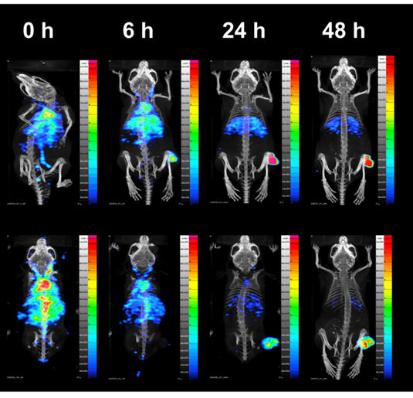
A
B
Free ¹¹¹In
¹¹¹In-NOTA
¹¹¹In-NOTA-TMab
TMab
Free ¹¹¹In
¹¹¹In-NOTA
P-TMab
¹¹¹In-NOTA-P-TMab
Figure 7.
Notes:
Figure 7. In vivo biodistribution pattern of Hergreen in BT474 tumor model. (A) TLC results confirming antibody labeling efficiency of radioactive isotope ¹¹¹Indium. (B) SPECT/CT images of 111 In-labeled antibodies in BT474 tumor model.

Slide 8
A
B
M 1 2
M 1 2
M 1 2
12% PAGE
Anti- β1,2-Xylose
Anti- α1,3-fucose
Supplementary figure 1. Investigation of genome editing of callus line #1-12-20-11. (A) Editing efficiency was analyzed using Synthego program. (B) Immunoblotting using anti-β1,2-XylT and anti-α1,3-FucT. M, size marker; Lane 1, Wild-type (Dongjin); Lane 2, # 1-12-20-11.

Slide 9
A
RB
LB
16485887
Chr. 1: LOC_Os01g29409
B
RB
LB
16485887
Chr. 1: LOC_Os01g29409
RB
LB
27131462
Chr. 2: Intergenic (between LOC_Os02g44780 and LOC_Os02g44810
Supplementary figure 2. Summary of the T-DNA insertion into rice genome of PMOsC1 (A) and PMOsC2 (B).

Slide 10
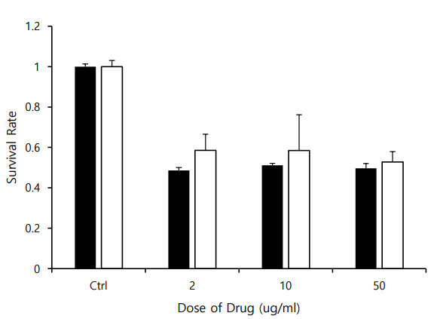
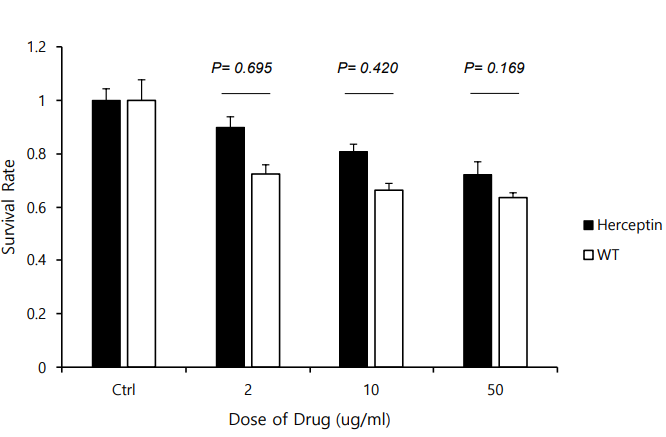
TMab
O-TMab
Supplementary figure 3. Anti proliferation assay of O-TMab using human breast cancer cell lines, BT474 (left panel) and SKBr3 (right panel).

Slide 11
Supplementary figure 4. In vitro ADCC assay of O-TMab and trastuzumab

Slide 12
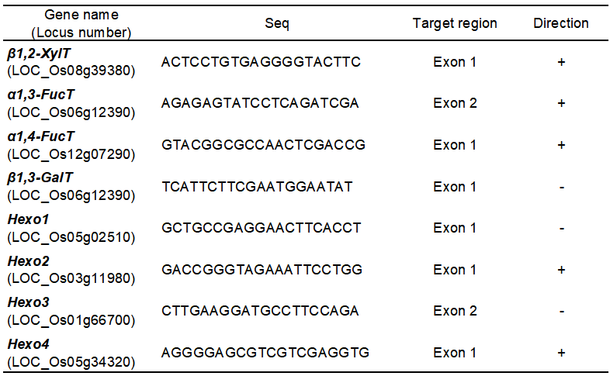
Table 1. Information of sgRNAs for CRISPR-cas9-based knock-out of
8 target genes involved in plant specific N-glycosylation in rice.

Slide 13
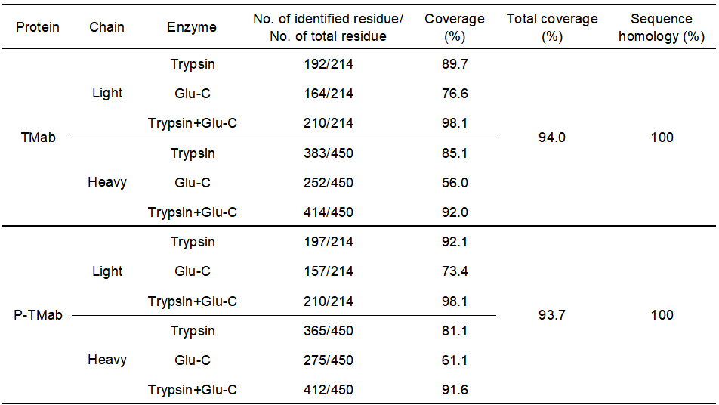
Table 2. Analysis of full-length amino acid sequence of P-TMab by LC/MS/MS.

Slide 14
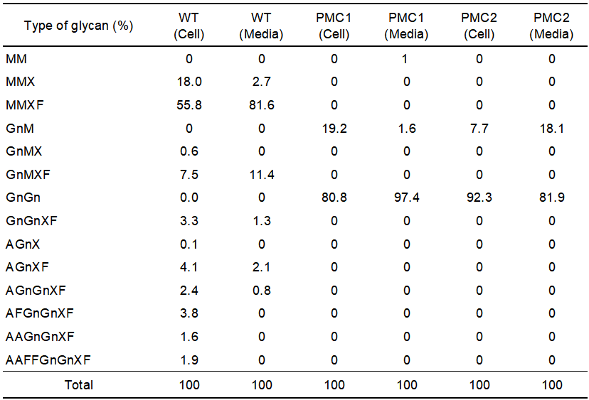
Table S1. N-glycan profile of PMOsCs.

Slide 15
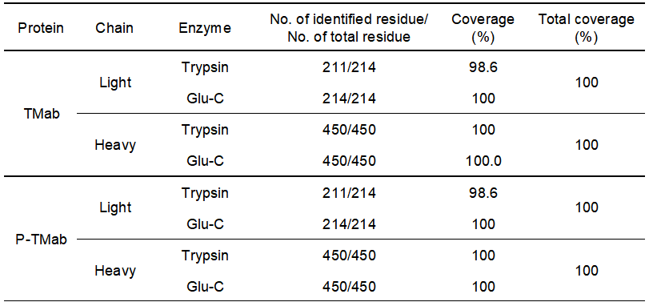
Table S2. Analysis of full-length amino acid sequence of P-TMab by LC/MS.

Slide 16
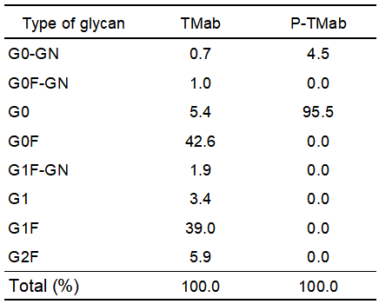
Table S3. N-glycan profile of P-TMab and trastuzumab.

Slide 17
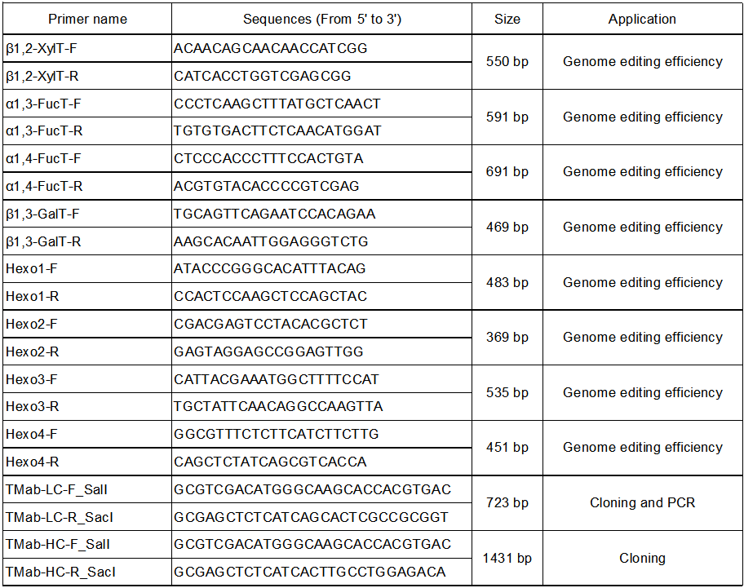
Table S4. List and sequences of Primers used in this study.

