Slide 1
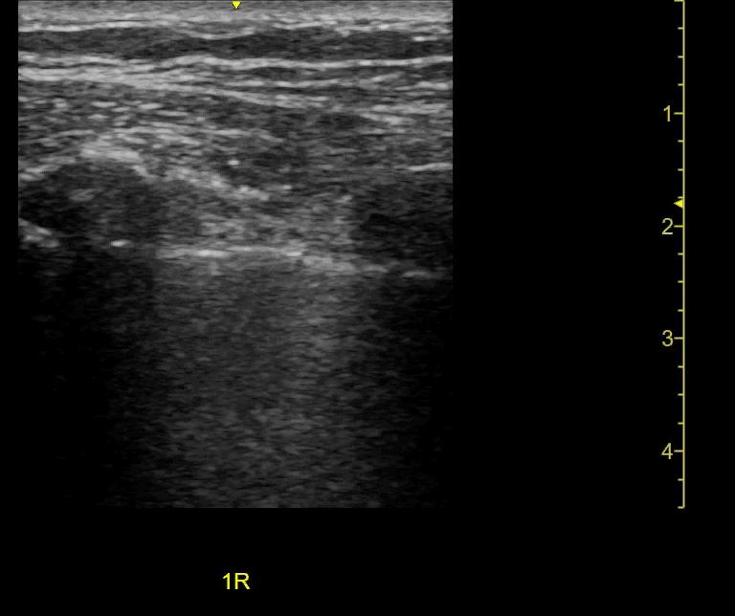
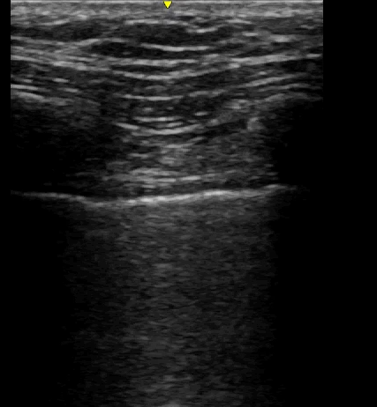
INTERCOSTAL MUSCLE ULTRASOUND: expiration
R
R
R
R
Lung
Lung
NORMAL
WEAK
Notes:
These are cross sections of the chest wall showing intercostal muscles with the arrows.
R is for rib.
LEFT is normal. The intercostal muscle relaxes during expiration and becomes thinner.
On the RIGHT, the intercostal is paralysed.

