Slide 1
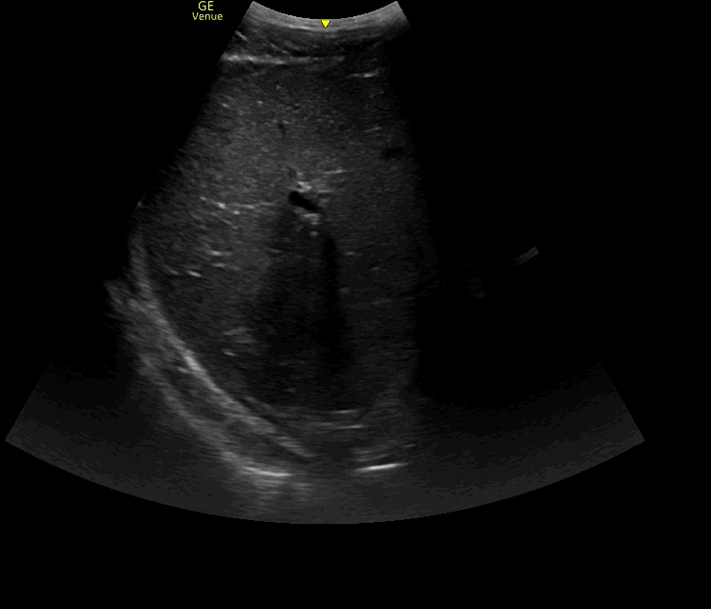
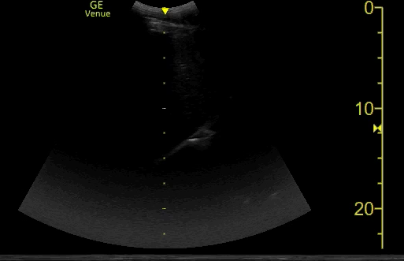
DIAPHRAGM EXCURSION
excursion
Liver
NORMAL
Lung
WEAK

