Slide 1
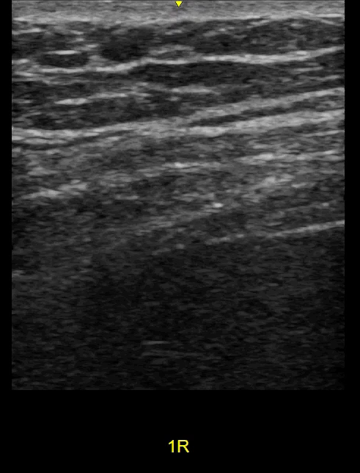
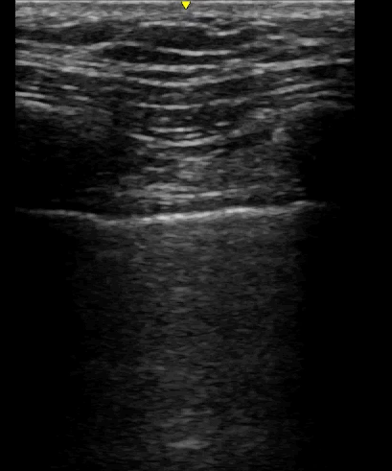
DIAPHRAGM USS, B-Mode
Chest wall
Chest wall
Diaphragm
Liver
Liver
cm
NORMAL
WEAK
Notes:
LEFT is normal. Here you can see the right hemi diaphragm contracting and moving downward toward the liver during inspiration. Contraction makes the diaphragm thicker.
RIGHT is WEAK. The right hemidiaphragm barely moves during breathing.

