Slide 1
Figure 4A
WB
Myc IP
Myc-Wdr11 - +
- +
246
180
135
100
75
63
48
35
22
IFT20
Different exposure images
246
180
135
100
75
63
48
35
22
Different exposure images
IFT57
246
180
135
100
75
63
48
35
22
IFT88
246
180
135
100
75
63
48
35
22
IFT140
246
180
135
100
75
63
48
35
22
Wdr11

Slide 2
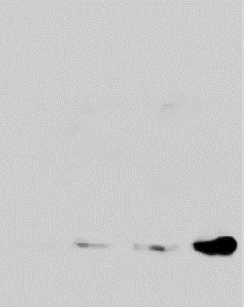
Figure 6A
Ptch1
Ptch2
Shh-N
- +
- +
246
180
135
100
75
63
48
35
22
Gas1
246
180
135
100
75
63
48
35
22
Hhip1
246
180
135
100
75
63
48
35
22
B-actin
246
180
135
100
75
63
48
35
22
Ptch1
246
180
135
100
75
63
48
35
22
Ptch2

Slide 3
Figure 6C
Cell lysate
Gas1
B-actin
Conditioned medium
Gas1

Slide 4
Figure 6D
CM
Lysate
TMI005(uM)
TMI005(uM)
TMI005(uM)
0 0.5 1 2
0 0.5 1 2
0 0.5 1 2
246
180
135
100
75
63
48
35
22
246
180
135
100
75
63
48
35
22
ADAM17
Gas1
Gas1

Slide 5
Fig S6 A
IFT88
B-Actin
WT
WDR11
RC
WDR11
MT
WDR11
KO
WT
IFT88
KO
WT
IFT88
KO
246
180
135
100
75
63
48
35
22
246
180
135
100
75
63
48
35
22
WDR11
B-Actin

