Slide 1
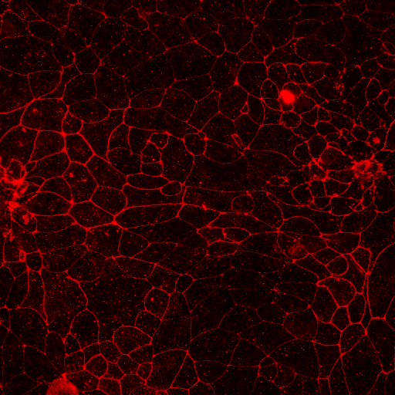
Supplementary Fig 3
Control
PAF
200 nmol/L BML-111 + PAF
ZO-1
Dapi
Claudin-1
Dapi
E-cadherin
Dapi
Figure S3. BML-111 restores PAF-reduced ZO-1. Images of 16HBE14o- cells treated with Pseudomonas aeruginosa filtrate (PAF) or PAF + 200 nmol/L BML-111 and immunostained for ZO-1 or Claudin-1 or E-cadherin (red) with corresponding images of nuclei stained with Dapi (blue). All images were obtained at ×63 magnification. Scale bars (20 μm) are shown on control images only but are applicable to all.

