Slide 1
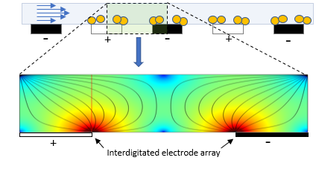
A
B
Notes:
Figure 1: Schematic of end-on electrodes within the DEP chip (A) and the DEP fields within a microfluidic channel (B). A. Yellow circles denotes particle of interest e.g. bacteria. Blue arrows indicate sample under flow. The interdigitated electrode array has an alternating current applied, shown as black (negative) or white (positive) rectangles. B. Lines represent DEP field. Colour represents field strength where red denotes strong attractive forces.

Slide 2
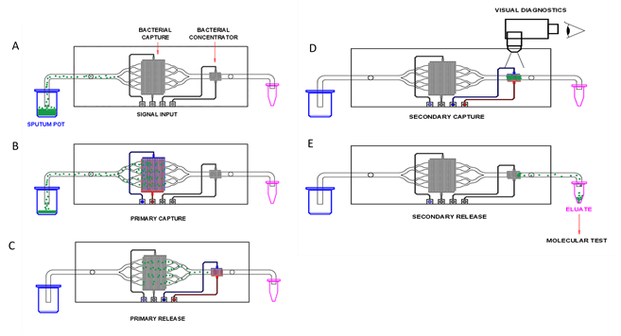
2
3
4
A
D
1
Signal input
Secondary capture
1
B
E
Primary capture
Secondary capture
5
C
Primary release
Notes:
Figure 2: Mtb concentration process flow: A) Sputum sample is thinned, stained, and connected to the fluidic system (1). Sample is directed through the microfluidic cassette, flowing over parallel arrays of interdigitated electrodes. B) The primary electrode arrays are activated, establishing a capture field, attracting the Mtb towards the electrode edges (2). C) When the sample is almost exhausted, the smaller, secondary electrode array is activated (3). The primary arrays are deactivated, releasing the bacteria from the capture fields into the flow. D) The Mtb are re-captured on the secondary electrode array which can be visualised by fluorescent microscopy (4). The presence of fluorescent foci indicates a positive result for TB infection. E) Deactivation of the secondary electrode array releases cells into the flow allowing collection in a small volume (as low as 5µl) for molecular analysis (5).

Slide 3
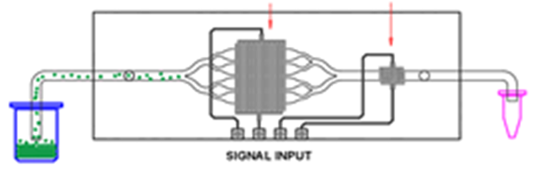

Slide 4
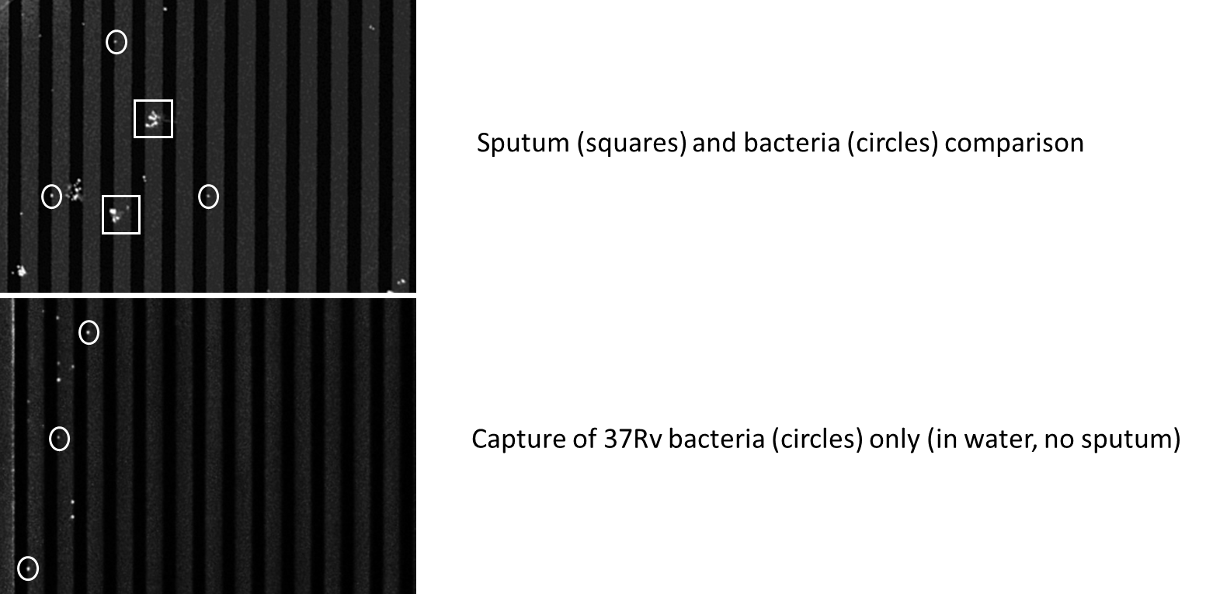
30 μm
30 μm
Notes:
Figure 3: Comparison of sputum vs bacteria. Top panel shows an electrode bank capturing a positive sputum sample, with both bacteria (in circles) and sputum debris (squares) visible. Bottom panel shows bacteria isolated from medium only.

Slide 5
A
B
36
total
1200
total
Notes:
Figure 4: Particle counts pre- (left) and post- (right) Mtb-spiked sputum thinning optimisation. Pre-optimisation was with NALC only. Post optimisation was with the lysis buffer described herein, with a two-hour incubation at 40°C. Arrows indicate the time point at which the dielectric field was terminated and bacteria were released. Signal noise due to low capture numbers in the NALC-only run (left).

Slide 6
Notes:
Figure 5: Representative samples from each of the smear microscopy and culture classifications of TB burden are presented with sample identification number in parentheses. Bacilli were clearly visible at the edges of electrodes, where the field strength is greatest, indicating successful cell capture from the sputum sample. Mtb smear negative, culture positive sputum showed only minimal captured bacteria. All samples demonstrated a low level of background non-specific captured debris. A correlation between smear positive grading and visual count of captured particles interpreted as Mtb bacilli was seen. Correlation between Mtb DNA quantification by species-specific qPCR was also seen with the degree of captured fluorescent particles on the DEP electrodes (Table 3). Images of negative and S-C+ samples are magnified (x 100, rather than x 40) for better clarity.

