Slide 1
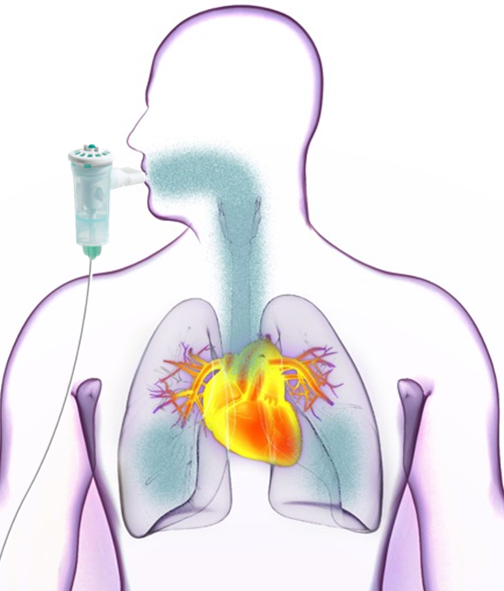
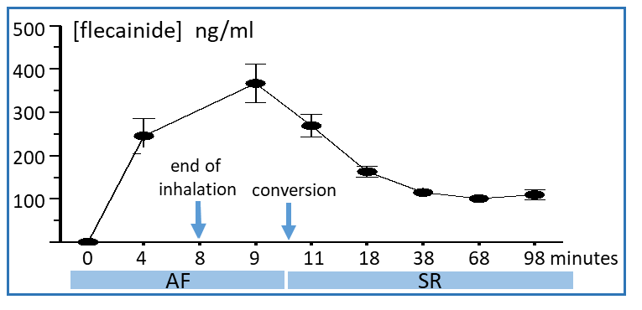
Inhaled flecainide converts recent-onset atrial fibrillation to sinus rhythm
AF ≤ 48 hrs since onset
Start flecainide
inhalation
Delivery of bolus to left atrium via pulmonary veins
Breath actuated inhaler generates flecainide aerosol upon inhalation
Rapid conversion to normal SR
normal sinus rhythm
Median time to conversion: 8.1 min
At 120 mg dose, 48% conversion rate
Notes:
"AF </= 48 hrs since onset Median time for conversion: 8.1 min At 120 mg dose, 48% conversion rate"

