Slide 1
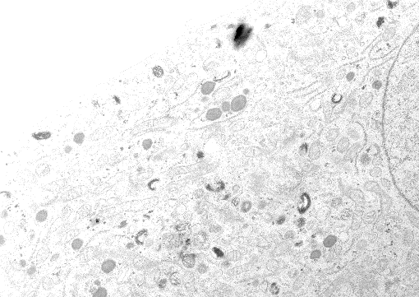
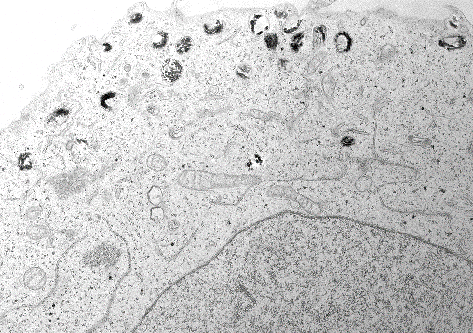
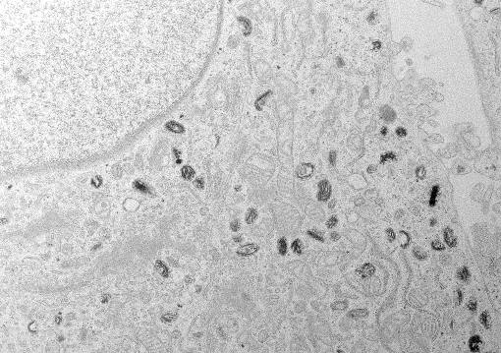
a
I
IV
IV
IV
II
I
IV
III
IV
IV
III
IV
III
N
MNT1 si-CTR
MNT1 si-MGRN1-03
I
IV
IV
I
III
III
III
III
N
III
b
100
si-CTR
N
III
si-03
IV
80
si-04
MNT1 si-MGRN1-04
IV
60
I
Melanosomal stage (%)
I
IV
40
II
III
III
IV
III
20
IV
0
Stages
I
II
III
IV
c
1.0
0.8
0.6
0.04
Relative MGRN1 mRNA level
0.02
0
si-CTR
si-03
si-04
Suppl Fig S1

Slide 2
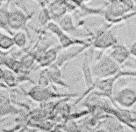
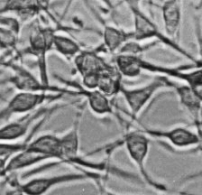
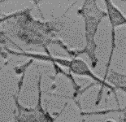
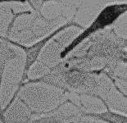
a
b
Melan-a6
Melan-md1
1.5
Endo H
-
+
+
-
+
+
1.0
PNGase F
-
-
-
-
-
-
100 –
Relative tyrosine uptake
70 –
TYR
0.5
55 –
ERK2
40 –
0
PTU
-
+
-
+
Melan-a6
Melan-md1
c
8
d
6
4
Relative tyrosine
hydroxylase activity
3
4
Relative tyrosine
hydroxylase activity
2
2
1
0
0
pH 5
pH 6
pH 6.8
pH 5
pH 6
pH 6.8
NH₄Cl
-
+
-
+
Melan-a6
Melan-md1
Melan-a6
Melan-md1
e
f
CTR
10 mM NH₄Cl
3
Melan-a6
2
Relative melanin content
1
Melan-md1
0
NH₄Cl
-
+
-
+
Melan-a6
Melan-md1
Suppl Fig S2

Slide 3
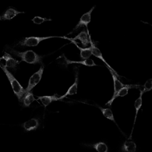
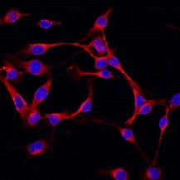
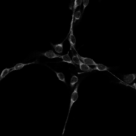
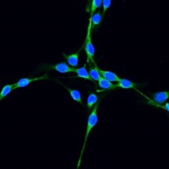

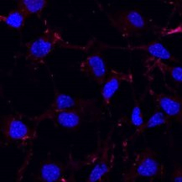

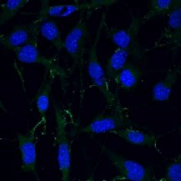
a
Alexa 647
Alexa 488
b
2.0
Alexa 647
Alexa 488
Melan-a6
1.5
Relative fluorescence intensity
1.0
0.5
Melan-md1
0
-a6
-md1
-a6
-md1
c
Melan-a6 Mgrn1-KO
CTR
6C34
6C45
2.0
1.5
AO staining
Relative fluorescence
intensity
1.0
0.5
0
CTR
6C34
6C45
d
B16F10 Mgrn1-KO
CTR
5C5
6C26
2.0
1.5
AO staining
Relative fluorescence
intensity
1.0
0.5
0
CTR
5C5
6C26
Suppl Fig S3

Slide 4
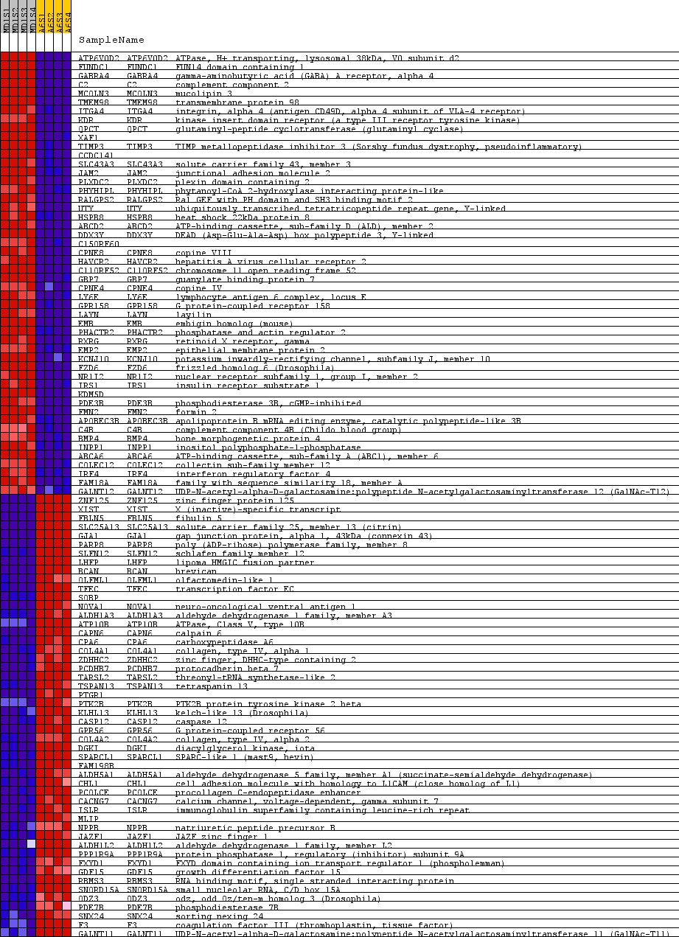
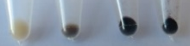
a
Melan-a6
Melan-md1
b
c
d
120
20
Melan-a6
50
Melan-a6
15
Melan-md1
100
Melan-md1
10
80
20
80
Relative ornithine
decarboxylase activity
5
5
Intracellular polyamine level
(nmol/mg protein)
Relative mRNA level
60
4
40
2
0
20
0
Az1
DFMO
-
+
-
+
Odc
Ssat
Azin1
SpdSt
Azin2
Melan-a6
Melan-md1
0
Put
Spd
Spn
e
40
30
Relative tyrosine
hydroxylase activity
20
10
0
-
+
-
+
DFMO
Melan-a6
Melan-md1
Suppl Fig S4

Slide 5
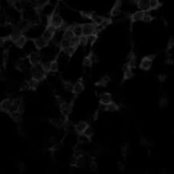
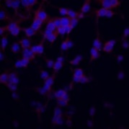
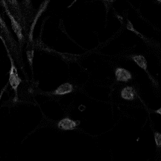
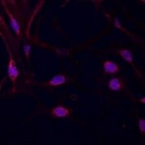
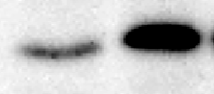
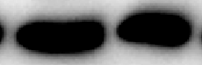
a
b
Melan-a6 si-Mgrn1
8
Atp6v0d2
Mgrn1
2·10³
80
1·10³
60
6
Relative Atp6v0d2 mRNA level
30
Relative Mgrn1 mRNA level
Relative mRNA level
2
20
4
1
10
2
0
0
CTR
6C24
6C34
6C35
6C45
CTR
-a6
-md1
Melan-a6
Mgrn1-KO
5C5
6C26
0
B16F10
Mgrn1-KO
si-CTR
si-01
si-04
si-CTR
si-01
si-04
si-Mgrn1
si-Mgrn1
c
d
ATP6V0D2
ATP6V0D2 + DAPI
10
si-CTR
si-A
si-B
si-C
8
40
ATP6V0D2
6
40
ERK2
Melan-a6
Relative fluorescence
intensity
1.5
4
2
1.0
0
-a6
-md1
Relative Atp6v0d2 mRNA level
Melan-md1
-a6
-md1
0.5
34 –
ATP6V0D2
0
43 –
ERK2
si-CTR
si-A
si-B
si-C
si-Atp6v0d2
e
2.5
2.0
1.5
Relative tyrosine hydroxylase activity
1.0
0.5
0
si-CTR
si-A
si-B
si-C
si-Atp6v0d2
Suppl Fig S5

