Slide 1
Figure 1
Normoxia
Hypoxia
Ischaemia
A
B
P<0.0001
P<0.0001
P<0.0001
P<0.0001
P<0.0001
P<0.0001
P<0.0001
P<0.0001
5
120
P<0.0001
4
100
3
80
ApoJ-Glyc (ug/ml)
% of change ApoJ-Glyc levels compared to 1h
60
2
40
1
20
0
1h
2h
4h
8h
0
1h
2h
4h
8h
1h
2h
4h
8h
1h
2h
4h
8h
Nx
Hx
Isch

Slide 2
Figure 2
A
B
6
P = 0.02
Mw Nx4h Hx4h Isch4h Nx4h Hx4h Isch4h Pool
5
4
ApoJ-Glyc (ng/ml)
3
P = 0.02
2
P = 0.01
1
0
Nx
Hx
Isch
Glycosylated forms in normoxia
Non-glycosylated forms in normoxia
Glycosylated forms in hypoxia
Non-glycosylated forms in hypoxia
Glycosylated forms in simulated ischaemia
Non-glycosylated forms in simulated ischaemia
C
D
P = 0.059
P = 0.04
1.8
1.6
1.6
1.4
1.4
1.2
1.2
1.0
P = 0.006
P = 0.005
1.0
P = 0.02
vs Nx
Total ApoJ intensity
(AUx10⁷)
ApoJ (AUx10⁷)
P = 0.04
vs Nx
0.8
0.8
0.6
0.6
0.4
0.4
0.2
0.2
0
0
Nx
Hx
Isch
Normoxia
Hypoxia
Ischemia

Slide 3
Figure 3
A
Acute MI phase
B
Acute MI phase
P = 0.02 vs basal
P=0.01 vs Sham
100
18
16
Sham
90
14
AMI
12
P = 0.03
vs basal
80
10
ApoJ-Glyc levels (ug/mL)
hs-Troponin-I levels (ng/mL)
70
8
6
P = 0.02
vs basal
60
P = 0.008
vs basal
P = 0.03
vs basal
4
P = 0.0002 vs basal
2
50
0
Basal
15min
30min
60min
90min
120min
Basal
15min
30min
60min
90min
120min
Occluded artery
Occluded artery
t=0
Balloon occlusion
t=120
Balloon deflation
t=0
Balloon occlusion
t=120
Balloon deflation
ApoJ decrease (Units AMI vs Sham) | 15 min | 30 min | 60 min | 90 min | 120 min
ApoJ decrease (Units AMI vs Sham) | 14 | 8 | 10 | 13 | 10
Troponin increase (Units AMI vs Sham) | 15 min | 30 min | 60 min | 90 min | 120 min
Troponin increase (Units AMI vs Sham) | 2 | 2 | 6 | 1 | 12
C
Recovery phase
D
Recovery phase
100
80
P < 0.0001 vs basal
P=0.04 vs Sham
90
70
60
80
50
ApoJ-Glyc levels (ug/mL)
40
hs-Troponin-I levels (ng/mL)
70
P = 0.04 vs basal
P = 0.02 vs Sham
30
P = 0.03 vs Sham
P = 0.03 vs Sham
20
60
10
50
0
Basal
3d
2w
4w
45d
Sacrifice
Basal
3d
2w
4w
45d
Sacrifice

Slide 4
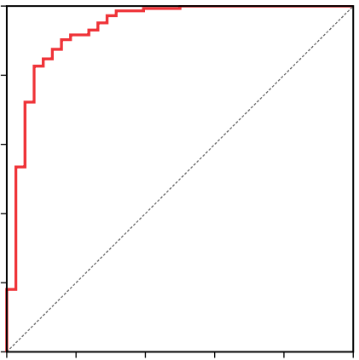
Figure 4
B
1.0
A
0.8
45% change
P < 0.0001
700
0.6
600
Sensitivity
500
0.4
400
ApoJ-Glyc levels at admission (ug/mL)
300
0.2
AUC: 0.934
95%CI: 0.883-0.986
P < 0.0001
200
100
cut-off value 332μg/mL
97% sensitivity 71% specificity
0
0.0
Control
(N=144)
Early-AMI
(N=38)
0.0
0.2
0.4
0.6
0.8
1.0
1 - Specificity

Slide 5
Figure 5
B
1.0
A
15% change
P < 0.0001
0.8
900
800
700
0.6
600
Sensitivity
500
ApoJ-Glyc levels at admission (ug/mL)
0.4
400
300
AUC: 0.713
95%CI: 0.660-0.765
P < 0.0001
200
0.2
100
cut-off value 409μg/mL
80% sensitivity 53% specificity
0
0.0
Control
(N=144)
STEMI
(N=212)
0.0
0.2
0.4
0.6
0.8
1.0
1 - Specificity
C
800
R = -0.259 P = 0.0003
700
600
500
ApoJ-Glyc levels at admission (ug/mL)
400
300
200
100
0
0
400
800
1200
1600
Ischaemia time (minutes)

Slide 6
Figure 6
A
P = 0.002
B
900
800
700
Admission
t=0h
PCI
3 days after admission
t=72h
600
500
ApoJ-Glyc levels 0h (ug/mL)
400
300
ApoJ-Glyc quantification
ApoJ-Glyc quantification
200
100
0
TIMI 0-1
TIMI 2-3
Final TIMI
C
18% reduction
P < 0.0001
D
E
P < 0.0001
P = 0.03
900
900
350
800
800
300
700
700
600
600
250
ApoJ-Glyc levels (ug/mL)
500
500
ApoJ-Glyc levels (ug/mL)
200
400
400
GRACE Risk Score
150
300
300
100
200
200
100
100
50
0
t = 72h
0
0
t = 0h
t=0h
t=72h
t=0h
t=72h
Increase
Decrease
STEMI
(N=82)
Increase
Decrease
Δ ApoJ-Glyc levels at 72h
Δ ApoJ-Glyc levels at 72h
in STEMI patients after PCI

Slide 7
Supplemental Figure 1
Glycosylated Apo J forms in the 2DE analysis of glycosylated proteins serum fraction (AU)
25% reduction
P < 0.05
ApoJ-Glyc intensity (AU)

Slide 8
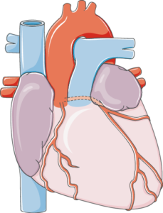
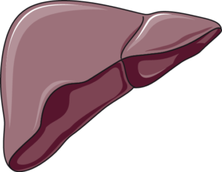
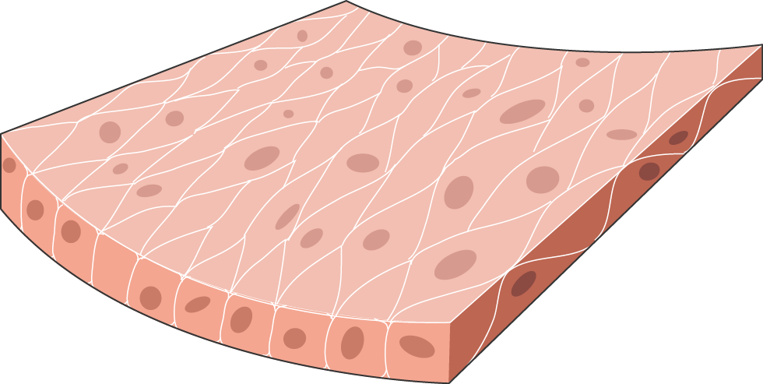
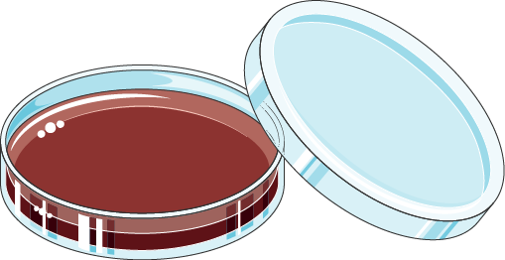
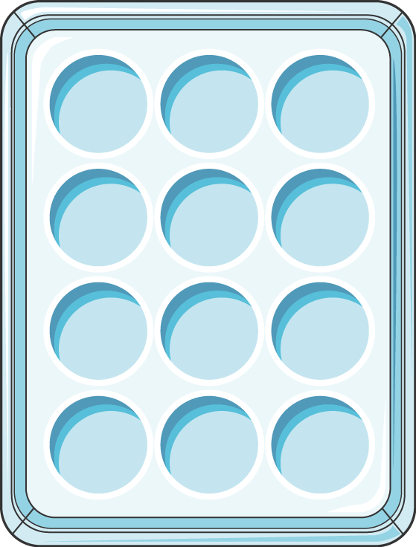
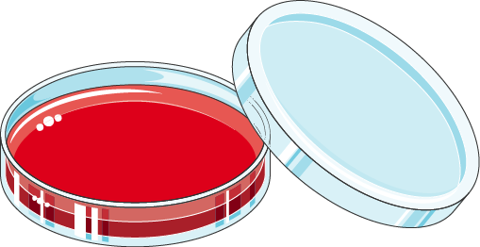
Supplemental Figure 2
A
Cardiac origin cells
Hepatic origin cells
Vascular origin cells
Vascular origin cells
PVCF
Porcine
Primary
HL-1
Murine
Stable cell line
HepG2
Human
Stable cell line
Stellate
Human
Stable cell line
HUVEC
Human
Stable cell line
VSMC
Human
Primary
1h, 2h, 4h and 8h
Normoxia
Hypoxia
Simulated ischaemia (hypoxia + acidosis)
Cell and medium collection and protein extraction
Cells (protein)
Medium
WB
ELISA
Enzymatic deglycosylation + WB
B
70kDa
Fully glycosylated ApoJ (Pre-secretory form)
55kDa
Core glycosylated ApoJ (Hypoglycosylated Apo J – Retro-translocated form)
Glycosylated variants
40kDa
Glycosylated ApoJ beta chain
Non-Glycosylated variants
30kDa
Non-glycosylated ApoJ beta chain
ApoJ bands intensity (optical density [OD] in arbitrary units; normalization with total protein load)

Slide 9
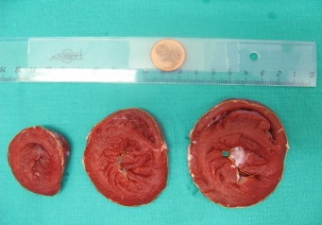
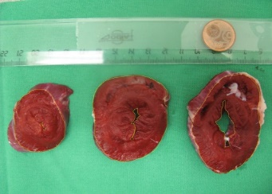
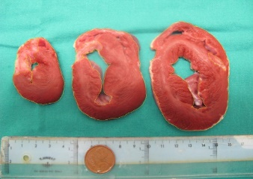
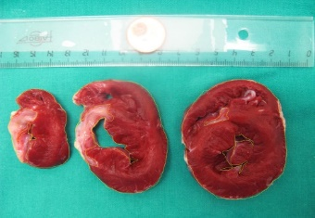
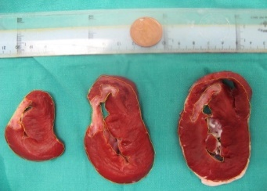
Supplemental Figure 3
30min ischaemia +
45days post-reperfusion
60min ischaemia +
45days post-reperfusion
90min ischaemia +
45days post-reperfusion
120min ischaemia +
45days post-reperfusion
Sham-operated
Infarct size assessed
(TTC staining)
30min ischaemia
60min ischaemia
90min ischaemia
120min ischaemia
+ 45 days post-reperfusion

Slide 10
Supplemental Figure 4
A
ApoJ deglycosylation analysis
PNGase F
Fully glycosylated ApoJ
De-glycosylated ApoJ
Normoxia
Ischaemia
B
C
* P<0.05
** P<0.01
*** P<0.001
**** P<0.0001
PVCF
HL-1
1.2
28% decrease
4.0
28% decrease
P=0.02
Nx Isch
3.5
P=0.04
Nx Isch
1.0
PNGase F
- + - +
PNGase F
- + - +
3.0
0.8
2.5
De-glycosylated vs. Glycosylated ApoJ band intensity (AU)
De-glycosylated vs. Glycosylated ApoJ band intensity (AU)
0.6
2.0
0.4
1.5
1.0
0.2
0.5
0
Nx
Isch
0
Nx
Isch

Slide 11
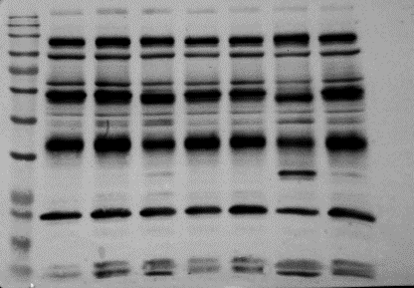
Supplemental Figure 5
A
PVCF
B
HL-1
C
HepG2
Mw Nx1h Hx1h Isch1h Nx8h Hx8h Isch8h Pool
Mw Nx1h Hx1h Isch1h Nx8h Hx8h Isch8h Pool
Mw Nx1h Hx1h Isch1h Nx8h Hx8h Isch8h Pool
D
Stellate
E
HUVEC
F
VSMC
Mw Nx1h Hx1h Isch1h Nx8h Hx8h Isch8h Pool
Mw Nx1h Hx1h Isch1h Nx8h Hx8h Isch8h Pool
Mw Nx1h Hx1h Isch1h Nx8h Hx8h Isch8h Pool

Slide 12
Supplemental Figure 6
Glycosylated forms in normoxia
Non-glycosylated forms in normoxia
Glycosylated forms in hypoxia
Non-glycosylated forms in hypoxia
Glycosylated forms in simulated ischaemia
Non-glycosylated forms in simulated ischaemia
A
ApoJ (AUx10⁷) in PCVF
B
ApoJ (AUx10⁷) in HL-1
C
ApoJ (AUx10⁷) in HepG2
1.4
P=0.0002
3.5
4.0
P=0.009
P=0.002
1.2
P=0.002
P=0.002
3.0
3.5
P=0.001
P=0.01
3.0
1.0
P=0.0006
2.5
2.0
2.5
P=0.0002
0.8
2.0
P=0.02
0.6
1.5
P<0.0001
1.5
0.4
1.0
1.0
0.2
0.5
0.5
0
1h
8h
1h
8h
1h
8h
0
1h
8h
1h
8h
1h
8h
0
1h
8h
1h
8h
1h
8h
Normoxia
Hypoxia
Ischaemia
Normoxia
Hypoxia
Ischaemia
Normoxia
Hypoxia
Ischaemia
D
ApoJ (AUx10⁷) in Stellate
E
ApoJ (AUx10⁶) in HUVEC
F
ApoJ (AUx10⁷) in VSMC
2.5
P=0.02
P=0.003
P=0.003
P=0.01
3.0
5.0
P=0.001
P=0.0007
4.5
2.0
2.5
4.0
2.0
3.5
1.5
P=0.0009
P=0.003
3.0
1.5
2.5
1.0
2.0
P=0.02
1.0
1.5
P=0.01
0.5
1.0
P=0.001
0.5
0.5
0
1h
8h
1h
8h
1h
8h
0
1h
8h
1h
8h
1h
8h
0
1h
8h
1h
8h
1h
8h
Normoxia
Hypoxia
Ischaemia
Normoxia
Hypoxia
Ischaemia
Normoxia
Hypoxia
Ischaemia

Slide 13
Supplemental Figure 7
A
Non-glycosylated/Glycosylated ApoJ forms in PCVF
B
Non-glycosylated/Glycosylated ApoJ forms in HL-1
C
Non-glycosylated/Glycosylated ApoJ forms in HepG2
Normoxia
Hypoxia
Simulated ischaemia
P=0.03 vs Nx
P=0.01 vs Hx
P=0.002 vs Nx
P=0.001 vs Hx
10
*
10
10
P=0.0006 vs Nx
P=0.001 vs Hx
P=0.03 vs Nx
P=0.04 vs Hx
#
*
#
0
0
0
*
*
*
#
-10
-10
-10
*
#
#
P=0.02 vs Nx
-20
-20
-20
-30
-30
-30
P=0.01 vs Nx
P=0.008 vs Hx
-40
-40
-40
-50
-50
-50
-60
1h
2h
4h
8h
-60
1h
2h
4h
8h
-60
1h
2h
4h
8h
D
Non-glycosylated/Glycosylated ApoJ forms in Stellate
E
Non-glycosylated/Glycosylated ApoJ forms in HUVEC
F
Non-glycosylated/Glycosylated ApoJ forms in VSMC
10
10
10
0
0
#
0
-10
-10
P=0.04vs Hx
-10
-20
-20
-20
-30
-30
-30
-40
-40
-40
-50
-50
-50
-60
1h
2h
4h
8h
-60
1h
2h
4h
8h
-60
1h
2h
4h
8h

Slide 14
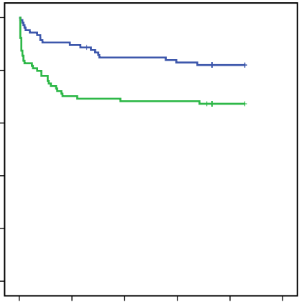
Supplemental Figure 8
1.0
ApoJ-Glyc t=0 > 398ug/mL
0.8
0.6
ApoJ-Glyc t=0 < 398ug/mL
Event free cumulative survival
0.4
0.2
0.0
Log Rank (Mantel-Cox) P = 0.008
0
50
100
150
200
250
Total recurrent ischaemic event/death (days)
at 6 months of follow-up

Slide 15
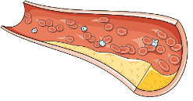
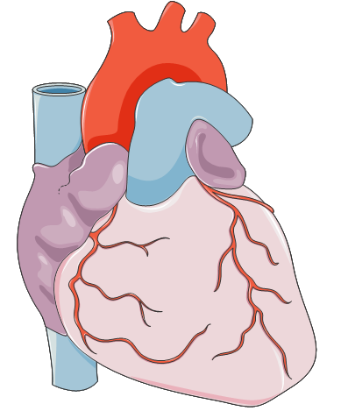
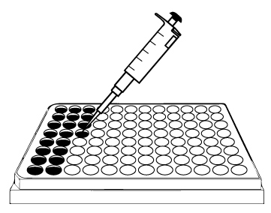
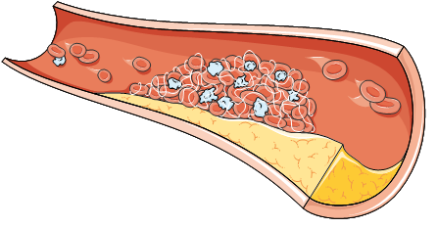
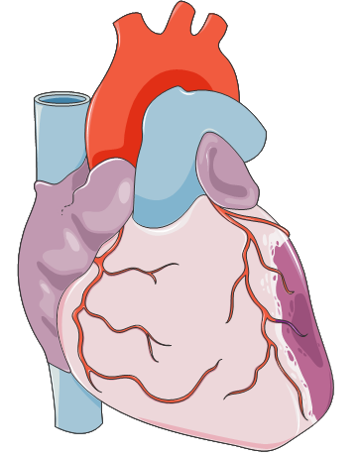
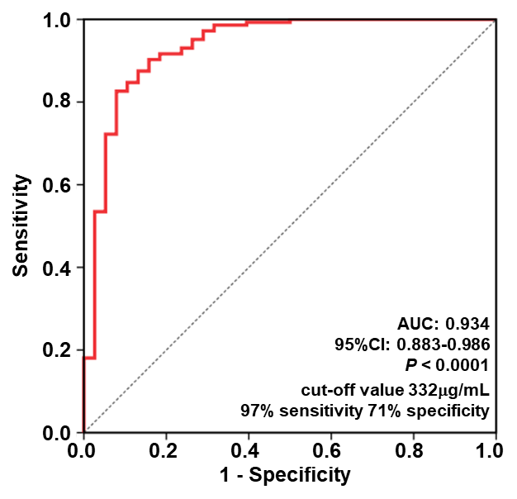
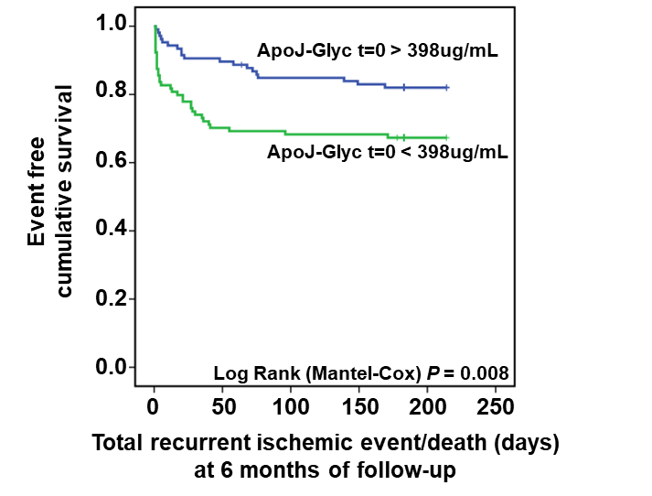
Graphical Abstract
ApoJ-Glyc secretion
Normal condition
Specific detection of glycosylated ApoJ
ApoJ-Glyc
Decreased ApoJ-Glyc
secretion
Discrimination of the ischaemic event
Acute ischaemic event
Novel immunodetection assay
Recurrent events and mortality at 6-months follow-up
Normal physiological state
85%
ApoJ-Glyc
vs.
Early ischaemic phase
40%
ApoJ-Glyc

