Slide 1
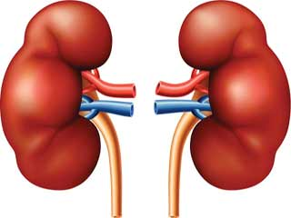
Figure 1
Fluid retention and preload
Active RAAS and afterload
Renal ischaemia – hypoperfusion
Renal congestion – low GFR

Slide 2
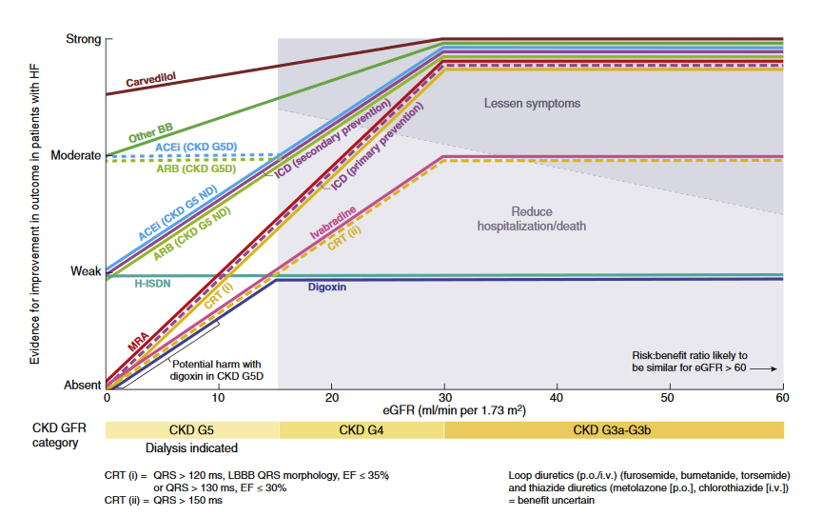
Figure 2

Slide 3
Figure 3
Salt restrict <2g/day, Fluid restrict <1.5 L/day
Start Furosemide 40-120 mg BD
Add Spironolactone 12.5-50 mg OD
Add Metolazone 2.5-5 mg BD
Monitor Sodium, Potassium, Creatinine, Weight and BP

Slide 4
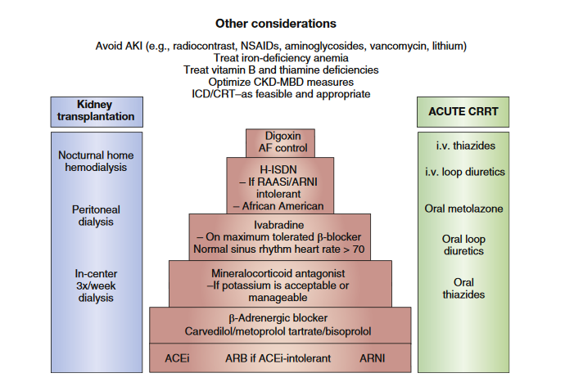
Figure 4

