Slide 1
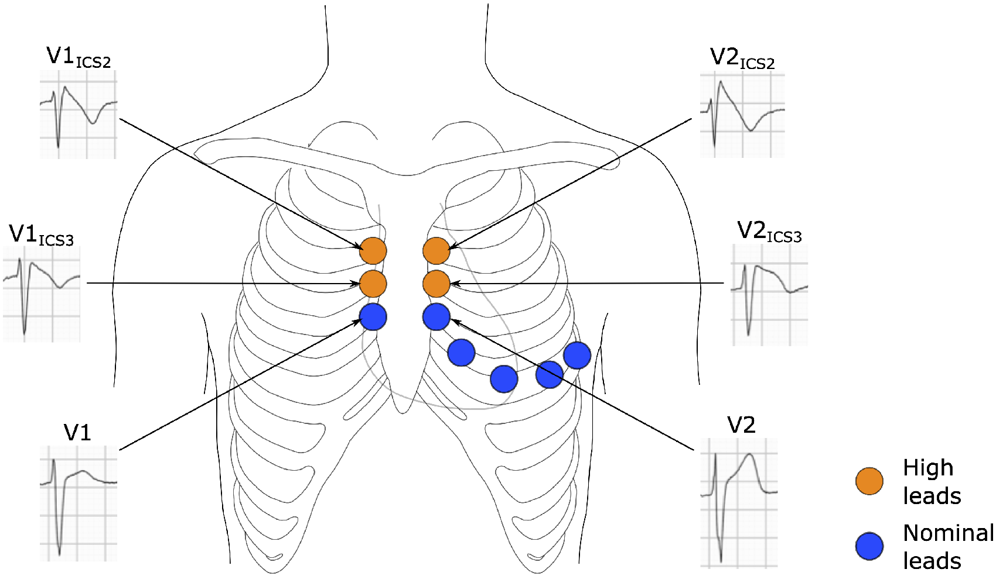
Figure 3 High lead placement and type 1 Brugada ECG pattern. In the high lead placement, leads V1 and V2 are placed in ...
Notes:
Figure 3 High lead placement and type 1 Brugada ECG pattern. In the high lead placement, leads V1 and V2 are placed in the 3rd and 2nd ICSs; this correlates with RVOT location and increases ECG sensitivity in BrS. The ECG tracings shown were recorded from high and nominal leads V1 and V2. Type 1 Brugada ECG pattern, characterized by a coved ST-segment elevation ≥2 mm followed by a negative T wave, is evident in the high but not the nominal leads. V1ICS2, lead V1 in the 2nd ICS; V2ICS2, lead V2 in the 2nd ICS; V1ICS3, lead V1 in the 3rd ICS; V2ICS3, lead V2 in the 3rd ICS.
Unless provided in the caption above, the following copyright applies to the content of this slide: Published on behalf of the European Society of Cardiology. All rights reserved. © The Author(s) 2021. For permissions, please email: journals.permissions@oup.com.This article is published and distributed under the terms of the Oxford University Press, Standard Journals Publication Model (https://academic.oup.com/journals/pages/open_access/funder_policies/chorus/standard_publication_model)

