Slide 1
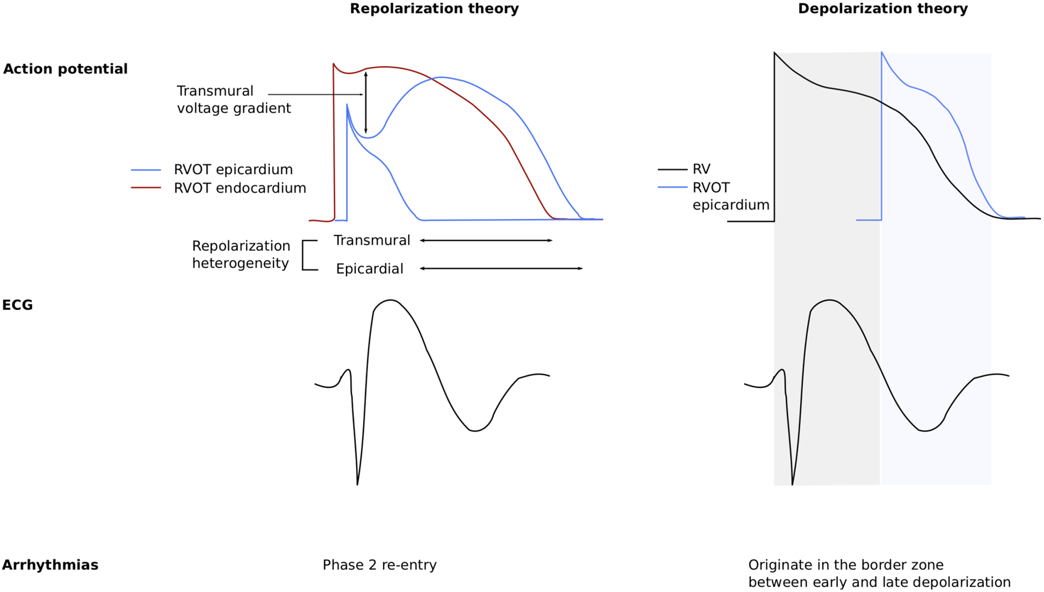
Figure 2 Repolarization vs. depolarization theories for the electrophysiological mechanism underlying Brugada ...
Notes:
Figure 2 Repolarization vs. depolarization theories for the electrophysiological mechanism underlying Brugada syndrome. The repolarization theory suggests that reduced INa current causes unopposed Kv4.3-mediated Ito. This creates an epicardial–endocardial transmural voltage gradient which disrupts the normal spike and dome morphology of the AP. Due to presumed differences in distribution of Ito and in thickness of epicardial and endocardial layers, these changes are more exaggerated in the RVOT epicardium than its endocardium and cause accentuation of the AP and therefore the J-point and right precordial ST elevation characteristic of the Brugada ECG pattern. Heterogeneity in repolarization and refractoriness in the RVOT epicardium lead to increased risk for phase 2 re-entry and VT or VF. The depolarization theory suggests that delayed conduction in the RVOT relative to the body of the RV causes the characteristic ECG pattern and arrhythmias. Delayed conduction in the RVOT creates an initial gradient driving current towards the RVOT and right precordial leads. The second phase of current returning to the RV and away from the right precordial leads, leads to the characteristic inverted T wave. Arrhythmias are thought to originate in the border zone between early and delayed depolarization where there are mismatched potentials. RV, right ventricle; RVOT, right ventricular outflow tract; VF, ventricular fibrillation; VT, ventricular tachycardia.
Unless provided in the caption above, the following copyright applies to the content of this slide: Published on behalf of the European Society of Cardiology. All rights reserved. © The Author(s) 2021. For permissions, please email: journals.permissions@oup.com.This article is published and distributed under the terms of the Oxford University Press, Standard Journals Publication Model (https://academic.oup.com/journals/pages/open_access/funder_policies/chorus/standard_publication_model)

