Slide 1
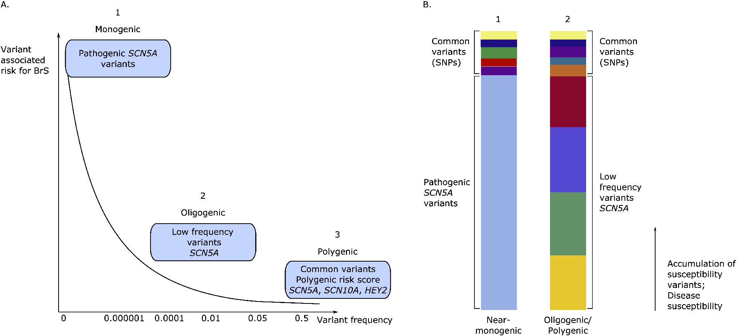
Figure 1 Monogenic, oligogenic, and polygenic models of genetic aetiology. Rare pathogenic variants in SCN5A have the ...
Notes:
Figure 1 Monogenic, oligogenic, and polygenic models of genetic aetiology. Rare pathogenic variants in SCN5A have the highest associated risk for BrS. Patients with a single highly penetrant pathogenic variant (A1, B1) with or without common susceptibility SNPs (A3, B1) will have sufficient genetic risk for development of the BrS phenotype, supporting a ‘near-monogenic’ model. On the other hand, in the oligogenic/polygenic models, multiple low-frequency variants (A2, B2) that have a much lower associated risk for BrS and/or common susceptibility SNPs causing a high PRS (A3, B2), may be needed for disease expression. SNPs, single-nucleotide polymorphisms.
Unless provided in the caption above, the following copyright applies to the content of this slide: Published on behalf of the European Society of Cardiology. All rights reserved. © The Author(s) 2021. For permissions, please email: journals.permissions@oup.com.This article is published and distributed under the terms of the Oxford University Press, Standard Journals Publication Model (https://academic.oup.com/journals/pages/open_access/funder_policies/chorus/standard_publication_model)

