Slide 1
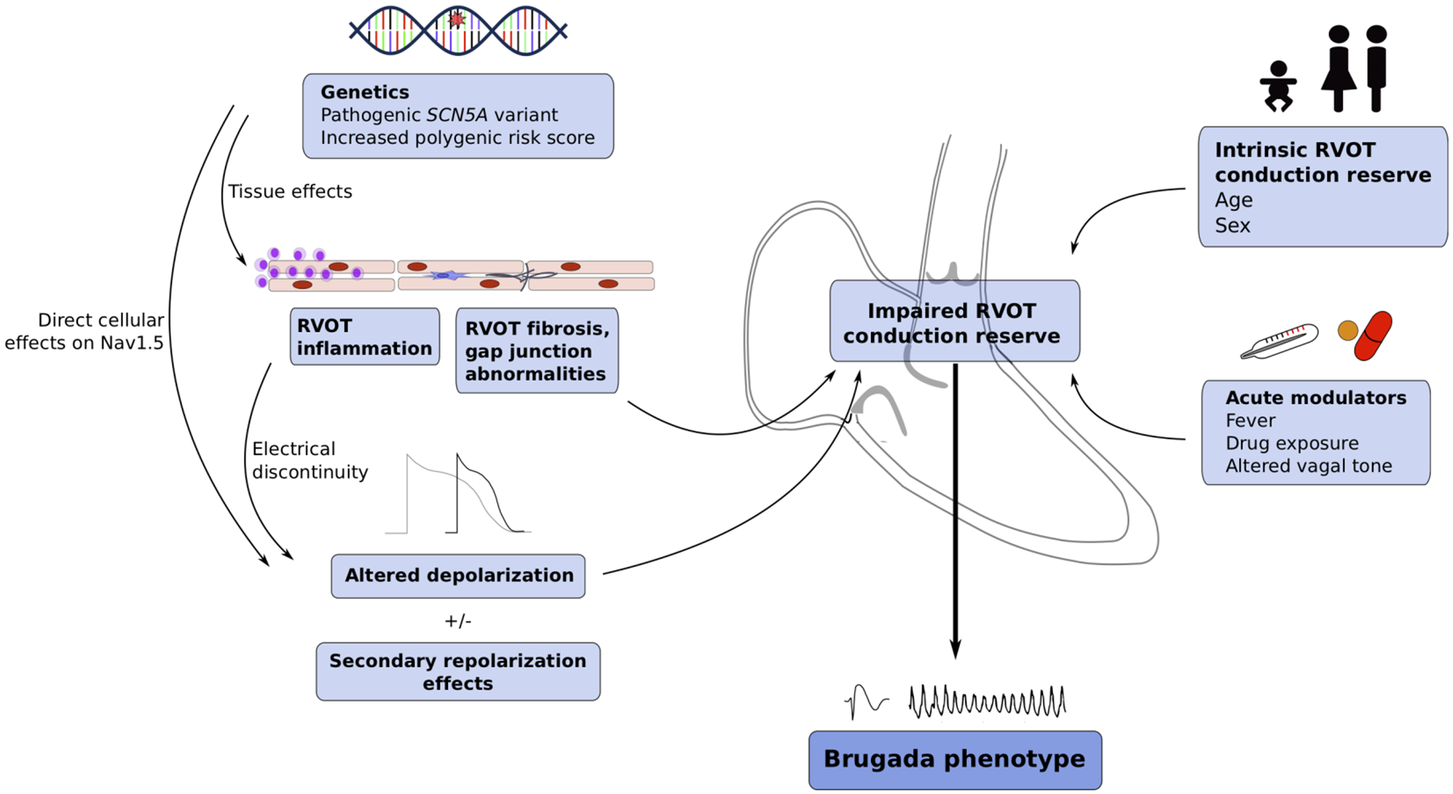
Brugada syndrome (BrS) as a disease of impaired right ventricular outflow tract (RVOT) conduction reserve. ...
Notes:
Brugada syndrome (BrS) as a disease of impaired right ventricular outflow tract (RVOT) conduction reserve. Normally, intrinsic RVOT conduction reserve may be affected by a patient’s age and gender. In BrS, cellular and tissue abnormalities cause a reduction in RVOT conduction reserve: genetic abnormalities, whether mediated by a pathogenic SCN5A variant, an increased BrS-PRS, and/or additional genetic insults, may have direct effects on Nav1.5, as well as tissue effects causing RVOT inflammation, fibrosis, and gap junction abnormalities. Decreased Nav1.5 current, together with electrical discontinuity caused by RVOT structural changes, converges to disrupt normal depolarization, with or without secondary repolarization effects, leading to impairment of the conduction reserve of the RVOT. In this framework, the marginal conduction reserve can be exposed by acute modulators such as fever, drugs, and altered vagal tone which further impair conduction and expose the Brugada phenotype.
Unless provided in the caption above, the following copyright applies to the content of this slide: Published on behalf of the European Society of Cardiology. All rights reserved. © The Author(s) 2021. For permissions, please email: journals.permissions@oup.com.This article is published and distributed under the terms of the Oxford University Press, Standard Journals Publication Model (https://academic.oup.com/journals/pages/open_access/funder_policies/chorus/standard_publication_model)

