Slide 1
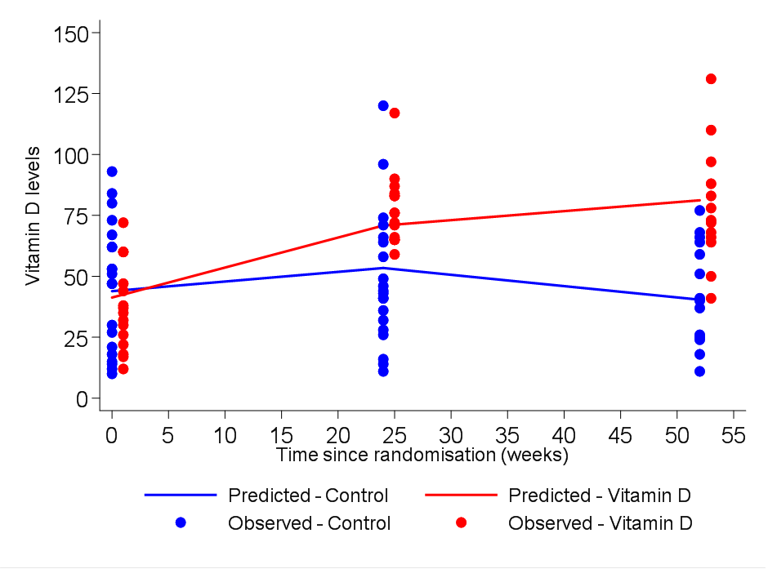
Figure 3: 25 hydroxy Vitamin D concentration in patients on vitamin D and placebo at baseline, 24 and 52 weeks

