Slide 1
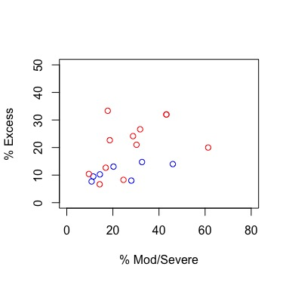
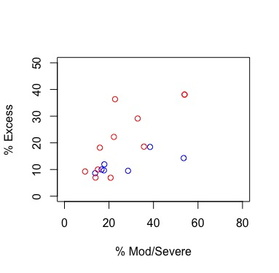
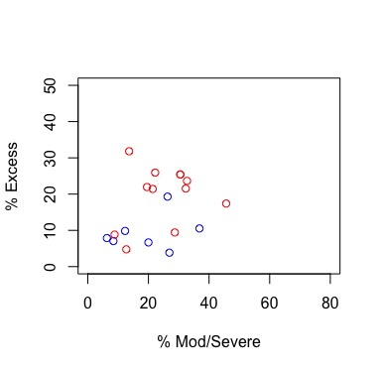
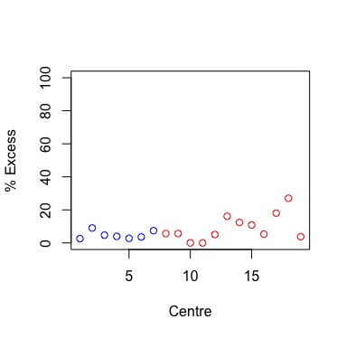
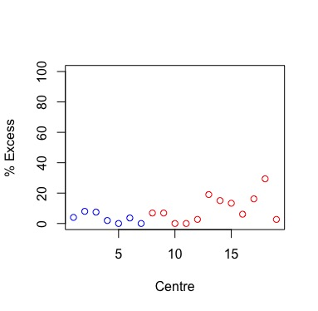
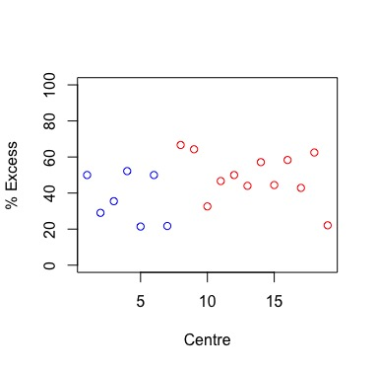
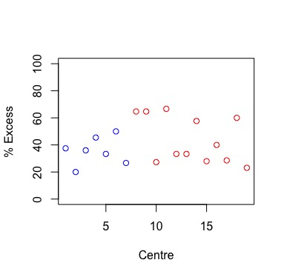
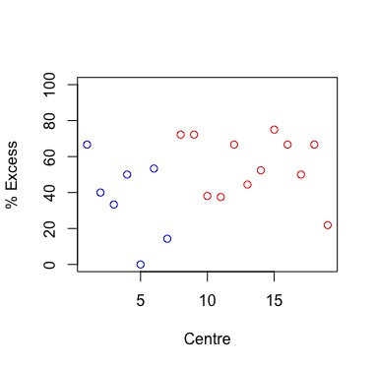
All patients
CD
UC
(A)
(B)
(C)
r=0.47
p=0.04
r=0.55
p=0.01
r=0.17
p=0.3
(D)
(E)
(F)
(G)
(H)
(I)
Supplementary figure 1 Excess rates of steroid exposure captured at each centre. (A-C) shown against percentage of patients recorded as having moderate or severe disease. (D-F) shown by centre for those patients with mild disease or disease in remission. (G-I) shown by centre for those patients with moderate or severe disease. Data are shown for all patients (A, D, G), or restricted to those patients with CD (B, E, H) or UC (C, F, I). Blue circle represent data from centres in the intervention group. Red circle represent centres in the non-intervention group.
Notes:
Supplementary figure 1 Excess rates of steroid exposure captured at each centre. (A-C) shown against percentage of patients recorded as having moderate or severe disease. (D-F) shown by centre for those patients with mild disease or disease in remission. (G-I) shown by centre for those patients with moderate or severe disease. Data are shown for all patients (A, D, G), or restricted to those patients with CD (B, E, H) or UC (C, F, I). Blue circle represent data from centres in the intervention group. Red circle represent centres in the non-intervention group.

