Slide 1
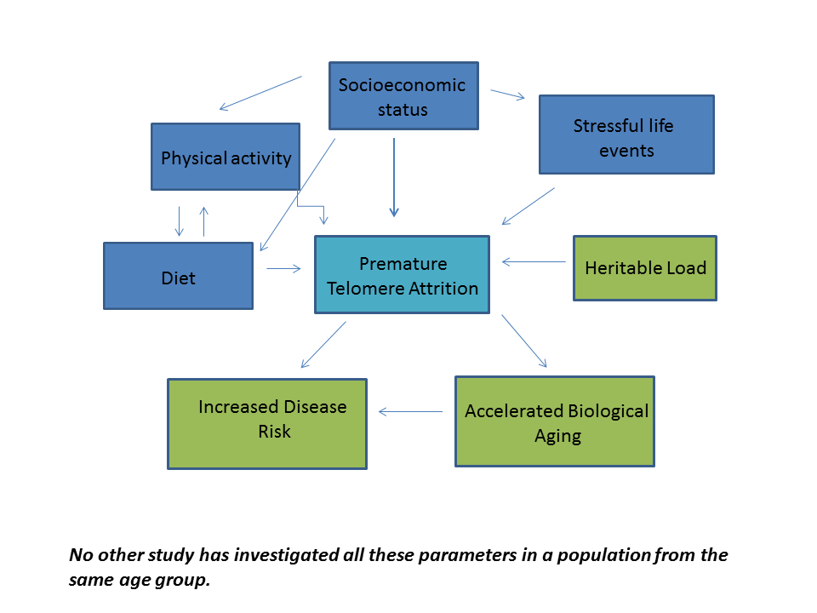
Impact of diet, household income and stress on telomere length in a cohort of Colombian schoolchildren
E. D. Kidd¹, A. Walley² , J. Buxton ³, J Le Page-Pezet ¹ , D.D. Cohen^{4,5}, P. Lopez-Jaramillo^{4,5}, AIF Blakemore ^{6,7} , U. Fairbrother¹
Introduction
Mean telomere length (TL) has been associated with aging, cancer, diet and stress. In order to assess the effects of diet and stress on TL, and minimise the effect of age, the current study assessed school-age children with a comprehensive phenotyping approach..........
Methods
Relative telomere length ratios were determined in 375 subjects (age 9-14 years). Subjects were recruited within the ACFIES (Association between Cardiorespiratory Fitness, Muscular Strength and Body Composition with Metabolic Risk Factors in Colombian Children) study. Phenotypes were determined using standard tests and an extensive questionnaire. A composite stress score was derived by adding together the number of serious life events for each subject. Statistical analysis was carried out using SPSSv25 (IBM Inc., USA).
Table 1– ANOVA? Associations with mean log t/s
Food Group | Mean log T/S | P - Value
Dairy
Fruit juice
Fast food
 | Household Income | P - Value
Dairy
Fruit Juice
Fast food
Results
Consumption of 31 different foods was not significantly associated with TL (p>0.05). Uncorrected associations were observed for dairy (p=0.014), fast food (p=0.01) and fruit juice (p=0.049). Household income was positively associated with consumption of dairy (p=0.00005) and fruit juice (p=0.03) but not fast food (p>0.05). It was negatively associated with a composite stress score (p=0.00003). In this study, neither household income nor stress were associated with TL (p>0.05).
Discussion
Interestingly, TL appears to be positively associated with consumption of dairy products, possibly due to the beneficial effects of increasing micronutrients such as calcium in the diet for these children. The lack of association with household income and stress may be due to the relatively small cohort size, or their young age so that long-term effects are yet to manifest.
References

