Slide 1
Figure 1
A
Proliferating cells
B
Air-liquid-interface
H441
H441
HBEC
mM
kDa
5
15
mM
kDa
5
15
5
150
150
100
Hexokinase I
100
Hexokinase I
75
75
50
50
37
Actin
37
Actin
kDa
kDa
150
150
100
Hexokinase II
100
Hexokinase II
75
75
50
50
Actin
37
Actin
37
kDa
kDa
150
100
Hexokinase III
100
Hexokinase III
75
75
50
50
37
Actin
37
Actin

Slide 2
Figure 2
A
B

Slide 3
Figure 3
A
B
C
D
0.0001
0.001
0.01
0.1
1.0

Slide 4
Figure 4
A
H441 cells
B
Air-liquid-interface H441 cells
C
Air-liquid-interface HBEC
D
H441 cells

Slide 5
Figure 5

Slide 6
Figure 6
A
Proliferating H441 cells
B
Air-liquid-interface H441 cells
C
Air-liquid-interface HBEC

Slide 7
Figure 7
A
B
C

Slide 8
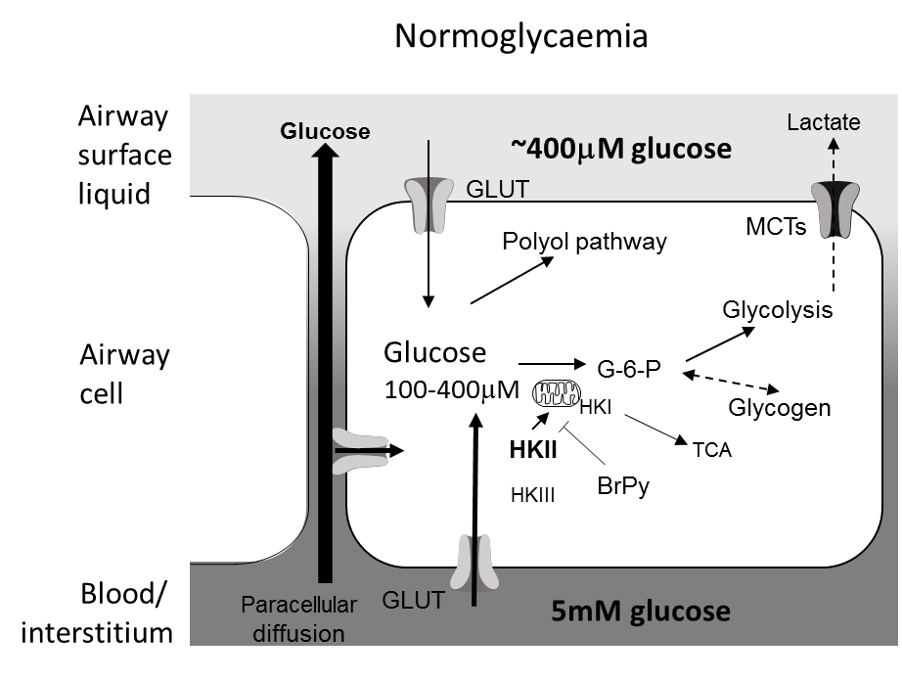
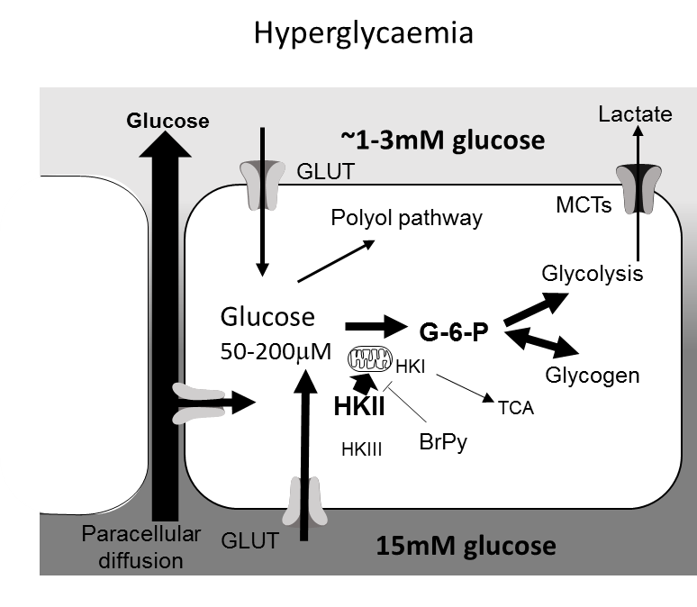
Figure 8
A
TEER
B
ASL glucose
C
D

