Slide 1
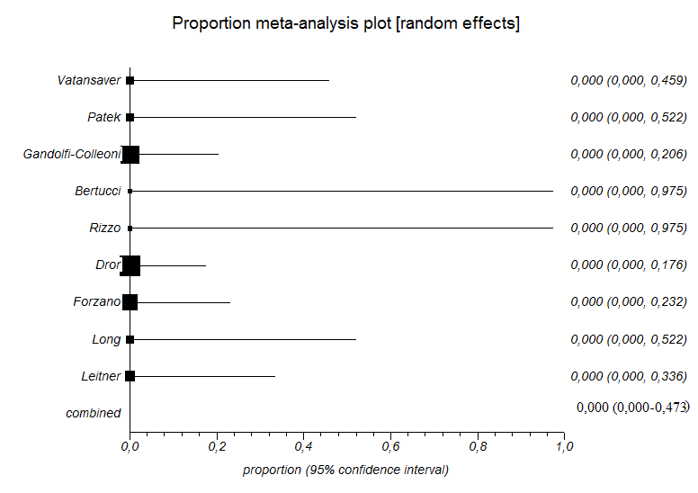
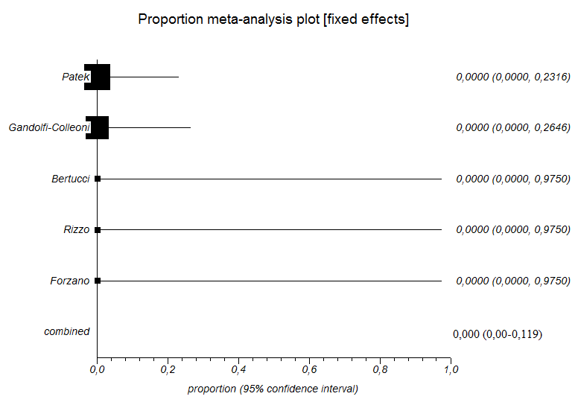
Chromosomal anomalies
Additional anomalies detected only at prenatal MRI

Slide 2
Additional CNS anomalies detected only post-natally
Additional extra-CNS anomalies detected only post-natally

Slide 3
Discrepancy between pre and post-natal diagnosis

