Slide 1
Figure 1: Hehle et al., 2015
A
Transgenic
Transient
B
Transgenic
Transient
WT
WT
1
2
3
4
5
6
250
*
*
a
150
a
b
100
b
75
c
50
d
37
e
25
f
20
15
anti-Fc
anti-κ

Slide 2
Figure 2: Hehle et al., 2015
Mr
bands
150
a
100
b
75
c
light chain
heavy chain
SDIE
EIKR
SQVQ
AKTT
50
a, b, c
d, f
a, b, c
d, f
d
37
V_{L}
C_{L}
V_{H}
C_{H}2
C_{H}3
C_{H}1
Hinge
25
f
20

Slide 3
Figure 3: Hehle et al., 2015
 |  | V_{H} |  |  |  |  |  | C_{H}1
 |  | P6 | P5 | P4 | P3 | P2 | P1 | P1’ | P2’ | P3’ | P4’ | P5’ | P6’
 |  | 108 | 109 | 110 | 111 | 112 | 113 | 114 | 115 | 116 | 117 | 118 | 119
 | Wild type | T | L | T | V | S | S | A | K | T | T | P | P
 | Guy’s13HC1 | T | L | T | V | S | T | G | K | T | T | P | P
 | Guy’s13HC2 | T | L | T | V | S | V | H | K | T | T | P | P
 | Guy’s13HC3 | T | L | T | V | T | A | A | K | T | T | P | P
 | Guy’s13HC4 | T | L | N | A | T | E | E | K | T | T | P | P
A
 | V_{L} |  |  |  |  |  | C_{L}
 | P6 | P5 | P4 | P3 | P2 | P1 | P1’ | P2’ | P3’ | P4’ | P5’ | P6’
 | 99 | 100 | 101 | 102 | 103 | 104 | 105 | 106 | 107 | 108 | 109 | 110
Wild type | G | G | G | T | K | L | E | I | K | R | A | D
Guy’s13LC1 | G | G | G | T | K | I | D | I | K | R | A | D
Guy’s13LC2 | G | G | G | T | K | S | G | I | K | R | A | D
Guy’s13LC3 | G | G | G | T | R | V | E | I | K | R | A | D
Guy’s13LC4 | G | G | T | A | E | Q | A | I | K | R | A | D
Guy’s13LC5 | G | G | G | T | S | L | E | I | K | R | A | D
Guy’s13LC6 | G | G | G | T | K | L | Q | I | K | R | A | D
Guy’s13LC7 | G | G | G | T | S | L | Q | I | K | R | A | D
Guy’s13LC8 | G | G | G | T | K | L | E | L | K | R | A | D
B

Slide 4
Figure 4: Hehle et al., 2015
HC + LC5
HC4 + LC
HC2 + LC
HC + LC8
HC + LC
HC1 + LC
HC + LC3
HC + LC1
*
150
a
b
100
c
75
d
50
e
37
25
f
20
% fully assembled antibody | 23.5 |  | 16.8 | 26 | - | 5.4 | 36.5 | 38.5 | 43.8

Slide 5
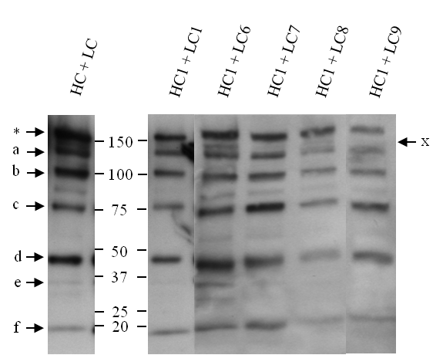
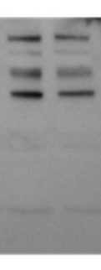
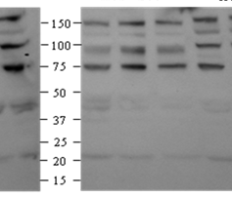
Figure 5: Hehle et al., 2015
A
HC+LC
HC1+LC1
HC1+LC5
HC1+LC6
HC1+LC7
HC1+LC8
B
HC+LC
HC+LC7
HC2+LC7
HC+LC5
HC2+LC5
HC2+LC6
HC+LC6

Slide 6
Figure 6: Hehle et al., 2015
2x increase in loading
2x increase in loading
HC + LC
250
HC2 + LC1
HC2 + LC8
*
150
100
75
50
37
25

Slide 7
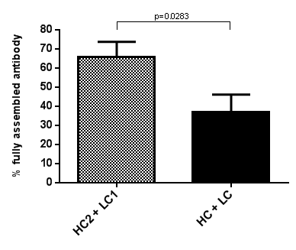
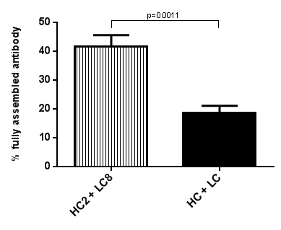
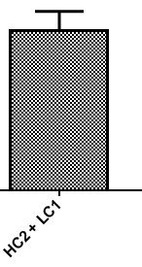
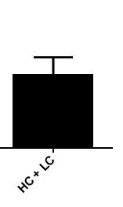
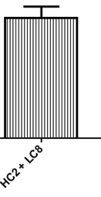
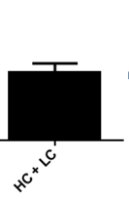
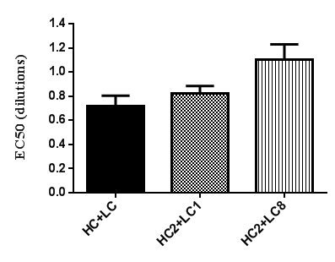
Figure 7: Hehle et al., 2015
A
*
B
**
C

