Slide 1
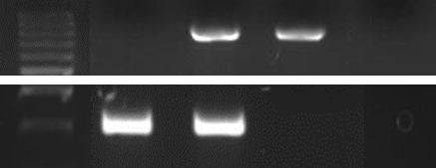
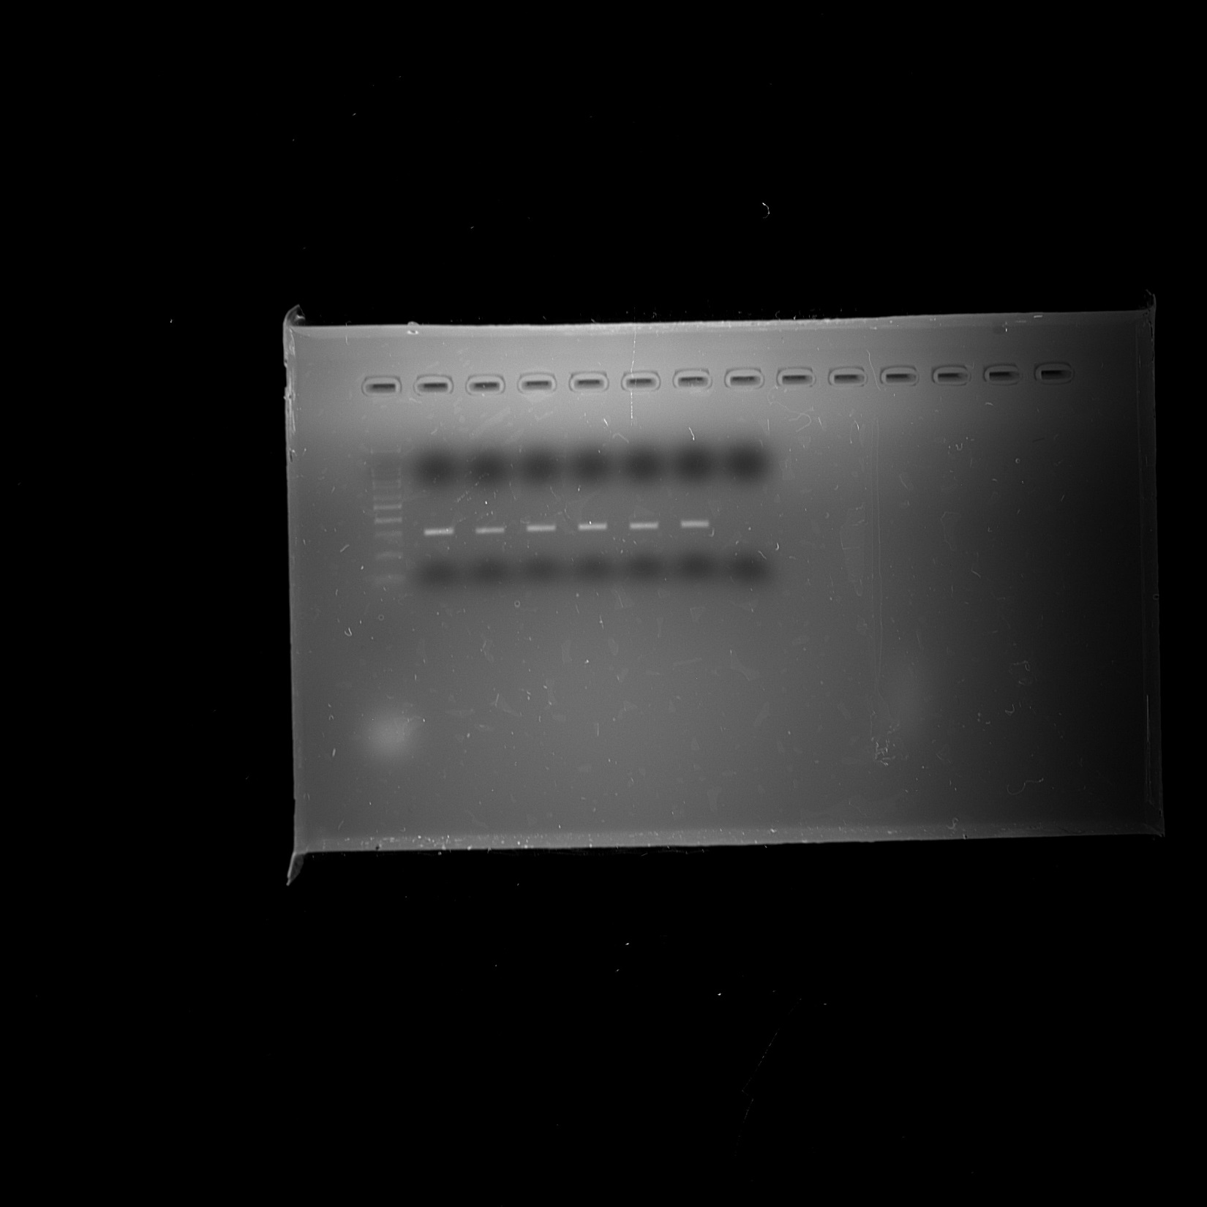
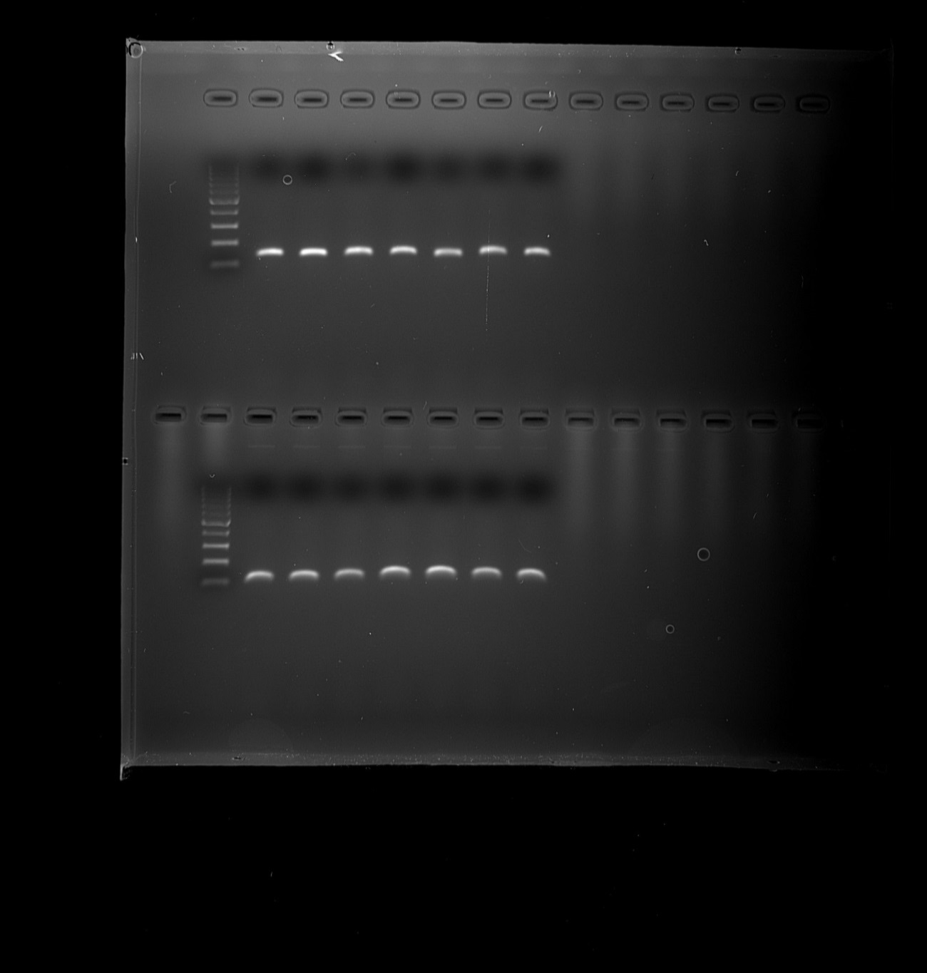
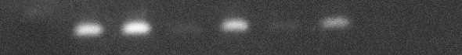

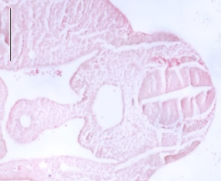
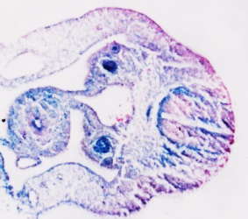
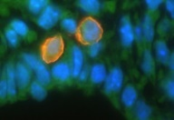
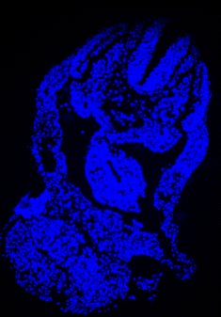
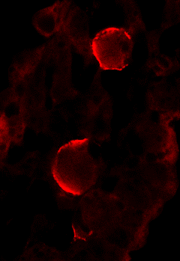
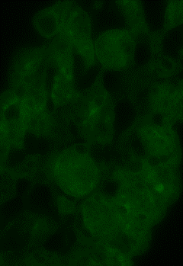
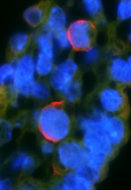
Figure S1
A
Wdr11
Stella ^{GFP}
Ladder
+/-
-/-
NC
+/+
Ladder
GFP+
GFP-
NC
KO allele (753bp)
GFP allele (307bp)
WT allele (233bp)
E10.5 UG
Epididymis
E9.5 HG
E11.5 UG
Ladder
Testes
Ovary
Kidney
B
NC
Wdr11 (131bp)
Blimp1 (209bp)
c-kit (122bp)
Steel (136bp)
Cxcr4 (132bp)
Sdf1 (101bp)
Gapdh (170bp)
C
+/+
+/-
n
HE / X-GAL
ao
nc
mt
hg
D
SSEA1
Wdr11
DAPI
Merge
E10.5
Wdr11+/+
n
mt
ao
Wdr11-/-
hg

Slide 2
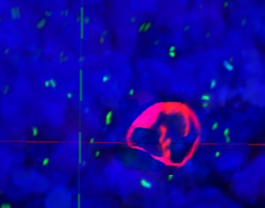
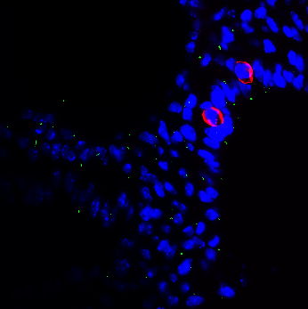
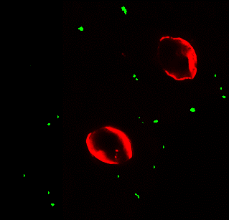
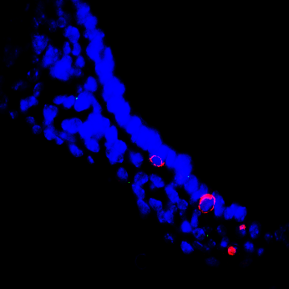
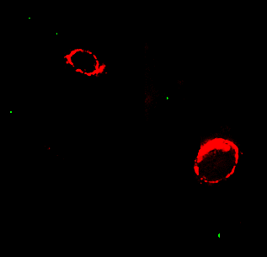
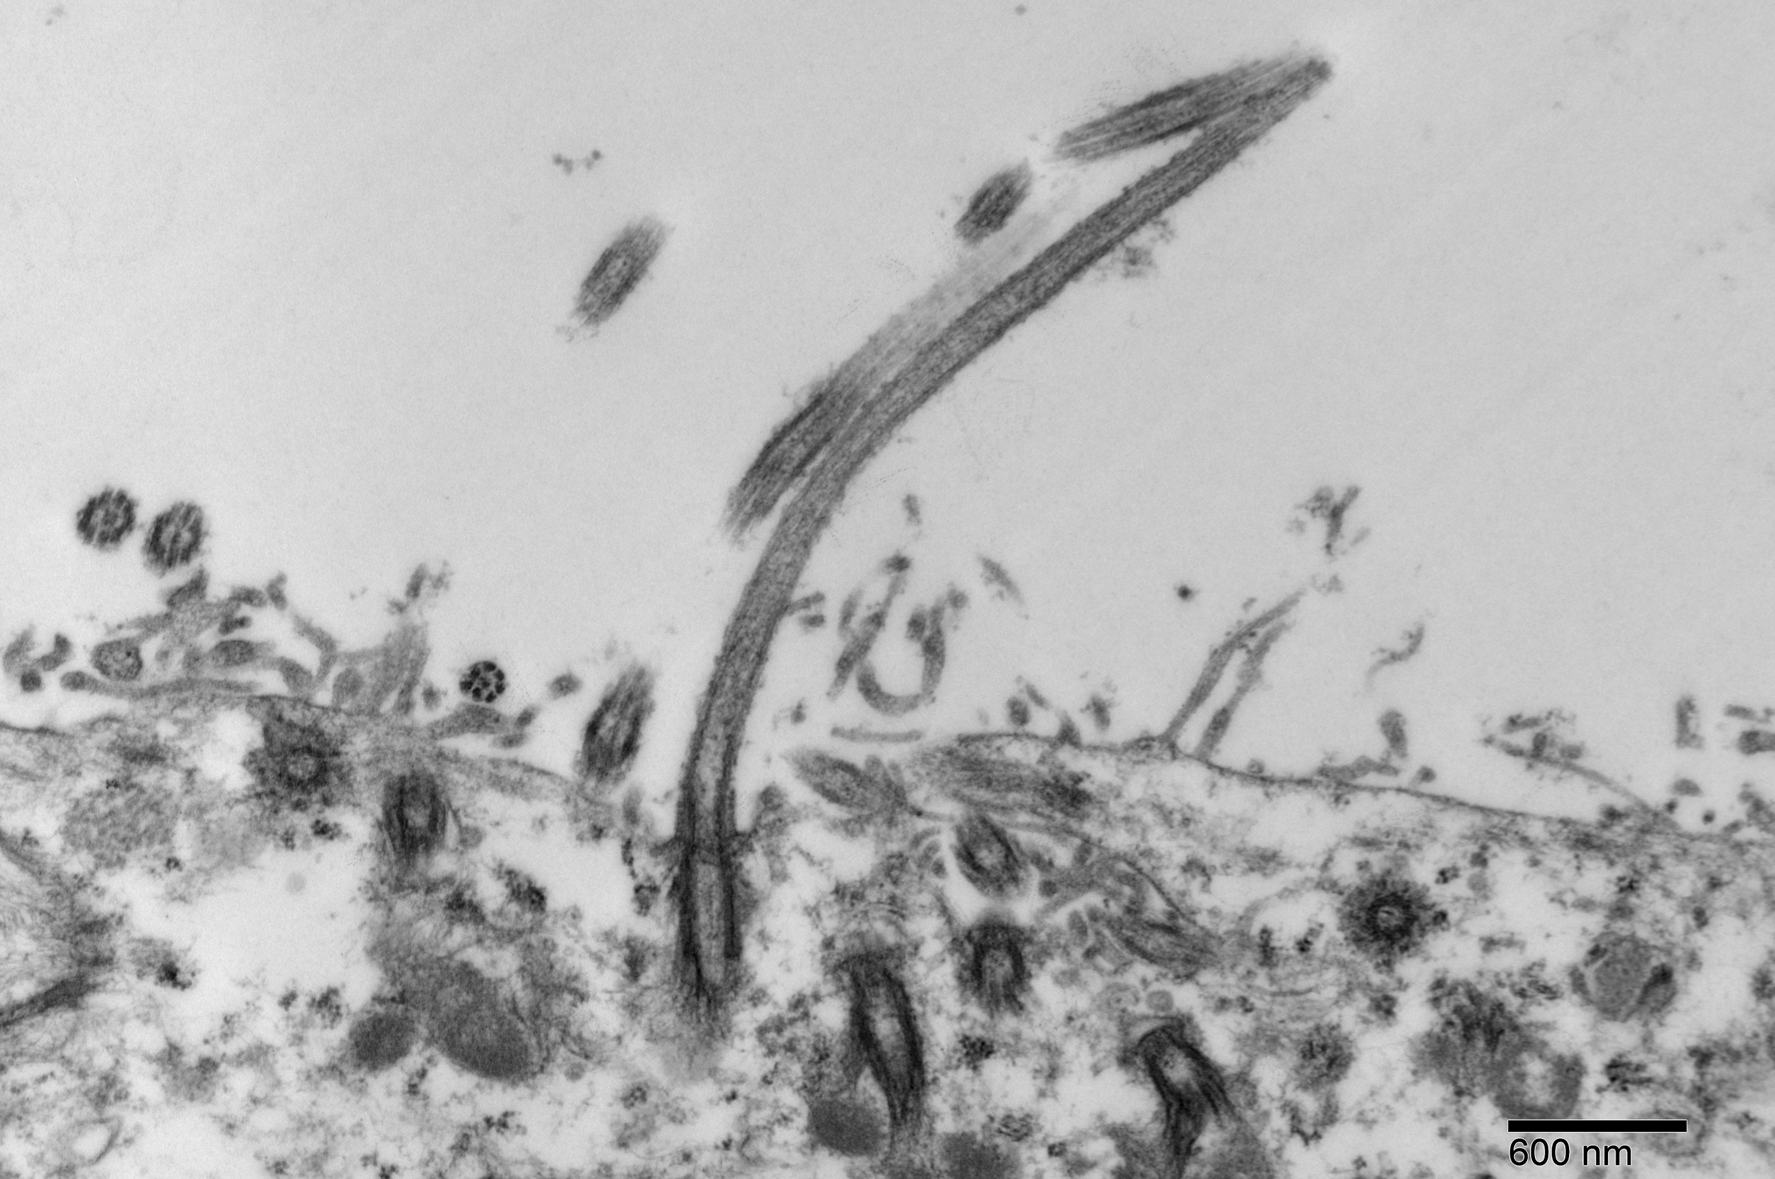
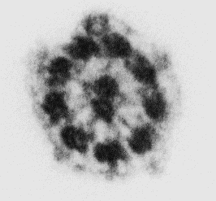
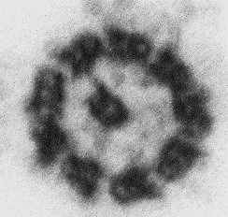
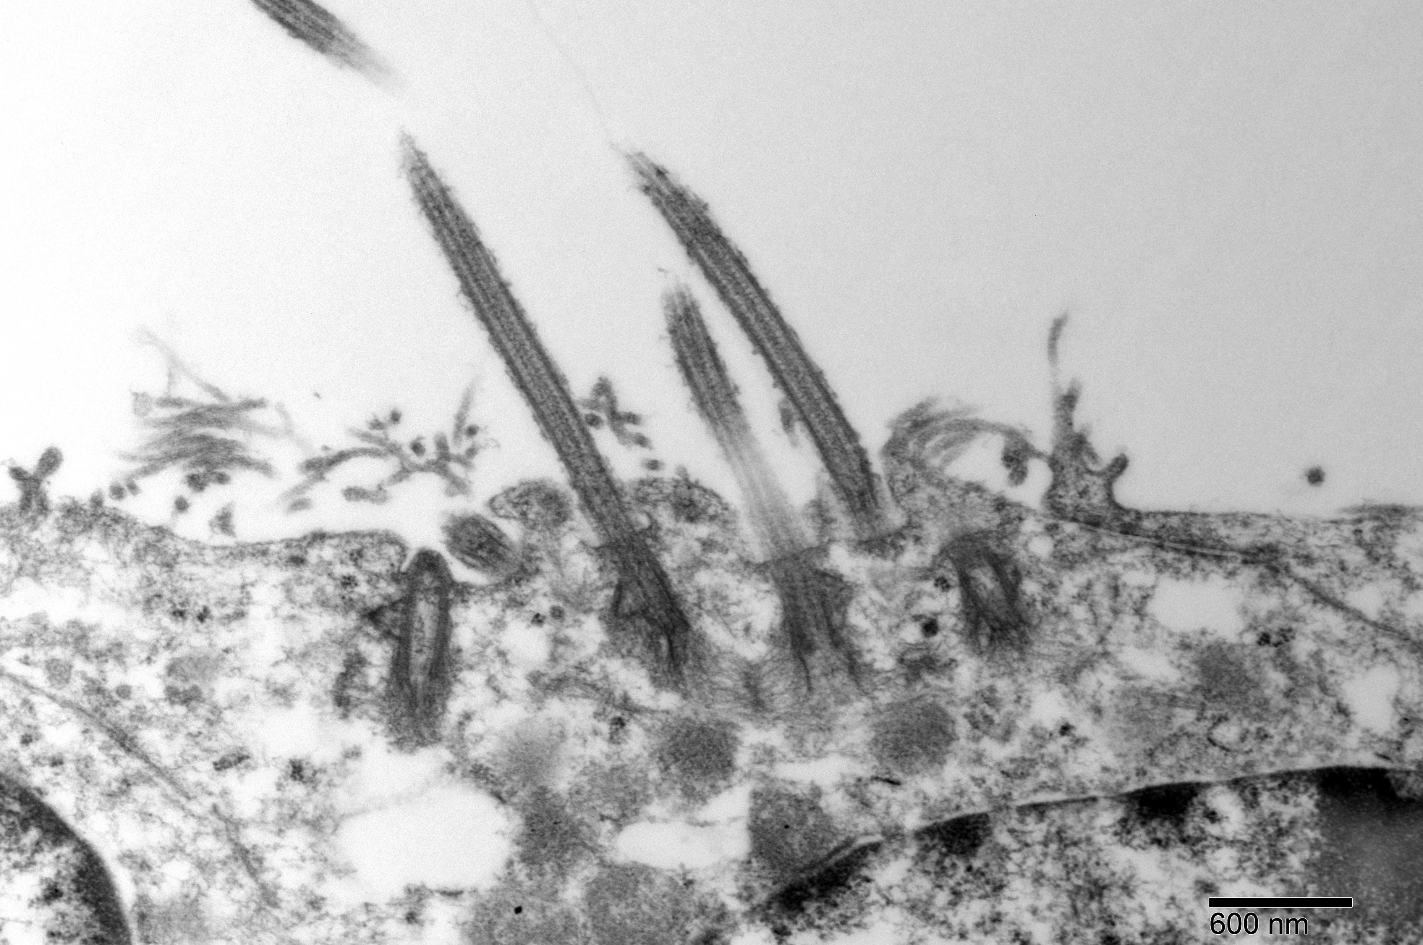
Figure S2
A
E10.5 Wdr11^{+/+}
3D reconstruction
B
ARL13B / SSEA1 / DAPI
ARL13B / SSEA1
C
Wdr11 +/+
Wdr11 -/-
D
Wdr11 +/+
Wdr11 -/-
Basal
body
Centrioles
Appendages
Appendages
Basal
body
Centrioles

Slide 3
Figure S3
A
WT
Wdr11-/-
B
****
WT
Wdr11-/-
WT Wdr11-/-

Slide 4
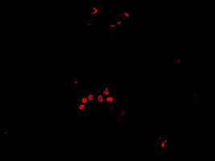
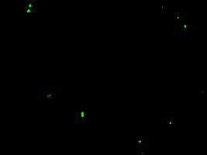
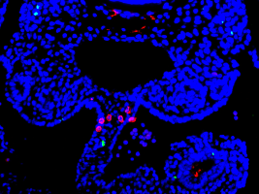
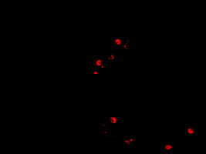
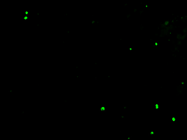
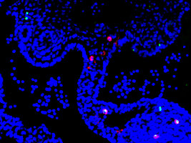
Figure S4
A
SSEA1
CASP3
SSEA1/CASP3/DAPI
A
B
C
Wdr11 +/+
a
me
hg
D
E
F
a
Wdr11 -/-
me
hg
B

Slide 5
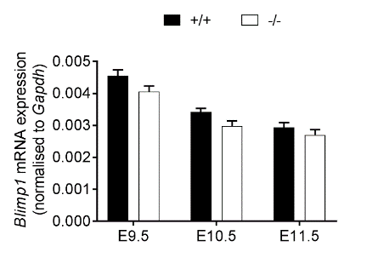

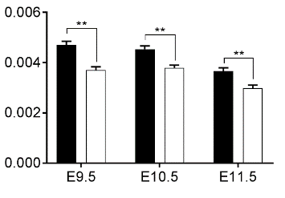
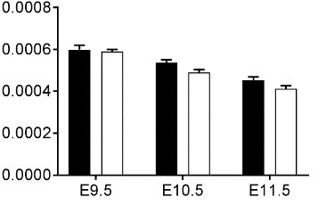
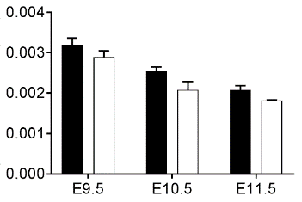
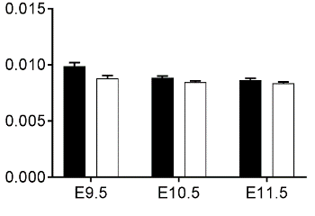
Figure S5
Blimp1
Relative expression
(normalised to Gapdh)
c-Kit
Steel
Relative expression
(normalised to Gapdh)
Cxcr4
Sdf1
Relative expression
(normalised to Gapdh)

Slide 6

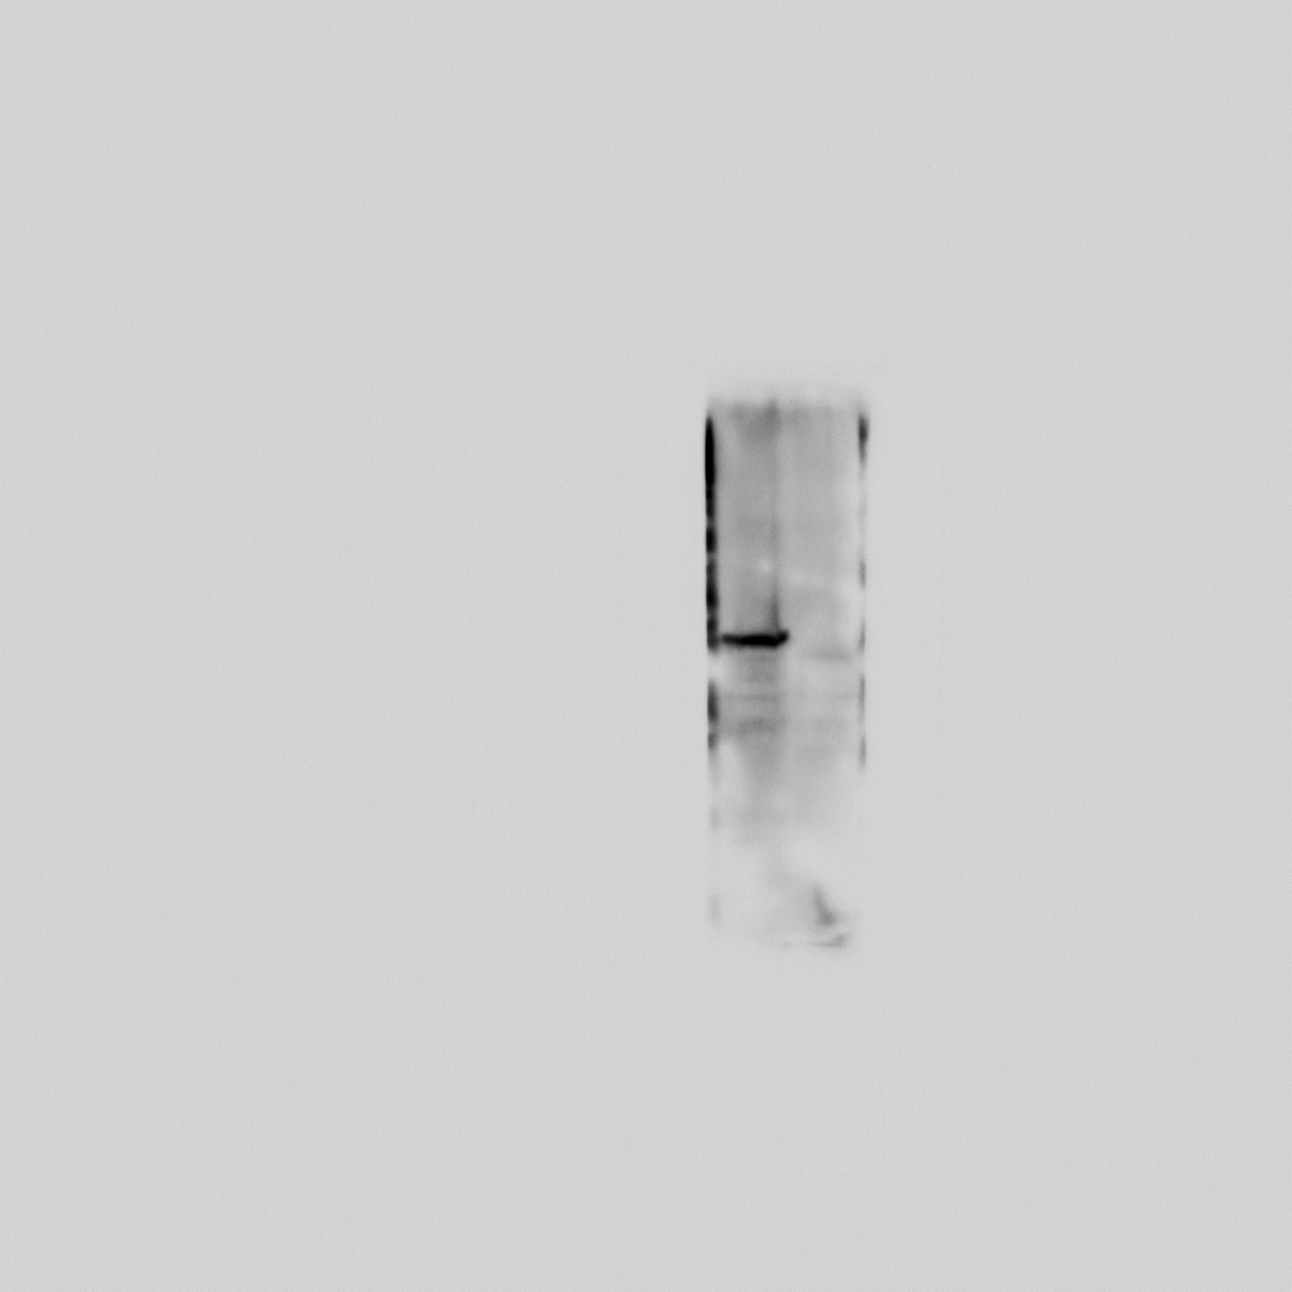
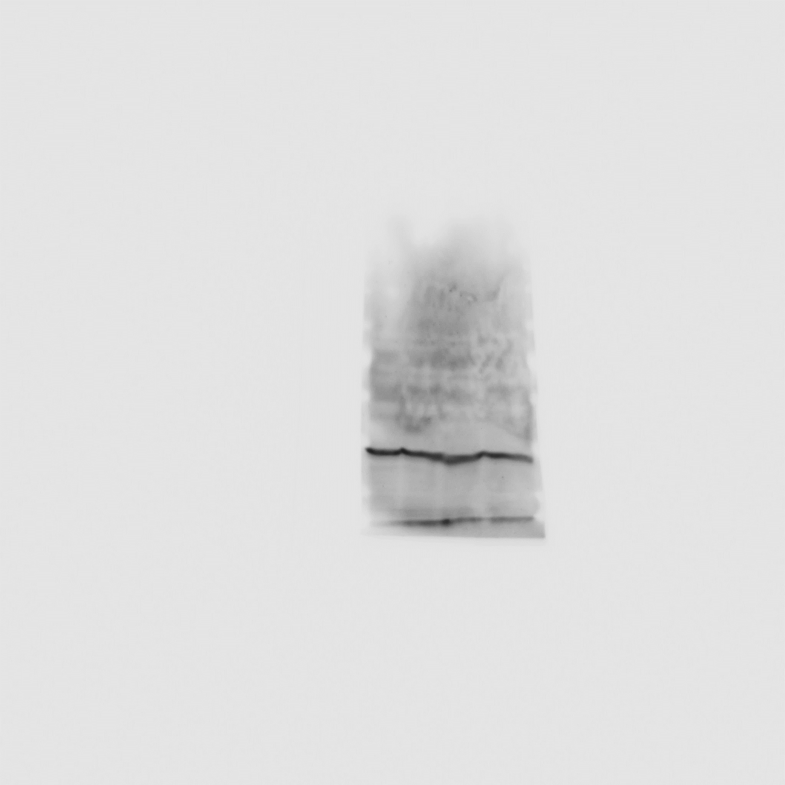

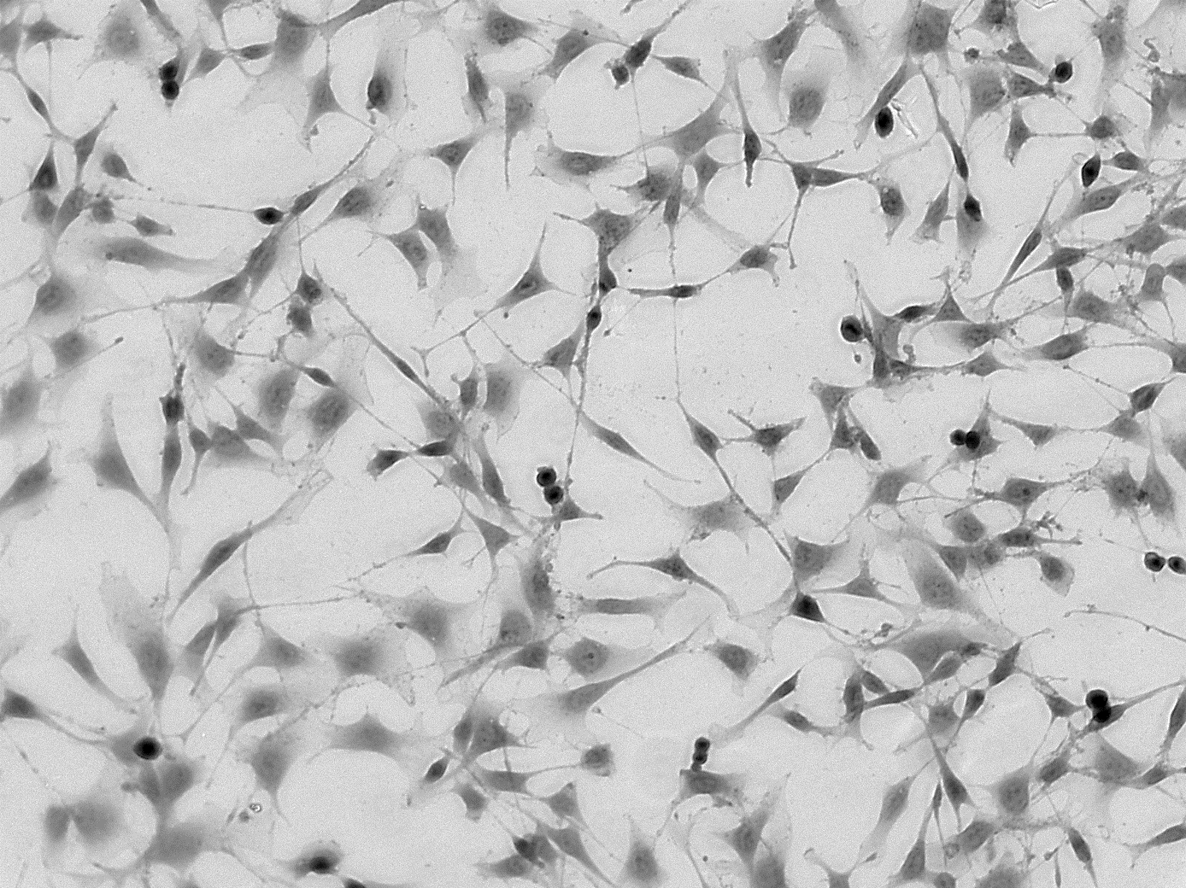
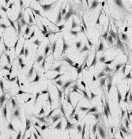
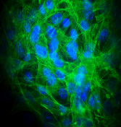
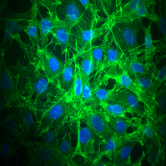
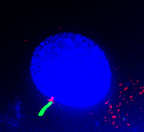
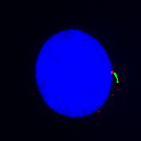
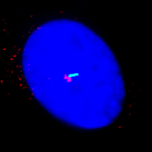
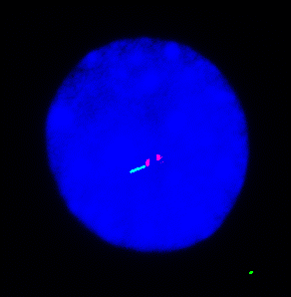
Figure S6
A
Wdr11
RC
Wdr11
MT
WT
Wdr11
KO
WT
Ift88 KO
WDR11
IFT88
b-Actin
b-Actin
B
WT
Wdr11 RC
Wdr11 MT
Wdr11 KO
Ift88 KO
Phase
contrast
F-actin
C
WT
Wdr11 RC
Wdr11 MT
Wdr11 KO
Ift88 KO

Slide 7
Figure S7
A
B
Wdr11 RC
Cell number (x10⁴)
WT
Cilia length (μm)
Wdr11 MT
Ift88 KO
Wdr11 KO
WT
Ift88 KO
Wdr11 KO
Wdr11 MT
Wdr11 RC

Slide 8
Figure S8
A
B
C
E10.5
E10.5
D
E
E10.5
Dhh expression

Slide 9
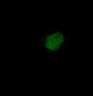
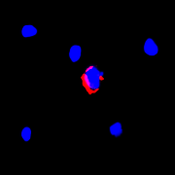
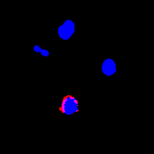
Figure S9
A
Merge
SSEA1
p-Creb
DAPI
DMF
Wdr11+/+
+Shh-N
DMF
Wdr11-/-
+Shh-N
B
Wdr11+/+ Wdr11-/- (E10.5)
DMF
+Shh-N
DMF
+Shh-N
Gli3

