Slide 1
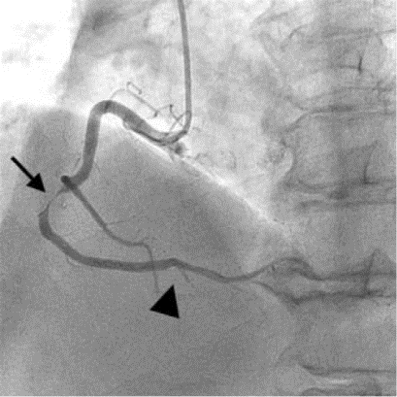
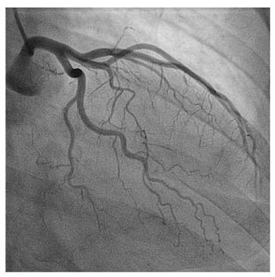
Figure 1:
Anatomic Assessment of Stable Angina
Diagnostic test e.g. CCTA
Occluded or stenotic
coronary arteries
No obstructive coronary lesions
Stents
Bypass surgery
1 in 5 patients;
mostly male
≥ 2 in 5 patients;
Small Vessel Disease
mostly female
INOCA
Obstructive
CAD
Vasospasm, l large or small a a arteries
No CAD
Specific tests not used
Diagnosis – false negative
Treatment – sub-optimal
>50% re-attend hospital
x2↑ risk CV death / MI
No CAD
Colin Berry, 06.03.2022

