Slide 1
**
A
B
**
**
# <0.35 IU/mL:
405
117
0
47
Ecuador
Kenya
AGS
Control
AGS
Control
USA
Ecuador
Kenya
USA
C
**
D
**
*
Χ² for trend, p=0.003
Ecuador
Kenya
AGS
Control
Neg
n=401
Class 1
n=58
Class 2
n=80
Class 3
n=46
Class 4+
n=9
USA
α-Gal sIgE level

Slide 2
A
B
NS
*
C
NS
*
**
**
234
171
30
87
Rural
Urban
Rural
Urban
Rural
Urban
Rural
Urban
Rural
Urban
Rural
Urban
Ecuador
Kenya
Ecuador
Kenya
Ecuador
Kenya

Slide 3
Ascaris
Trichuris
Hookworm
A
x98
r_{s} = 0.05, p=0.19
x81
r_{s} = -0.01, p=0.79
r_{s} = 0.14, p<0.001
x174
x227
x178
x181
x224
x388
x17
Eggs per gram of stool
B
C

Slide 4
A
r_{s} =0.45,
p<0.001
B
Prevalence,
Χ² for trend, p<0.001
Titers,
Kruskall-Wallis, p=0.63
0 1st 2nd 3rd 4th
IU/mL:
(0)
(0.36-0.96)
(0.96-2.9)
(2.9-7.2)
(7.2-164)
Ascaris sIgE stratified by zero and quartiles of positives

Slide 5
A
*
B
C
**
*
**
α-Gal
Casein
Ascaris
α-Gal
Casein
Ecuador
USA

Slide 7
Fig E1
A
B
NS
NS
C
NS
NS
*
NS
x163
x242
x13
x102
Wheeze
No
Wheeze
No
Wheeze
No
Wheeze
No
Wheeze
No
Wheeze
No
Ecuador
Kenya
Ecuador
Kenya
Ecuador
Kenya

Slide 8
Fig E2
A
B
C

Slide 9
A
B
Prevalence,
Χ² for trend, p<0.001
Titers,
Kruskall-Wallis, p=0.17
Fig E3
(Kenya)
r_{s} =0.56,
p<0.001
0 1st 2nd 3rd 4th
IU/mL:
(0)
(0.36-1.2)
(1.2-2.6)
(2.8-7.8)
(8.7-100)
Ascaris sIgE stratified by quartiles of positives

Slide 10
Fig E4
A
B
r_{s} =0.49
p<0.001
r_{s} =0.59,
p<0.001

Slide 11
Fig E5
A
Prevalence:
Χ² for trend, p<0.001
Titers:
Kruskall-Wallis, p<0.001
1st 2nd 3rd 4th 5th
IU/mL:
(6-127)
(128-320)
(320-732)
(735-1,519)
(1,560-20,650)
Total IgE stratified by quintile
B
Prevalence,
Χ² for trend, p<0.001
Titers,
Kruskall-Wallis, p<0.001
1st 2nd 3rd 4th 5th
IU/mL:
(6-65)
(69-220)
(221-682)
(683-1,693)
(1,725-16,180)
Total IgE stratified by quintile

Slide 13
A
**
**
**
**
**
**
Fig 1
x405
x117
x0
Ecuador
Kenya
α-Gal
syndrome
Ecuador
Kenya
α-Gal
syndrome
Ecuador
Kenya
α-Gal
syndrome
ns
ns
B
*
ns
x163
x242
x13
x102
Asthma
Asthma
Asthma
Asthma
No Asthma
No Asthma
No Asthma
No Asthma
Ecuador
Kenya
Ecuador
Kenya

Slide 14
Fig 1
**
**
A
**
**
*
**
x405
x117
x0
x47
Ecuador
Kenya
AGS
Control
AGS
Control
AGS
Control
USA
Ecuador
Kenya
Ecuador
Kenya
USA
USA
B
ns
ns
*
ns
x163
x242
x13
x102
Wheeze
No
wheeze
Wheeze
No
wheeze
Wheeze
No
wheeze
Wheeze
No
wheeze
Ecuador
Kenya
Ecuador
Kenya

Slide 15
Χ², p=0.01
Χ² for trend, p=0.17
Neg
n=401
Pos
n=193
Class 1
n=58
Class 2
n=80
Class 3
n=46
Class 4+
n=9
α-Gal sIgE status/class
Χ² for trend, p=0.003
Neg
n=401
Class 1
n=58
Class 2
n=80
Class 3
n=46
Class 4+
n=9
α-Gal sIgE level

Slide 16
Fig 2
A
*
B
C
**
**
*
**
*
**
ns
α-Gal
Casein
Ascaris
Ecuador
USA
α-Gal sIgE: neg pos neg pos
α-Gal
Casein
Ecuador
USA

Slide 17
Fig 3
ns
*
x234
x171
x30
x87
Rural
Less rural
Rural
Less rural
Ecuador
Kenya

Slide 18
A
ns
*
x234
x171
x30
x87
Rural
Less rural
Rural
Less rural
Ecuador
Kenya
B
ns
ns
*
ns
x163
x242
x13
x102
Wheeze
No
wheeze
Wheeze
No
wheeze
Wheeze
No
wheeze
Wheeze
No
wheeze
Ecuador
Kenya
Ecuador
Kenya

Slide 19
A
Ascaris
Trichuris
Hookworm
B
C

Slide 20
A
B
Toxocara
Neg
(n=351)
Toxocara
Pos
(n=165)

Slide 21
A
Ascaris
Trichuris
Hookworm
Fig 4
B
C
D
r_{s} =0.31,
p<0.001
r_{s} =0.43,
P<0.001
r_{s} =0.02,
P=079

Slide 22
Ecuador cross-sectional cohort, n=599
α-Gal sIgE prevalence and levels as relates to total IgE
Ascaris sIgE prevalence and levels as relates to total IgE
Titers across groups:
Kruskall-Wallis, p = 0.03
Titers across groups:
Kruskall-Wallis, p<0.001
1st 2nd 3rd 4th 5th
1st 2nd 3rd 4th 5th
IU/mL:
(6-127)
(128-320)
(320-732)
(735-1,519)
(1,560-20,650)
(6-127)
(320-732)
(1,560-20,650)
Total IgE stratified by quintile
(128-320)
(735-1,519)
Spearman’s r =0.75, p<0.001

Slide 23
A
B
Titers across groups:
Kruskall-Wallis, p = 0.03
Fig 5
1st 2nd 3rd 4th 5th
IU/mL:
(6-127)
(128-320)
(320-732)
(735-1,519)
(1,560-20,650)
Total IgE stratified by quintile
C
Prevalence:
Χ² for trend, p<0.001
Titers:
Kruskall-Wallis, p<0.001
1st 2nd 3rd 4th 5th
IU/mL:
(6-127)
(128-320)
(320-732)
(735-1,519)
(1,560-20,650)
Total IgE stratified by quintile

Slide 24
Prevalence,
Χ² for trend, p<0.001
Titers,
Kruskall-Wallis, p=0.01
A
B
r_{s} =0.59,
p<0.001
Supp E1
Africa
1st 2nd 3rd 4th 5th
IU/mL:
(6-65)
(69-220)
(221-682)
(683-1,693)
(1,725-16,180)
Total IgE stratified by quintile
C
Prevalence,
Χ² for trend, p<0.001
Titers,
Kruskall-Wallis, p<0.001
1st 2nd 3rd 4th 5th
IU/mL:
(6-65)
(69-220)
(221-682)
(683-1,693)
(1,725-16,180)
Total IgE stratified by quintile

Slide 25
Mann-Whitney, p=0.003
Χ² p<0.001
Mann-Whitney, p=0.14
Χ² p=0.003
#ND:
30
87
234
171
Rural
(n=131)
Urban
(n=123)
Rural
(n=376)
Urban
(n=223)
Total n:
Kenya
Ecuador

Slide 26
Supp E2
Ecuador
A
r_{s} =0.45,
p<0.001
B
Prevalence,
Χ² for trend, p<0.001
Titers,
Kruskall-Wallis, p=0.63
0 1st 2nd 3rd 4th
IU/mL:
(0)
(0.36-0.96)
(0.96-2.9)
(2.9-7.2)
(7.2-164)
Ascaris sIgE stratified by quartiles of positives
r_{s} =0.45,
p<0.001
r_{s} =0.43,
p<0.001

Slide 27
r_{s} =0.43,
p<0.001
r_{s} =0.24,
P=0.04

Slide 28
Supp E3
Kenya
A
B
Prevalence,
Χ² for trend, p<0.001
Titers,
Kruskall-Wallis, p=0.17
r_{s} =0.56,
p<0.001
0 1st 2nd 3rd 4th
IU/mL:
(0)
(0.36-1.2)
(1.2-2.6)
(2.8-7.8)
(8.7-100)
Ascaris sIgE stratified by quartiles of positives
Northern Sweden

Slide 29
Ecuador
Kenya
r_{s} =0.45,
p<0.001
r_{s} =0.56,
p<0.001
r_{s} =0.75,
p<0.001
r_{s} =0.81,
p<0.001

Slide 30
Ecuador
Kenya
r_{s} =0.75,
p<0.001
r_{s} =0.81,
p<0.001

Slide 31
A
B
Prevalence:
Χ² for trend, p<0.001
Titers:
Kruskall-Wallis, p<0.001
Prevalence:
Χ² for trend, p<0.001
Titers:
Kruskall-Wallis, p=0.57
Fig 5
1st 2nd 3rd 4th 5th
1st 2nd 3rd 4th 5th
IU/mL:
(6-127)
(128-320)
(320-732)
(735-1,519)
(1,560-20,650)
IU/mL:
(6-127)
(128-320)
(320-732)
(735-1,519)
(1,560-20,650)
Total IgE stratified by quintile
Total IgE stratified by quintile
A
B
Prevalence:
Χ² for trend, p<0.001
Titers:
Kruskall-Wallis, p=0.57
1st 2nd 3rd 4th 5th
IU/mL:
(6-127)
(128-320)
(320-732)
(735-1,519)
(1,560-20,650)
Total IgE stratified by quintile

Slide 32
Clinical and Immune Characteristics | Ecuador (n=599) | vs α-S, p | Kenya (n=254) | vs α-S, p | α-Gal Syndrome (n=31)
Age, median (range)ª | 11 (6-19) | 0.002 | 11 (8-15) | <0.001 | 13 (5-18)
Sex, male (%)^{b} | 337 (56%) | 0.11 | 130 (51%) | 0.04 | 22 (71%)
Asthma Diagnosis, n (%)^{b} | 170 (29%) | 0.76 | 19 (7%) | 0.001 | 8 (26%)
Total IgE, GM, IU/mL (95%CI)^{c} | 450 (404-502) | <.0001 | 330 (261-418) | 0.01 | 169 (120-241)
α-Gal sIgE, n>0.35 (%)^{b} | 194 (32%) | <0.001 | 137 (54%) | <0.001 | 31 (100%)
α-Gal sIgE GM, IU/mL (95%CI)^{c} | 1.8 (1.5-2.1) | <0.001 | 3.3 (2.7-4.1) | <0.001 | 9.4 (6.0-15)
% sIgE α-Gal, GM (95%CI)^{c} | 0.2 (0.1-0.2) | <0.001 | 0.4 (0.3-0.5) | <0.001 | 5.5 (3.8-8.1)

Slide 33
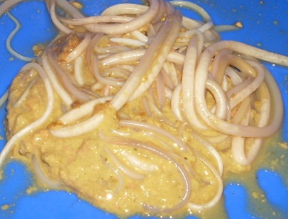
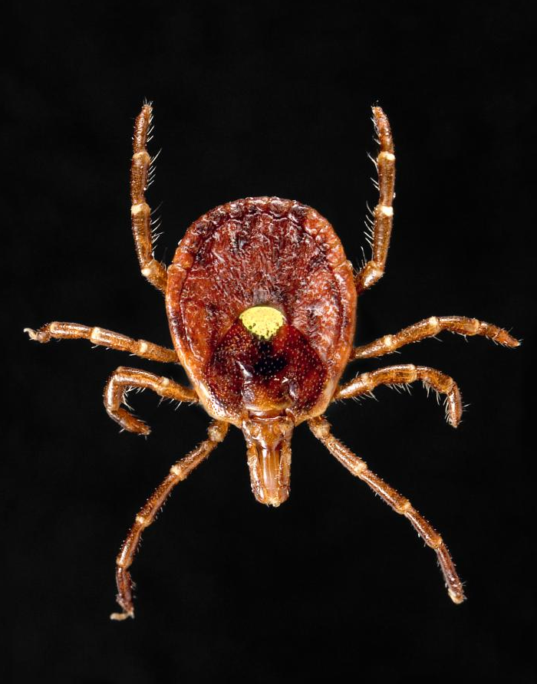
Geohelminth
Tick
Galactose
N-acetyl glucosamine
Mannose
Fucose
Xylose
“CCD”
α-Gal
“CCD”
α-Gal

Slide 34
Variable | Unadjusted OR (95%CI) | p | Adjusted OR (95%CI) | p
Total IgE >500 | 6.9 (4.6-10.2) | <0.001 | 6.6 (4.4-9.9) | <0.001
Ascaris IgE >0.7 IU/mL | 7.4 (11.8-11.3) | <0.001 | 7.0 (4.5-11.0) | <0.001

Slide 35
Characteristic | α-Gal IgE ≥ 0.35 IU/mL (n=194) | α-Gal IgE < 0.35 IU/mL (n=405) | OR | p
Age, mean (range) | 11.3 (7-19) | 11 (6-19) | na | 0.18
Sex, male | 136 (70.1%) | 201 (49.6%) | 2.4 (1.6-3.4) | <0.001
Rural | 142 (73.2%) | 234 (57.8%) | 2.0 (1.4-2.9) | <0.001
Monthly income > $250 | 33 (17.0%) | 80 (19.8%) | 0.8 (0.5-1.3) | 0.42
Asthma | 57 of 192 (29.7%) | 113 of 404 (28.1%) | 1.1 (0.7-1.6) | 0.69
Consume milk ≥ 1x per week | 156 (80.4%) | 347 (85.7%) | 0.7 (0.4-1.1) | 0.1
No milk | 4 (2.1%) | 4 (1.0%) | 2.1 (0.6-7.3) | 0.28
Consume unpasteurized milk | 75 (38.7%) | 153 (37.8%) | 1.0 (0.7-1.5) | 0.84
Cat in house | 72 of 193 (37.3%) | 155 (38.3%) | 1.0 (0.7-1.4) | 0.82
Dog in house | 147 of 193 (76.2%) | 324 (80%) | 0.8 (0.5-1.2) | 0.28
Farm animal contact | 56 of 193 (29.0%) | 68 (16.8%) | 2.0 (1.4-3.0) | <0.001
Ascaris in stool | 96 (49.5%) | 178 (44.0%) | 1.2 (0.9-1.8) | 0.2
Trichuris in stool | 113 (58.2%) | 224 (55.3%) | 1.1 (0.8-1.6) | 0.5
Hookworm in stool | 20 (10.3%) | 17 (4.2%) | 2.6 (1.4-5.2) | 0.004
Any worm in stool | 140 (72.2%) | 264 (65.2%) | 1.4 (0.96-2.0) | 0.09
Total IgE, GM (95%CI) | 1141 (975-1335) | 288 (255-326) | na | <0.001
Total IgE>500 IU/mL | 152 (78.4%) | 141 (34.8%) | 6.8 (4.6-10.1) | <0.001
Ascaris IgE ≥0.7 IU/mL | 162 (83.5%) | 165 (40.7%) | 7.4 (4.8-11.2) | <0.001
Dust mite IgE ≥0.7 IU/mL | 63 (32.5%) | 54 (13.3%) | 3.1 (2.0-4.7) | <0.001
Cockroach IgE ≥0.7 IU/mL | 68 (35.1%) | 28 (6.9%) | 7.3 (4.5-12.0) | <0.001
A. Americanum IgE≥0.35 IU/mL | 31 of 88 (35.2%) | 20 of 224 (8.9%) | 5.5 (3.0-10.2) | <0.001
Positive skin test (any allergen) | 54 (27.8%) | 71 (17.5%) | 1.8 (1.2-2.7) | 0.004

Slide 36
D
**
*
**
ns
α-Gal sIgE: neg pos neg pos
Ecuador
USA

Slide 38
Galactose
N-acetyl glucosamine
N-glycolyl neuramanic acid
Mannose
Glucose
N-acetyl galactosamine
Fucose

Slide 39
A
**
B
**
Fig 2
*
sIgE: neg pos neg pos
α-Gal
Ascaris
α-Gal sIgE: neg pos neg pos
Ecuador
USA

Slide 40
A
B

Slide 41
A
Ascaris
Trichuris
Hookworm
Fig 4
B
r_{s} =0.41,
P<0.001
r_{s} =0.43,
p<0.001
r_{s} =0.24,
P=0.04

