Slide 1


Microbiological endpoints for a
Group B Streptococcus human challenge study
Kirsty Le Doare
St. George’s, University of London
IABS meeting 7th February 2020

Slide 2

Group B Streptococcus
Streptococcus agalactiae, Group B Streptococcus (GBS). The leading cause of early onset (0-6 days, EO) and late onset (7-90 days, LO) sepsis and meningitis
5 serotypes that cause most disease are Ia, Ib, II, III, V
*Global estimate
♀♀♀♀♀
1000
18% women are colonised (11-35%)*
100/1000
50% of babies born to these mothers are colonised
2/1000
2% develop sepsis/meningitis
Russell et al CID 2017

Slide 3
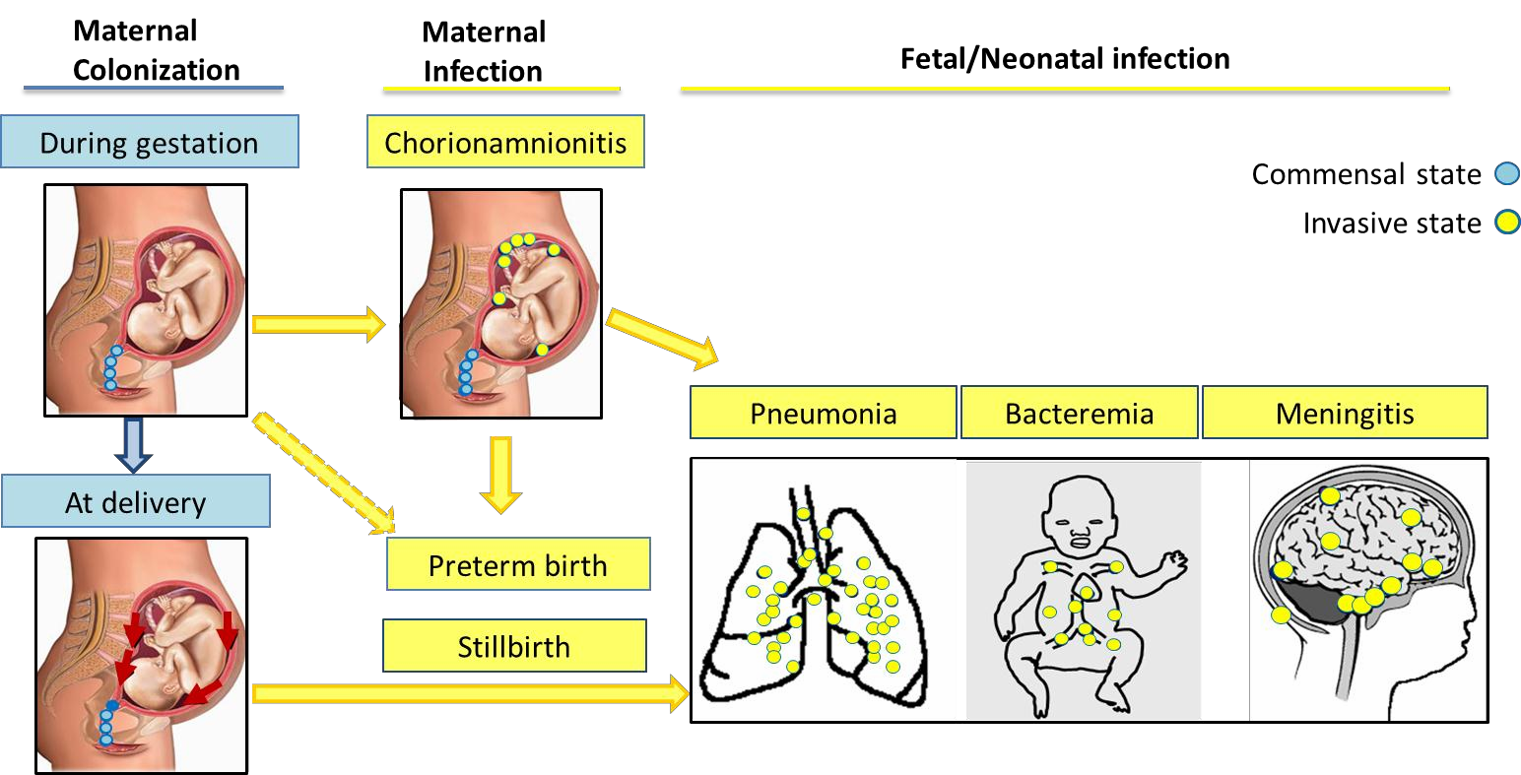
Stages of GBS maternal and neonatal infection
Adapted from: Doran & Nizet Molecular Microbiology 2004 54 (1), 23–31
Slide: courtesy S. Madhi

Slide 4
Colonisation is often transient in pregnancy.
Of 735 colonised women, only 28 (3.8%) colonised throughout pregnancy
Approx. 40% of women positive at delivery missed at 37 week screening
Goodman et al 1997

Slide 5
Women intermittently colonised had same PGFR pattern on subsequent culture
Cumulatively 50% colonised during 1 year of study (44 women)
16% colonised for >1 yr
Likely colonised at low densities
Hansen et al 2004

Slide 6
Multiple serotype carriage hampers strain selection

Slide 7
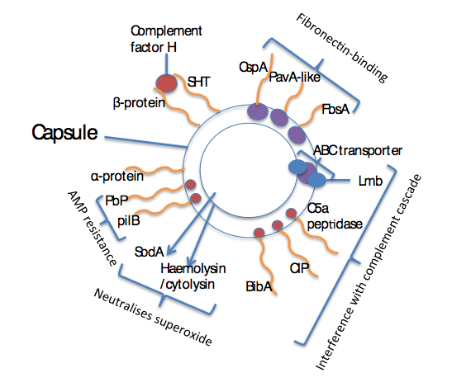
Bacterial factors allow colonisation and immune evasion
To et al 2020

Slide 8
Rib and alpha-C Proteins modulate invasion of the vaginal epithelium
No studies yet

Slide 9
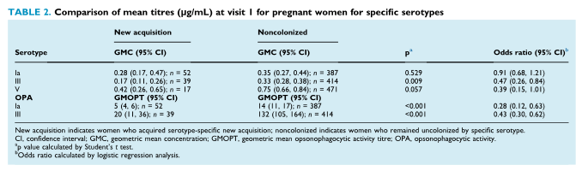
Higher functional antibody concentrations associated with absent carriage in South Africa
Kwatra et al 2015

Slide 10
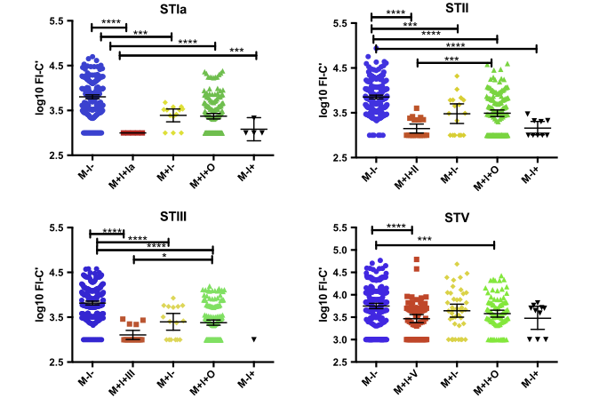
Opsonising antibodies are higher in non-colonised mother-infant pairs in the Gambia
This figure shows specific FI-C’ antibodies bound to complement in non-colonised (blue), mother and infant colonised with homologous ST (red), mother colonised only with homologous ST (yellow) and heterologous ST (green)
Le Doare et al 2017

Slide 11
High levels of pre-existing IgG in UK women aged 18-40 years
PHE, unpublished

Slide 12
Protective efficacy of colonisation in a GBS HIC study
Immunological and protective role of GBS colonisation is unknown, but colonisation in pregnancy is associated with increased disease risk.
A challenge model evaluating the immunising effect of experimental GBS carriage in non-pregnant women
First step towards reducing GBS associated preterm and stillbirth
and early onset disease

Slide 13
Challenges on the road to a GBS HIC model
The relative contribution of anti-capsular vs. anti-protein responses in protection against carriage
The correlation between mucosal and systemic immunity
The differences in relative contribution of serotypes to colonisation and immunity is not known
Identification of most sensitive method of detection of carriage

Slide 14

Thanks
John Tregoning
Tom Hall
Suzy Lim
Bengt Lindbom

