Slide 1
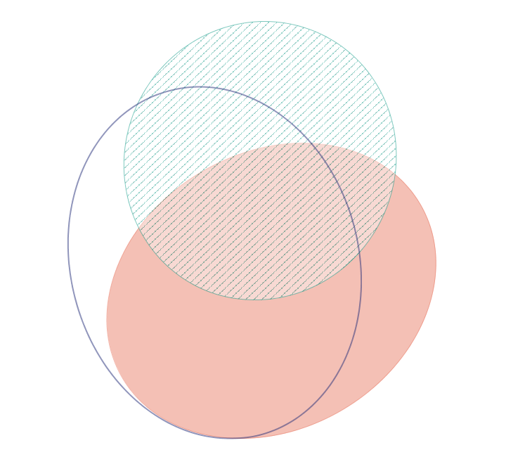
Long-term use
15.6%
11.1%
3.4%
Flarer
21.0%
8.8%
>1 course
11.6%
28.4%

Slide 2
Excess breakdown - 2017
(49.3%)
(50.7%)
Other indication
Total
(n=1,131)
Unavoidable
Probably avoidable
Avoidable
Avoidable excess in at least 6.2% of total cohort
CD
(n=524)
UC
(n=575)
Percent
Avoidable exposure in UC vs CD P=NS
1. T Raine unpublished data
Notes:
Grey bars on right are where weren’t able to identify/agree even after double checking due to eg unable to trace notes. Last time round we just removed these from the calucluations (i.e. just stated how many / % we were able to trace). Suggest we do same this time.
In slight hurry – I hope these data are correct – please remind me to double check them since we did do some further data cleansing (when you and I reviewed the notes together) and I can’t recall if these were pre- or post- cleansing data – just highlight all % in the text for now and I will double check!
As per 2015 data, I also have these for mod/severe cohorts only if you think it’s interesting?

