Slide 1
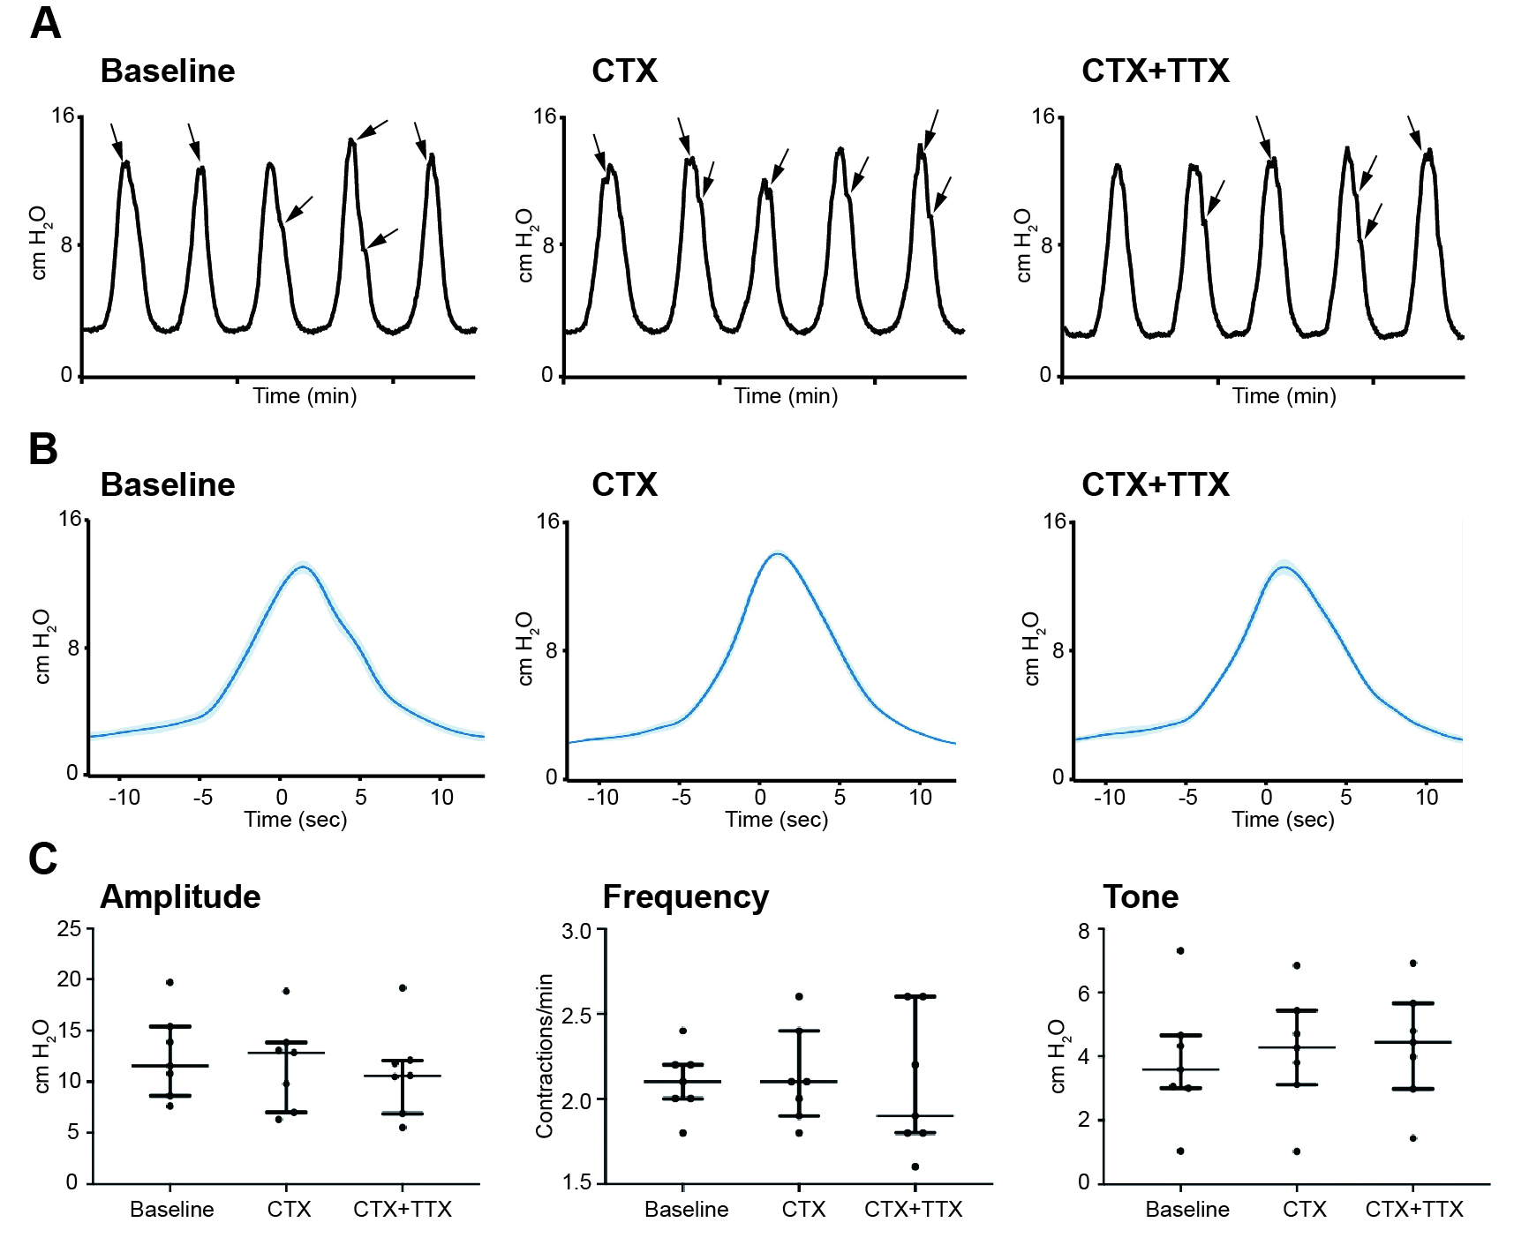
Supplementary Figure 1.

Slide 2
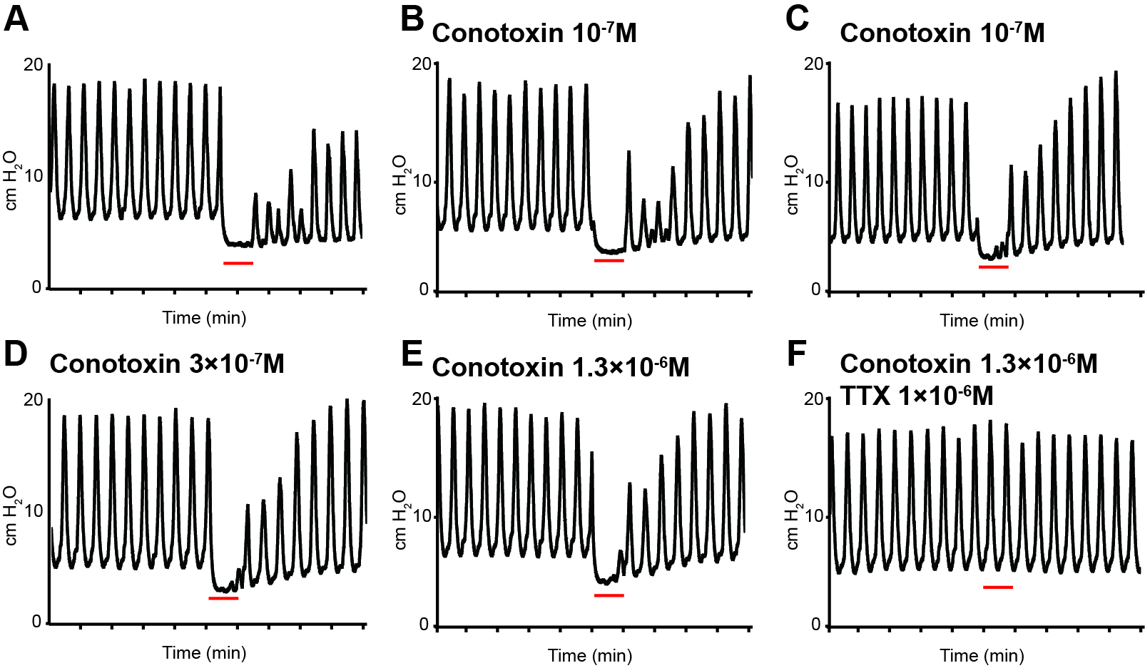
Supplementary Figure 2.

Slide 3
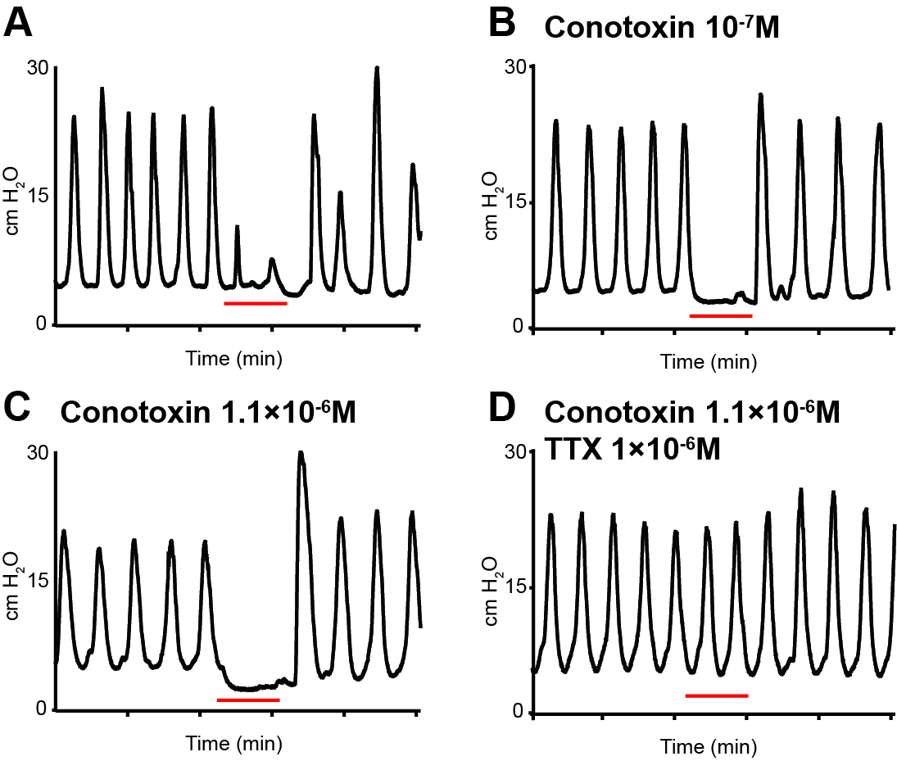
Supplementary Figure 3

