Slide 1
Supplemental digital content 1: Overview of women with LAM avulsion
Patient | Mode of delivery (1st) | LAM condition 3 months FU | LAM condition 1 year FU | Mode of delivery (2nd) | LAM condition 4 year FU | Conclusion LAM condition 4 year FU
One vaginal delivery
026 | Forceps | Major | - | x | Major | Persistent
049 | Forceps | - | Major | x | Major | Persistent
170 | Forceps | Major | Major | x | Major | Persistent
241 | Forceps | Major | Major | x | Major | Persistent
209 | Ventouse | - | - | x | Minor | Persistent
062 | SVD | Major | Intact | x | Intact | Non-persistent
110 | Ventouse | Major | - | x | Intact | Non-persistent
236 | Forceps | Major | Intact | x | Intact | Non-persistent
198 | SVD | Minor | Intact | x | Intact | Non-persistent
001 | Ventouse | Major | Major | ElCS | Major | Persistent
127 | SVD | Major | Intact | ElCS | Major | Persistent
263 | SVD | Minor | Minor | ElCS | Intact | Non-persistent
Two vaginal deliveries
074 | Forceps | Major | Major | SVD | Major | Persistent
107 | Forceps | Major | Major | SVD | Major | Persistent
007 | SVD | Major | Intact | SVD | Minor | Re-occurrence
043 | Ventouse | Major | Intact | SVD | Major | Re-occurrence
045 | SVD | Major | Intact | SVD | Intact | Non-persistent
051 | SVD | Major | Intact | SVD + SVD | Intact | Non-persistent
133 | SVD | Major | Intact | SVD | Intact | Non-persistent
105 | SVD | Minor | - | SVD | Major | Persistent
195 | SVD | Minor | Intact | SVD | Major | Re-occurrence
005 | Forceps | - | - | SVD | Major | Unknown
Other
163 | CS | Intact | Intact | Ventouse | Major | NEW
DNA 4 years
039 | V&F | Major | - | ? | - | -
076 | SVD | Minor | Intact | ? | - | -
103 | Forceps | Major | Minor | ? | - | -
109 | Forceps | Major | - | ? | - | -
136 | V&F | Major | Major | ? | - | -
164 | Forceps | Minor | Intact | ? | - | -
188 | Ventouse | Major | Intact | ? | - | -
206 | SVD | Major | - | ? | - | -
212 | SVD | Minor | - | ? | - | -
260 | SVD | Major | - | ? | - | -
262 | SVD | Major | - | ? | - | -
SVD: spontaneaus vaginal delivery; FU: follow-up; V&F: ventouse and forceps

Slide 2
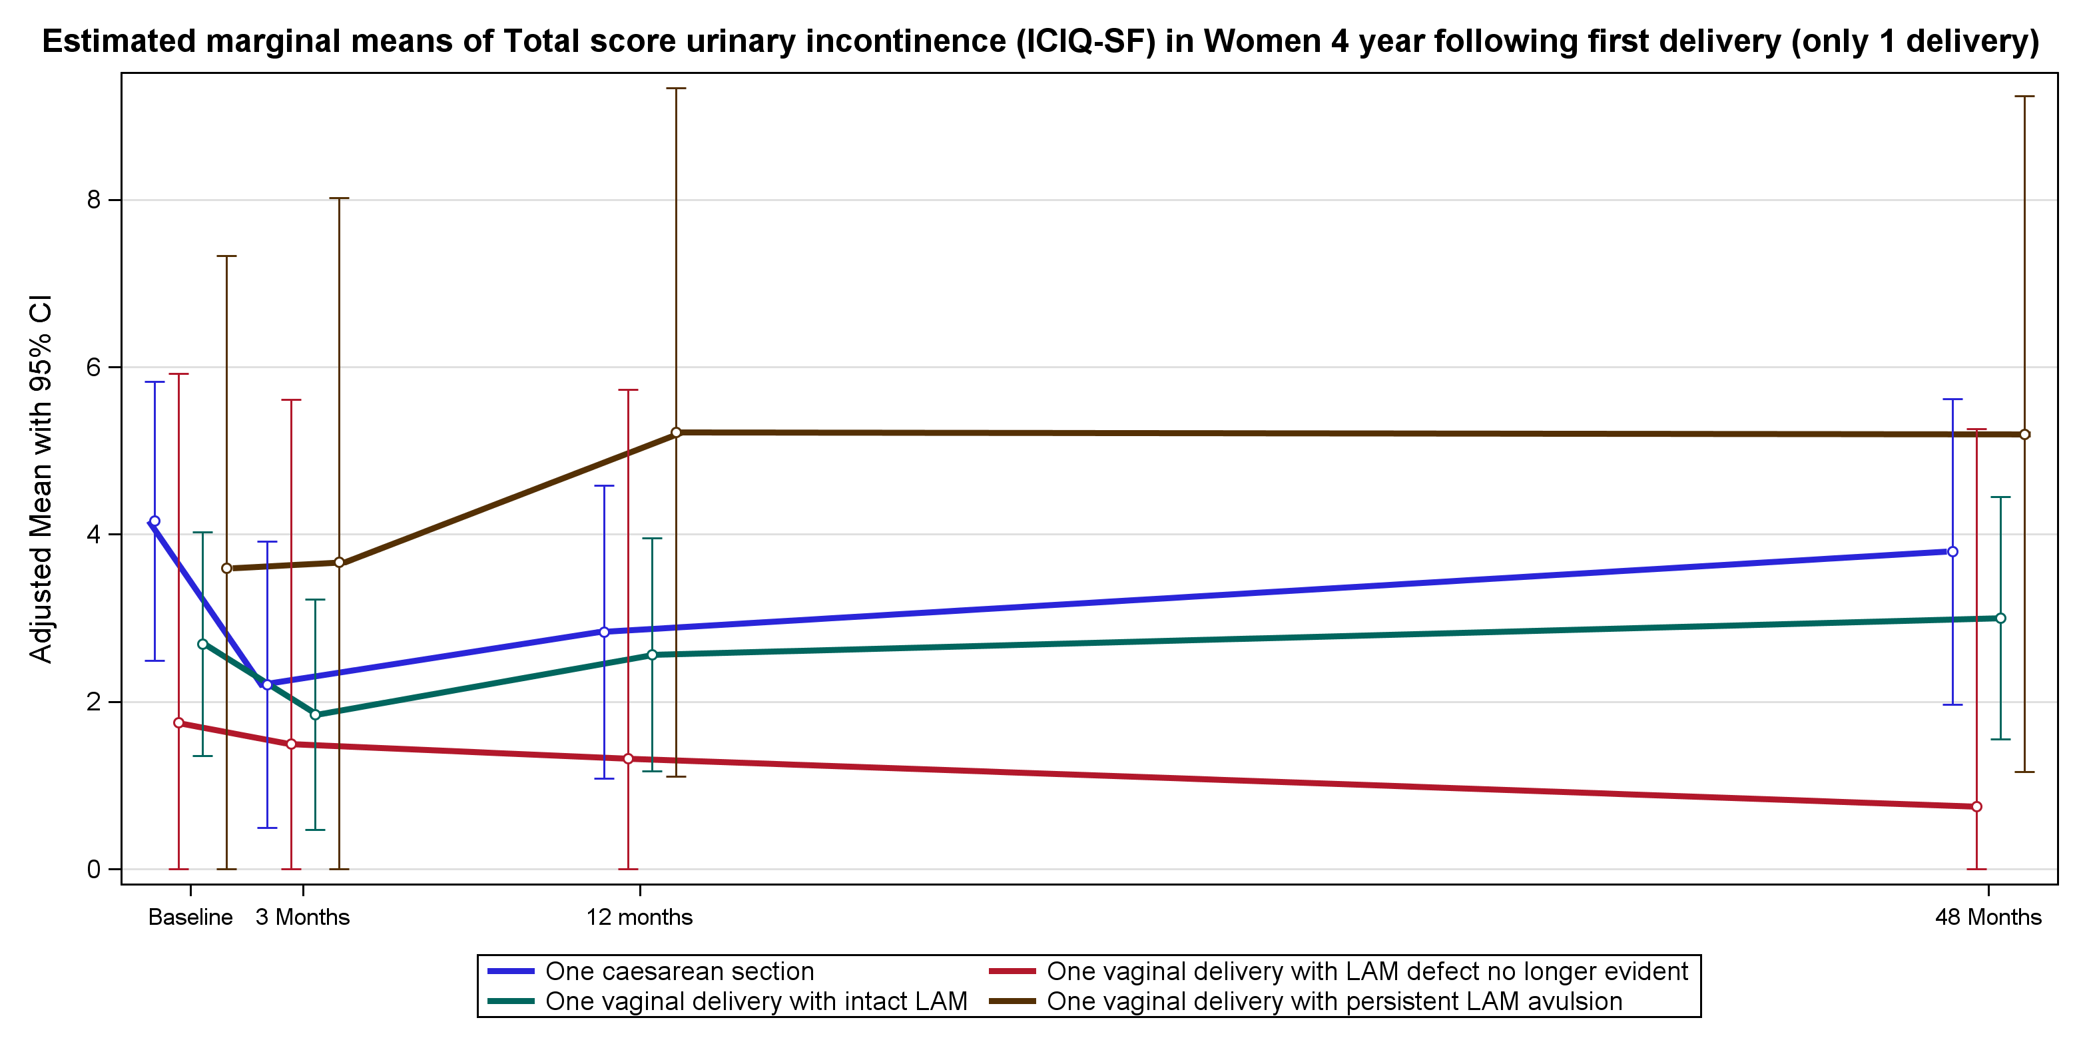
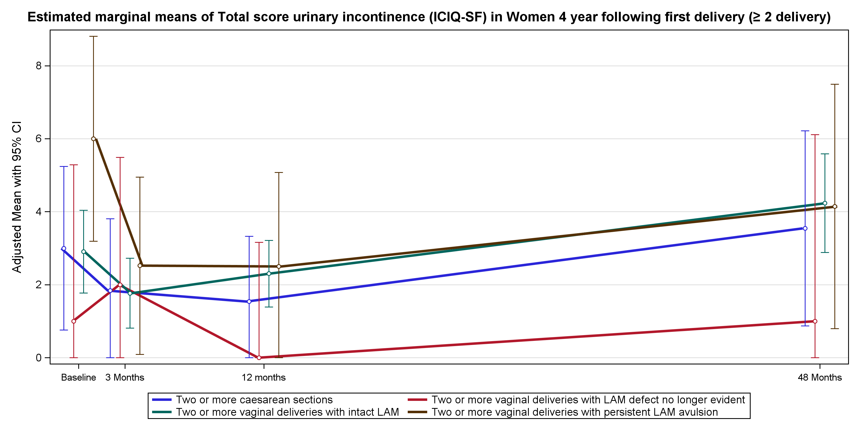
Supplemental digital content 2: Graphs of symptoms and signs of PFD four years after delivery in women with either one or two or more deliveries
A Urinary incontinence

Slide 3
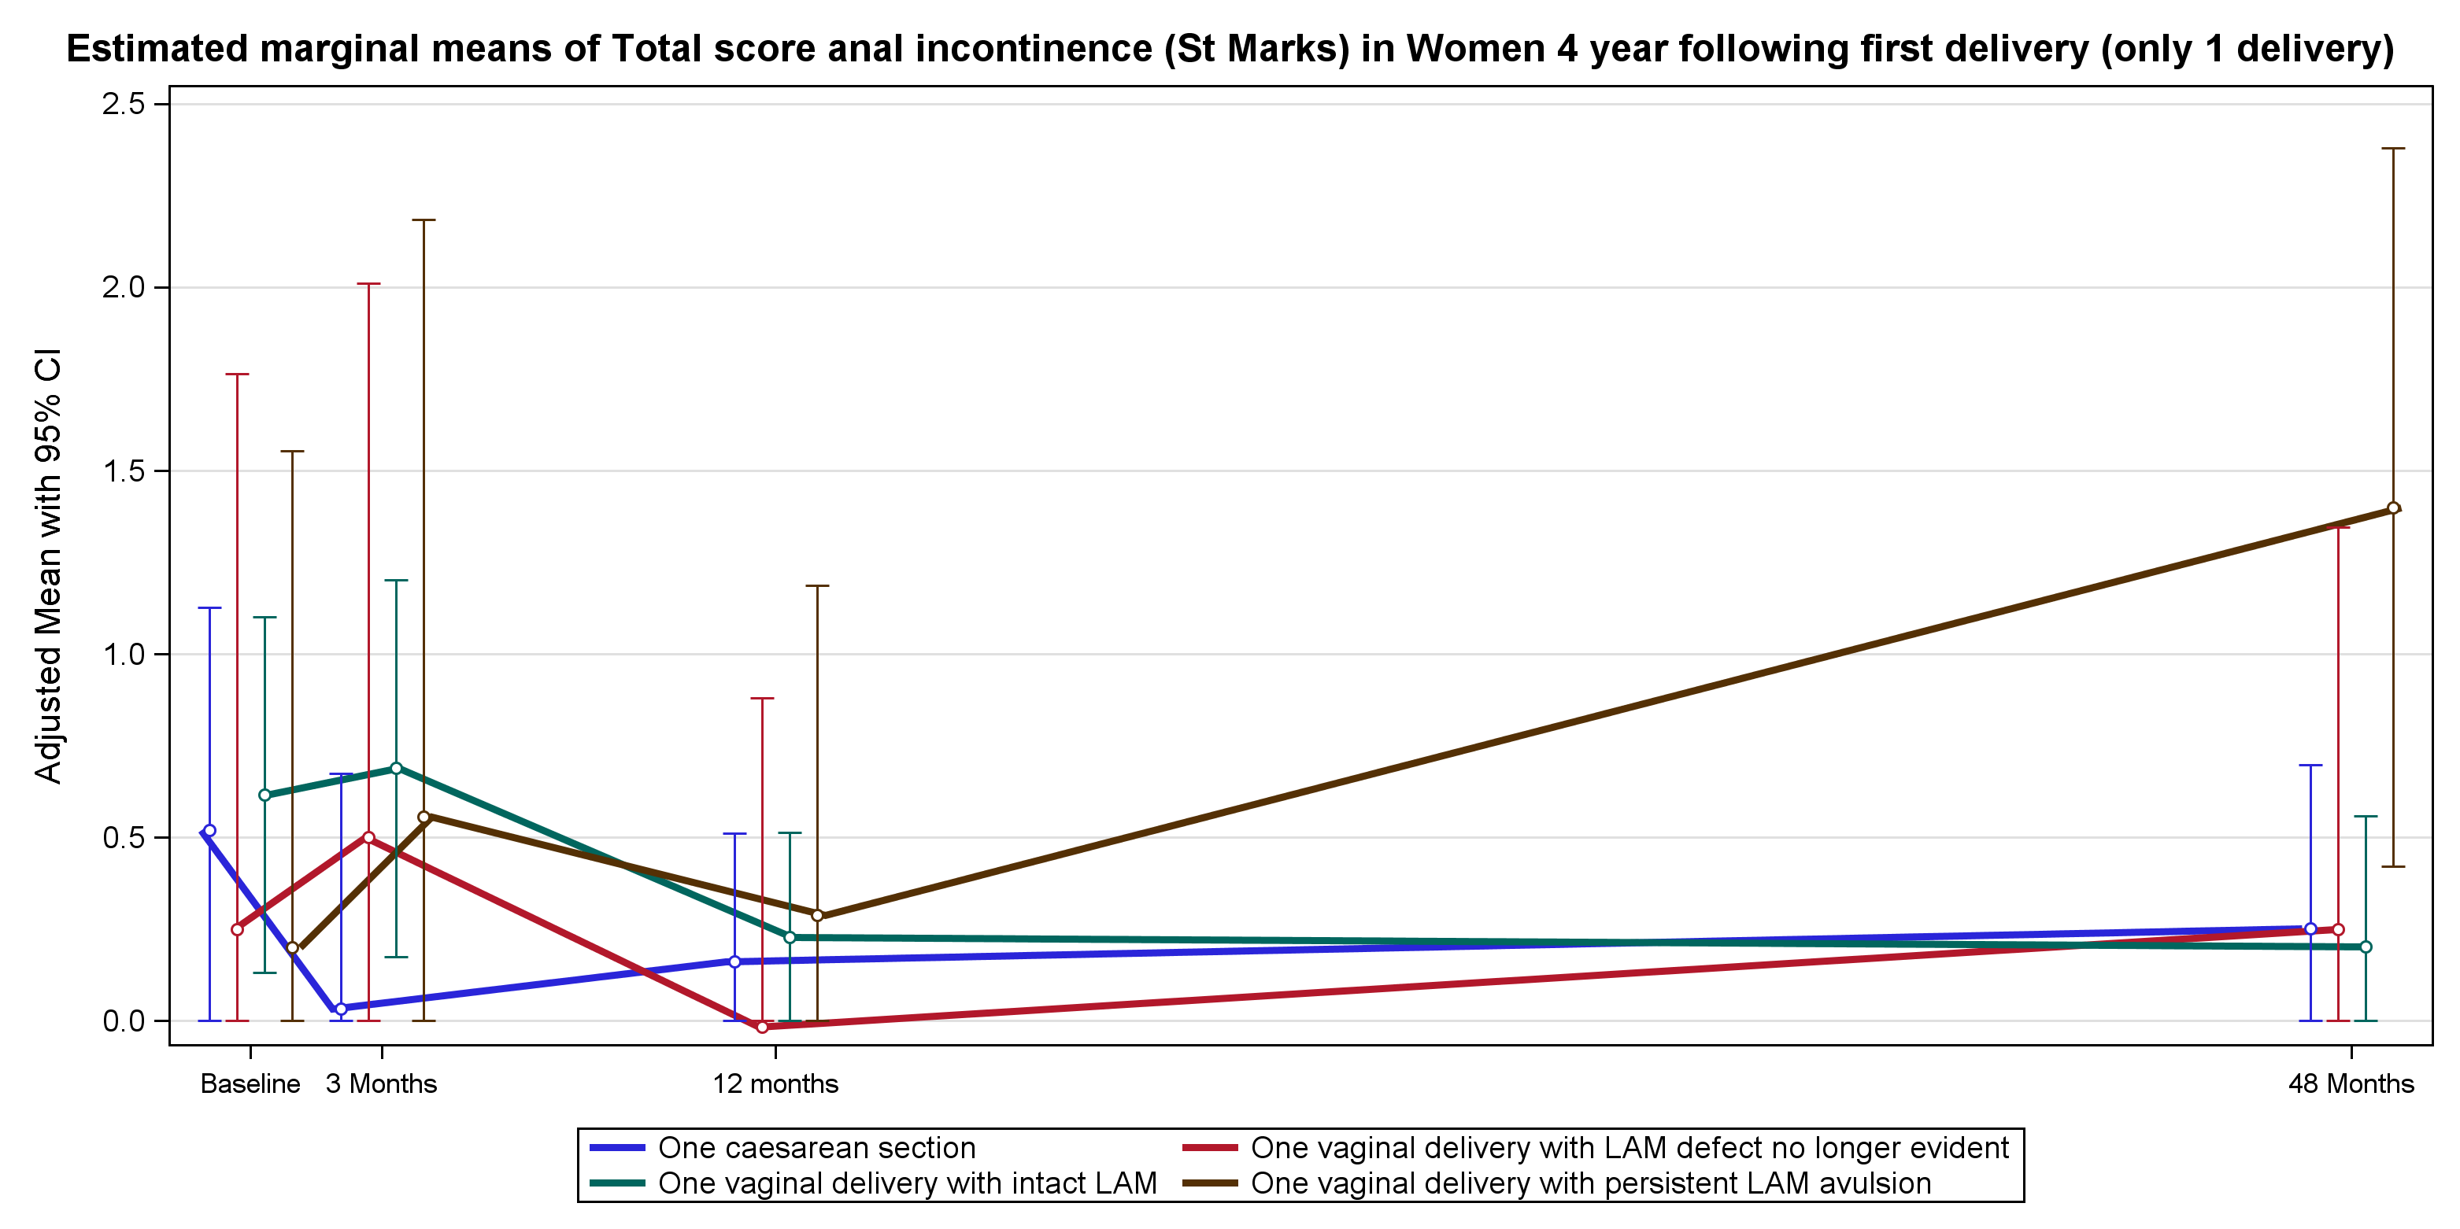
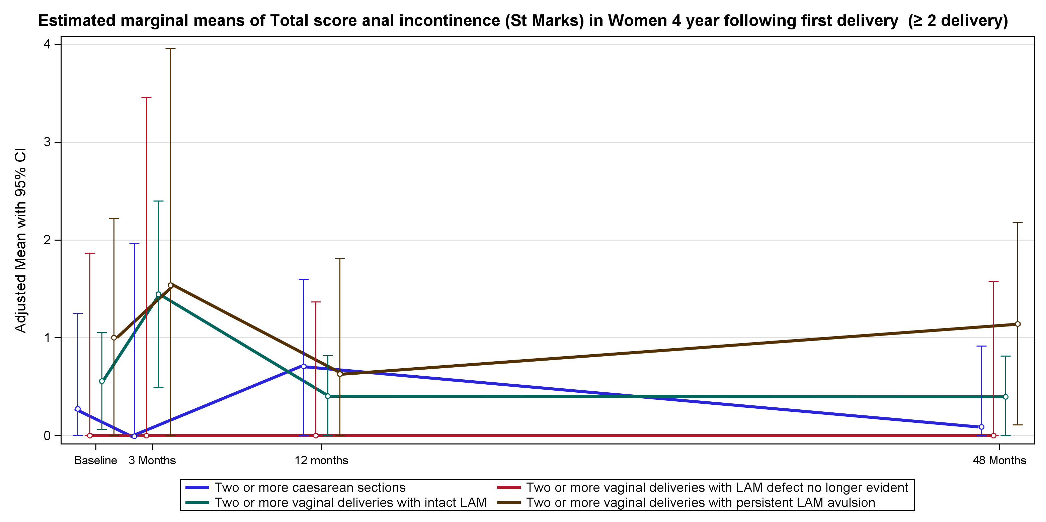
B Faecal incontinence

Slide 4
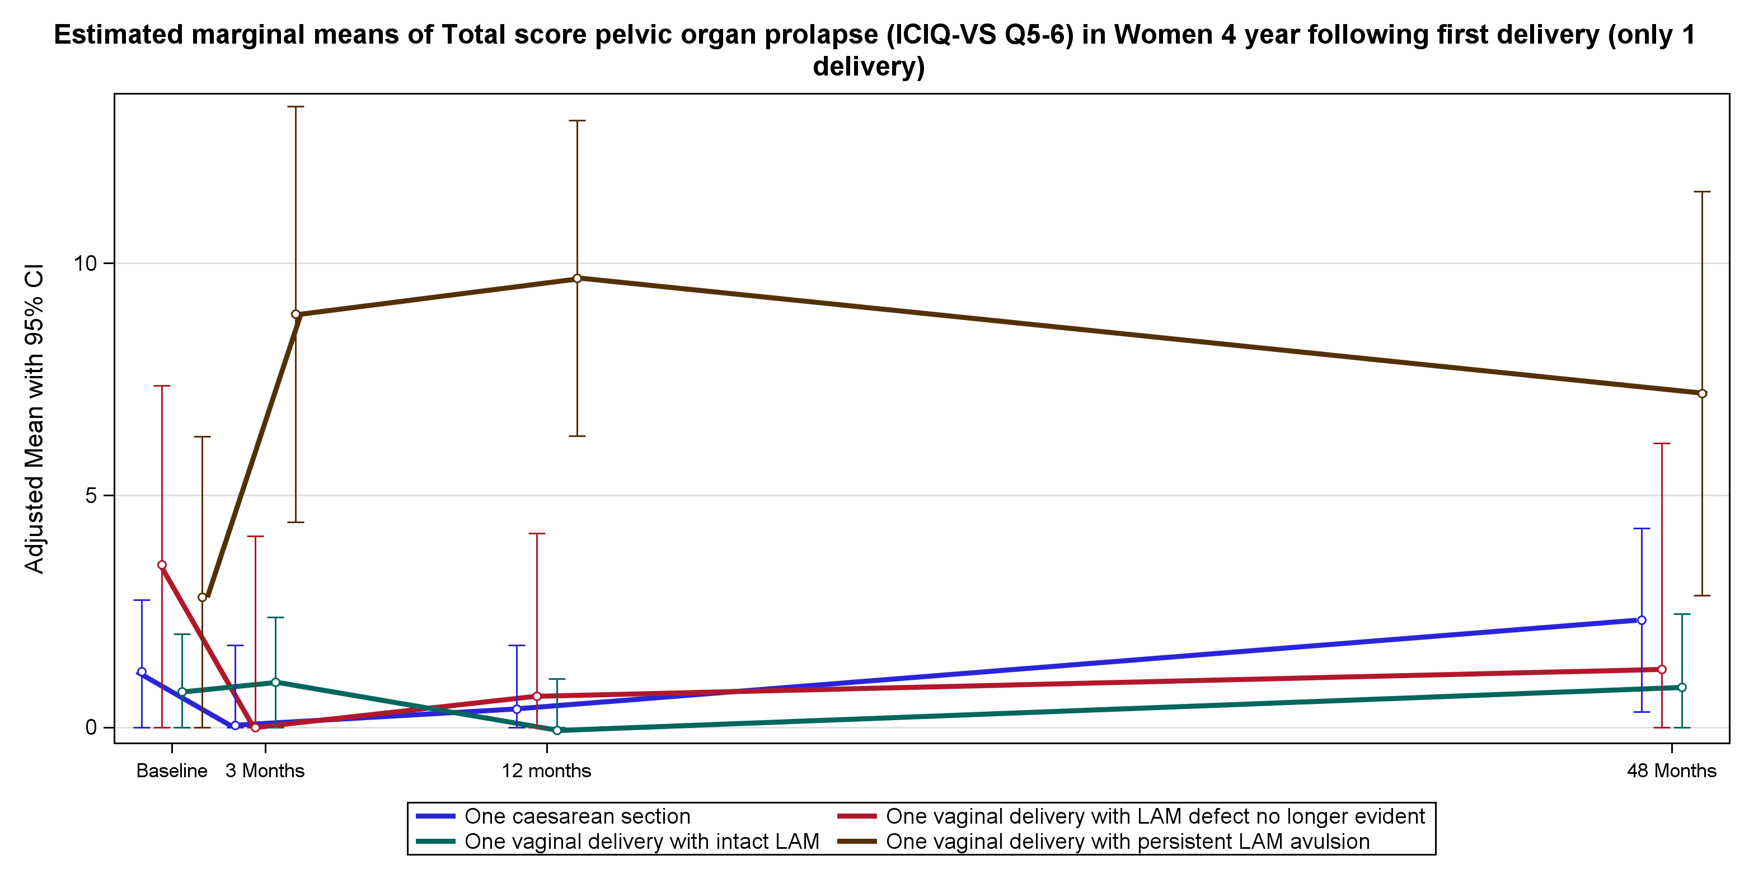
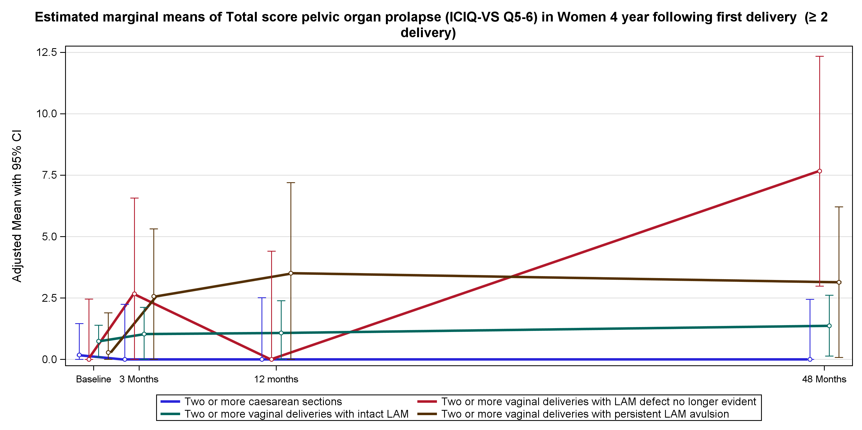
C Pelvic organ prolapse symptoms

Slide 5
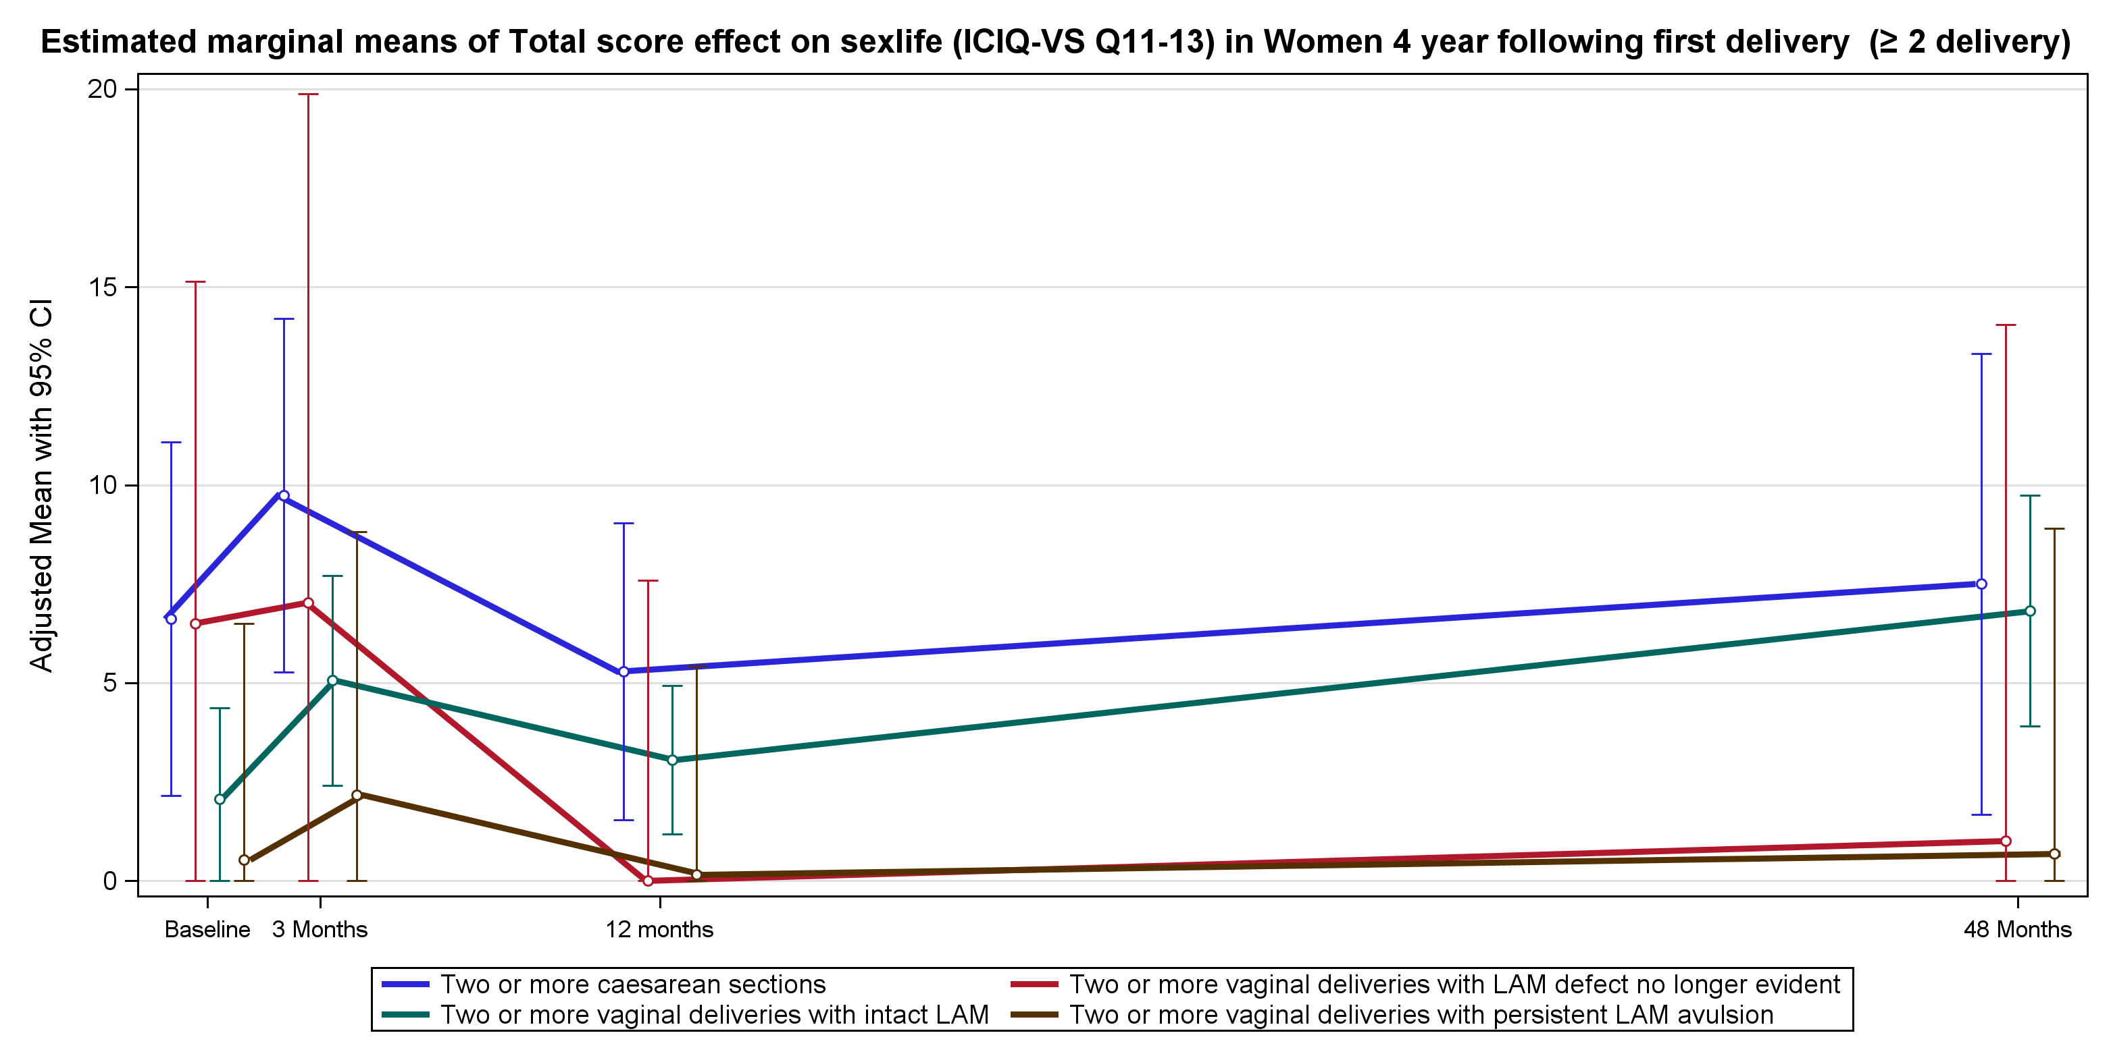
D Sexual dysfunction

Slide 6
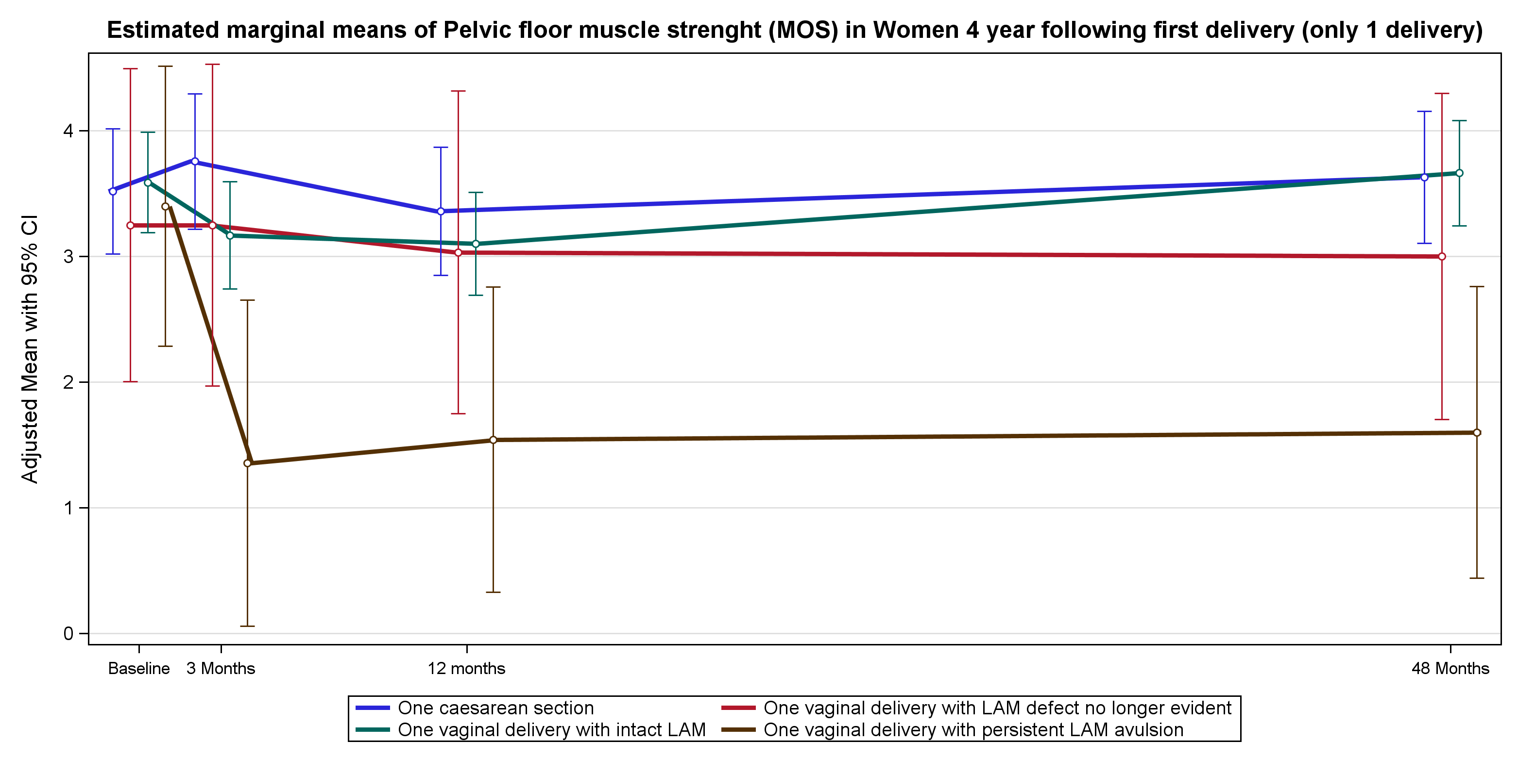
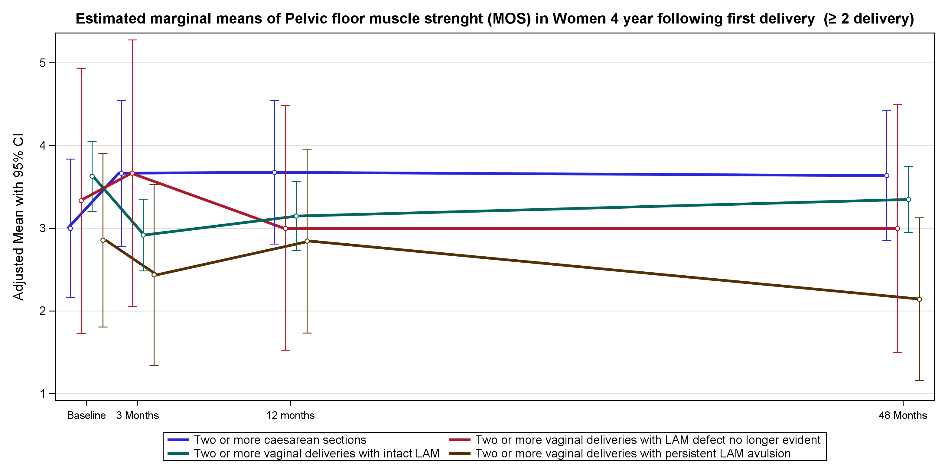
E Pelvic floor muscle strength

Slide 7
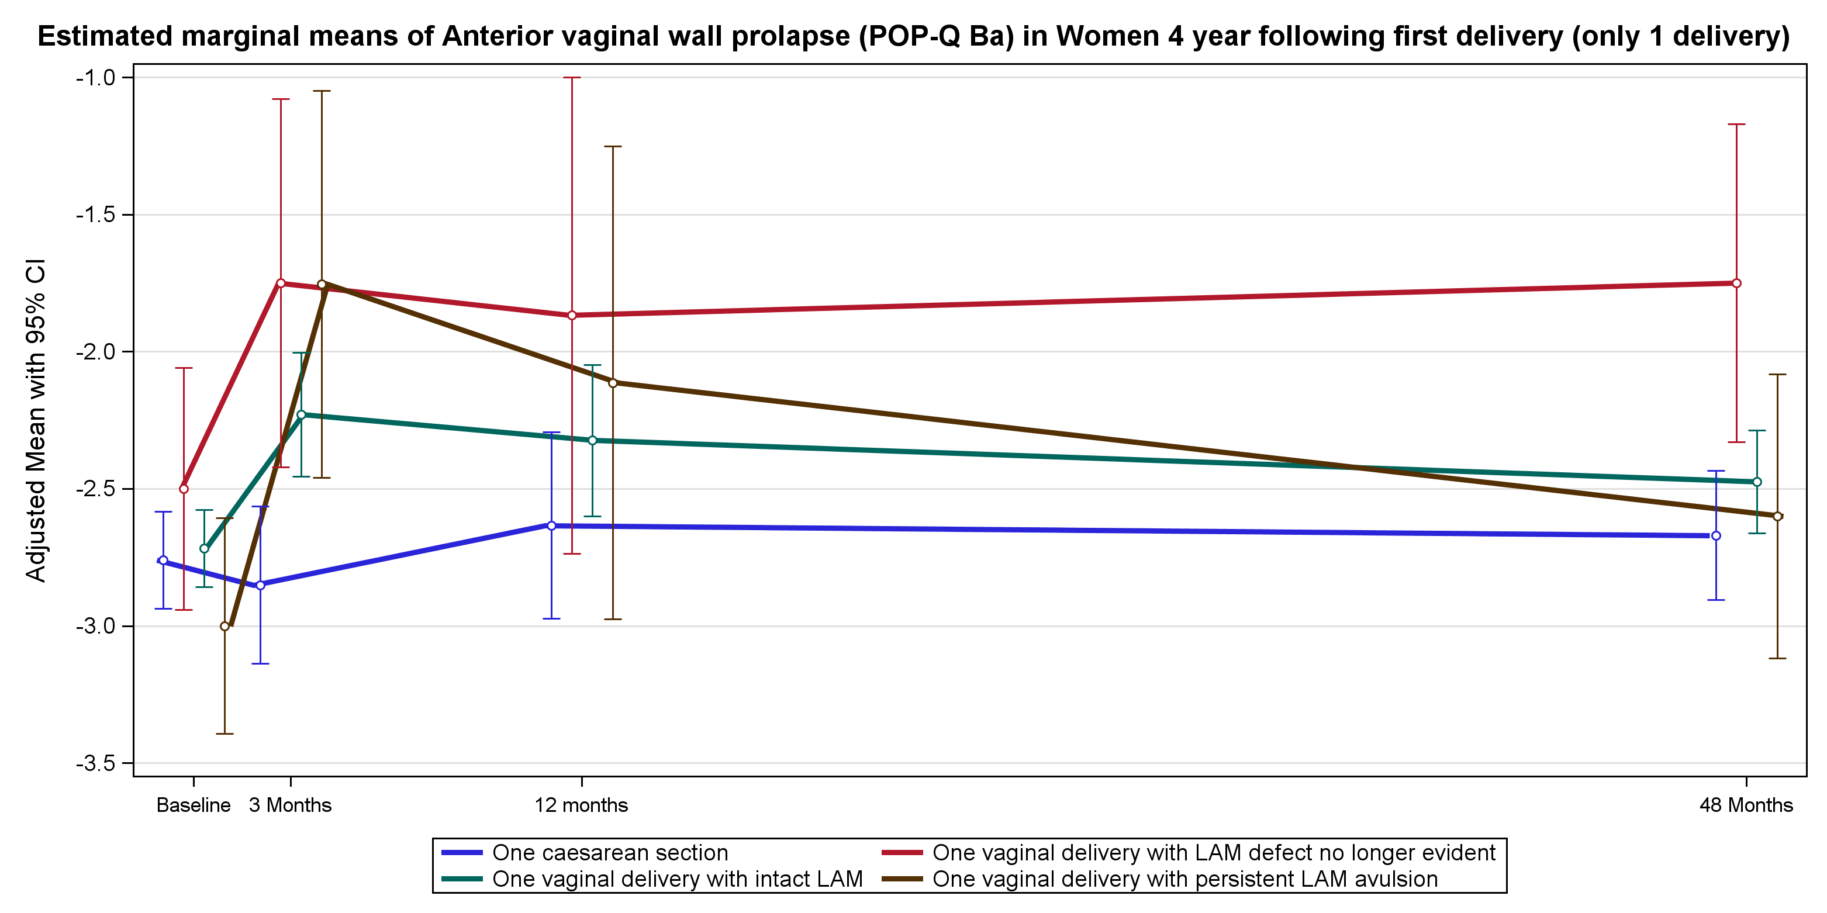
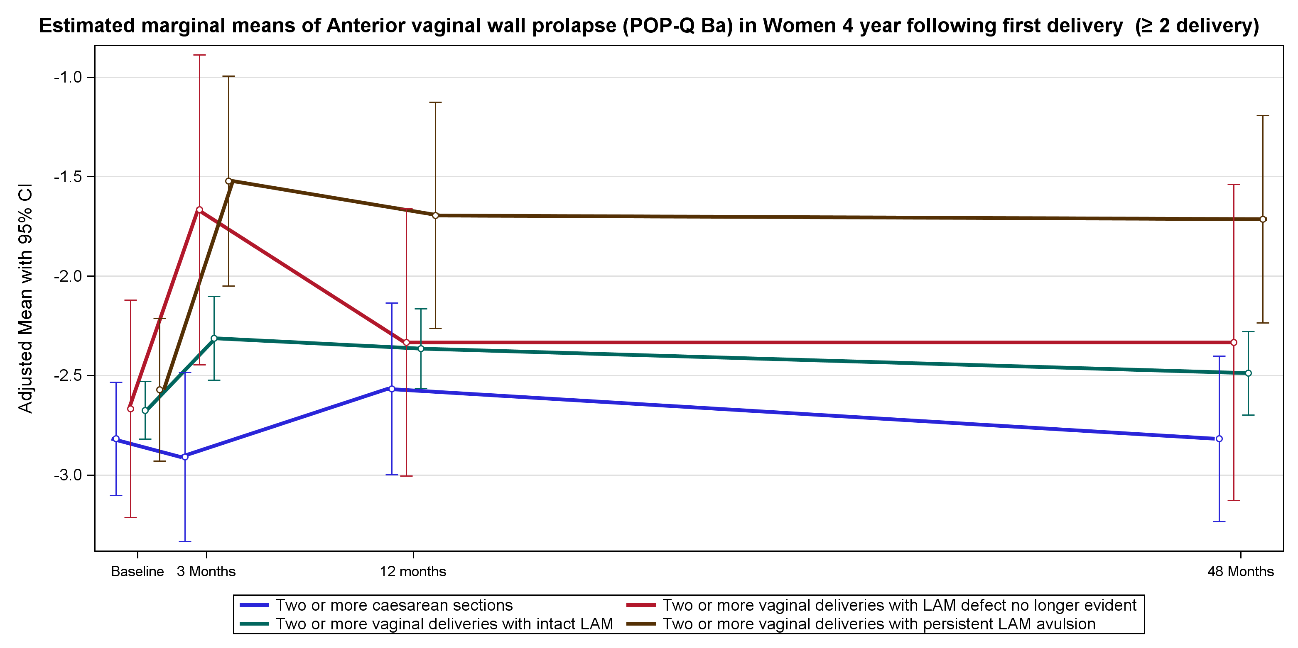
F Anterior Vaginal Wall Prolapse

Slide 8
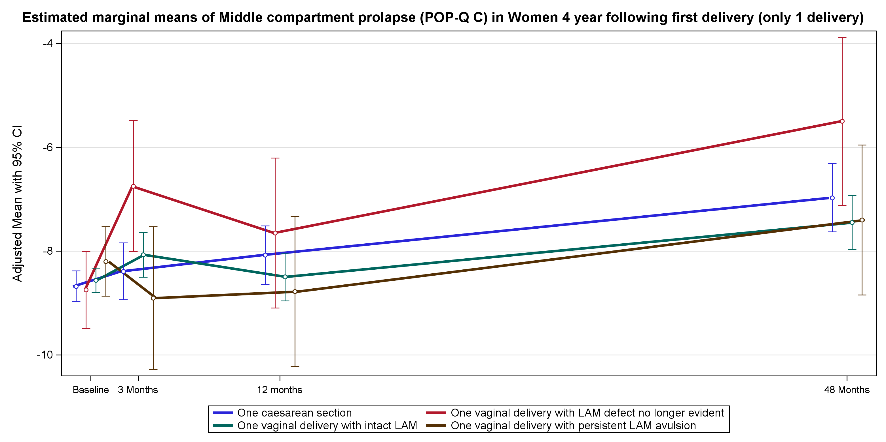
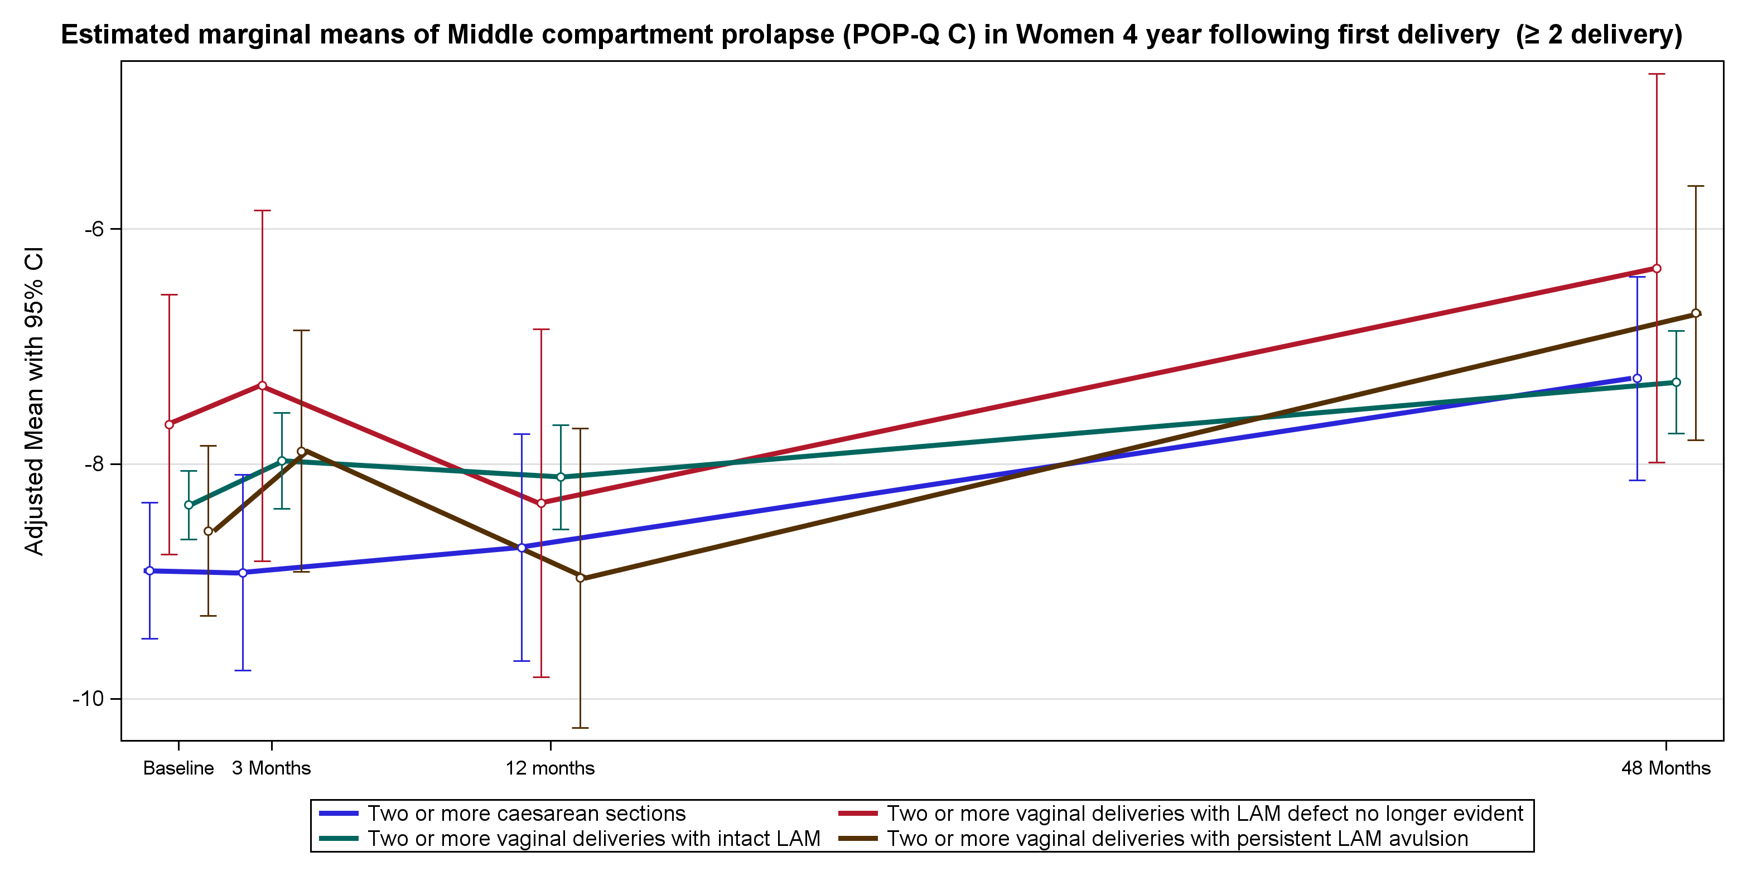
G Middle compartment prolapse

Slide 9
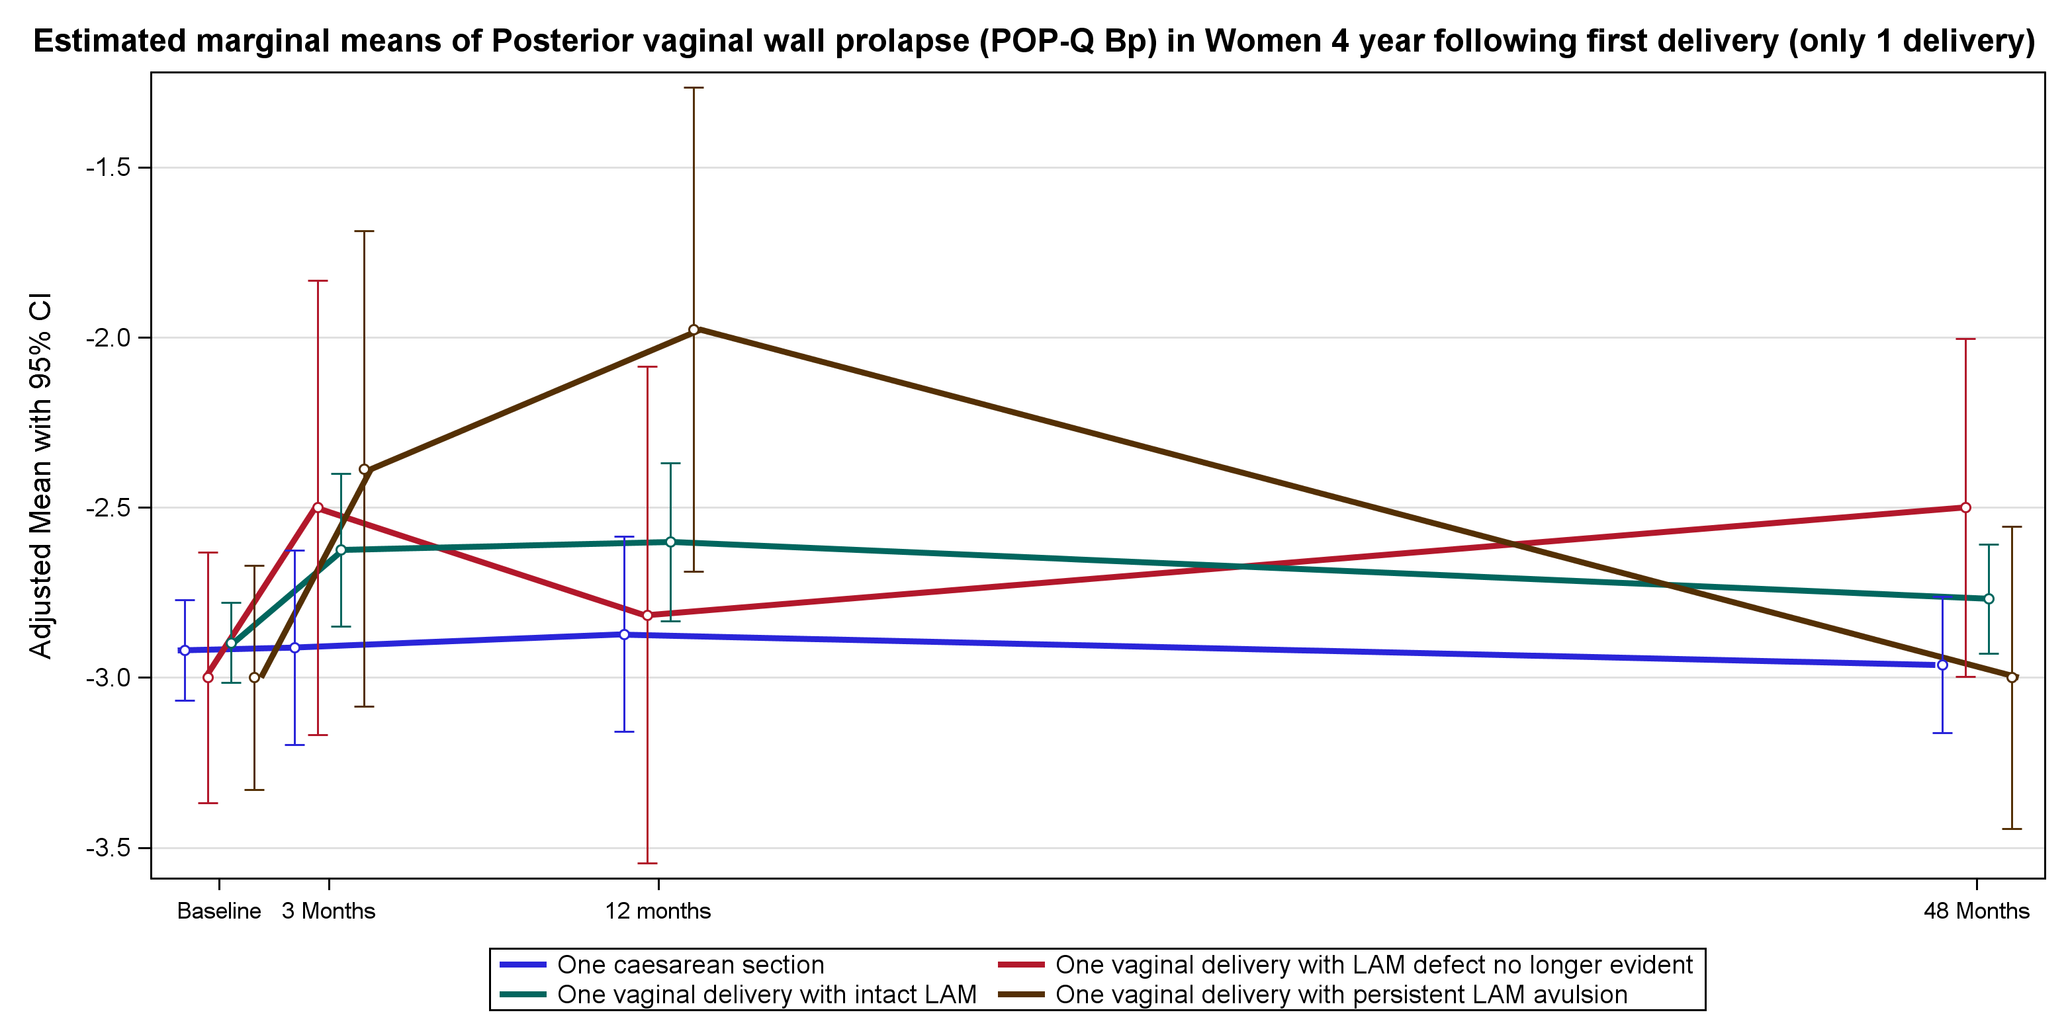
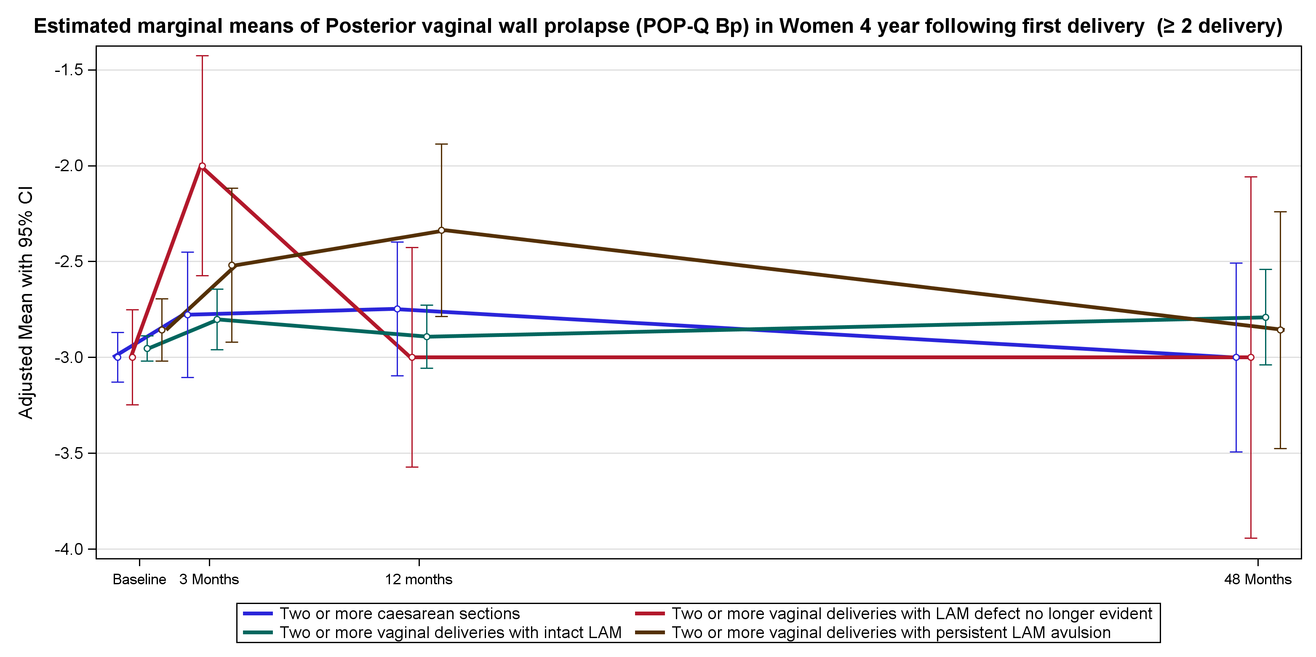
H Posterior Vaginal Wall Prolapse

Slide 10
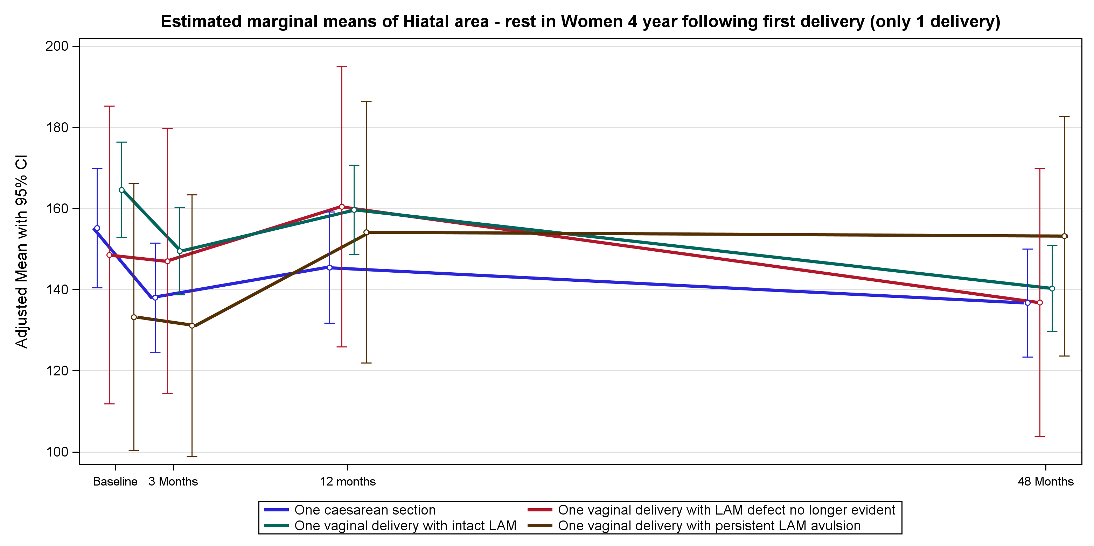
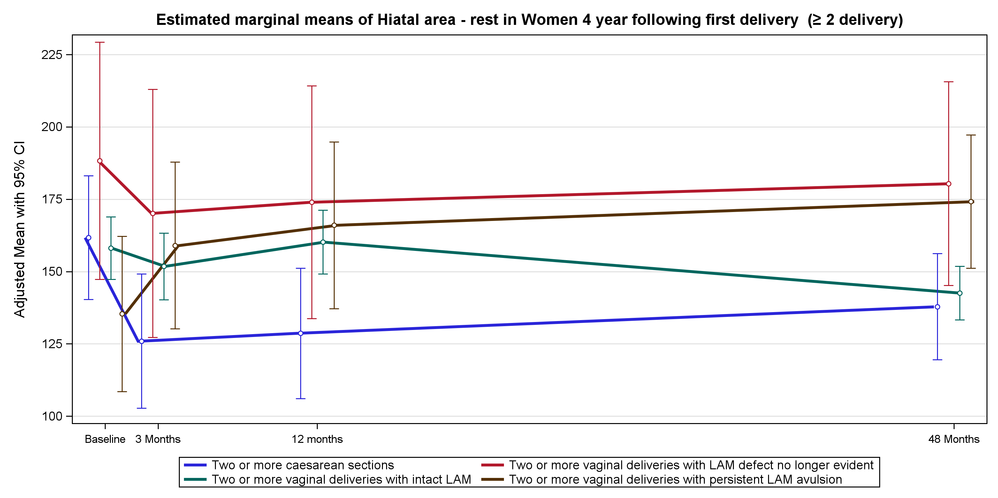
I Hiatal area at rest

Slide 11
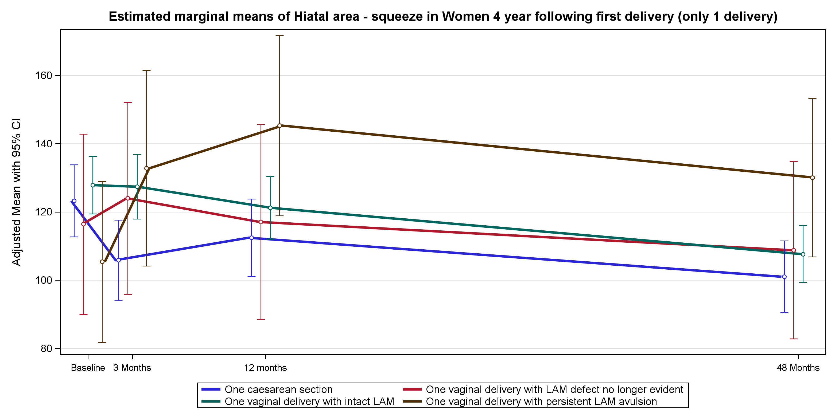
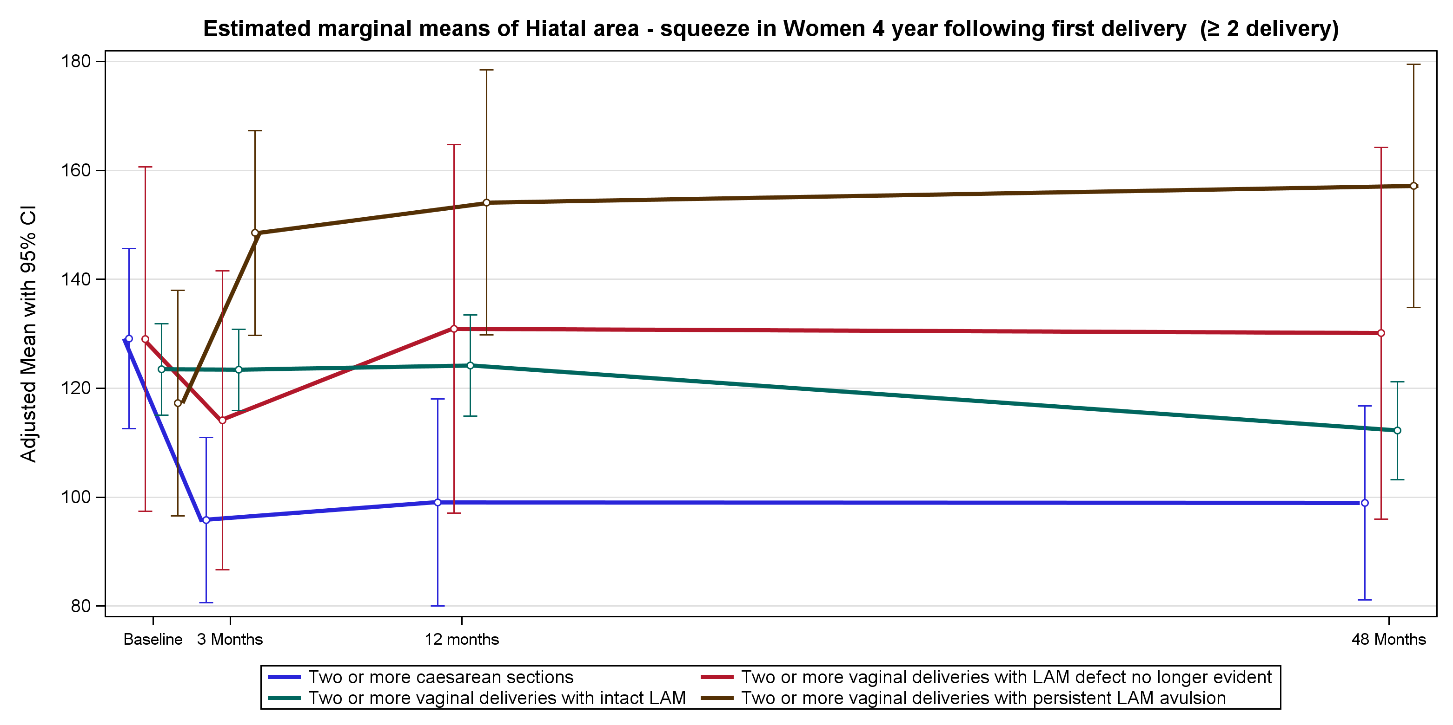
J Hiatal area squeeze

Slide 12
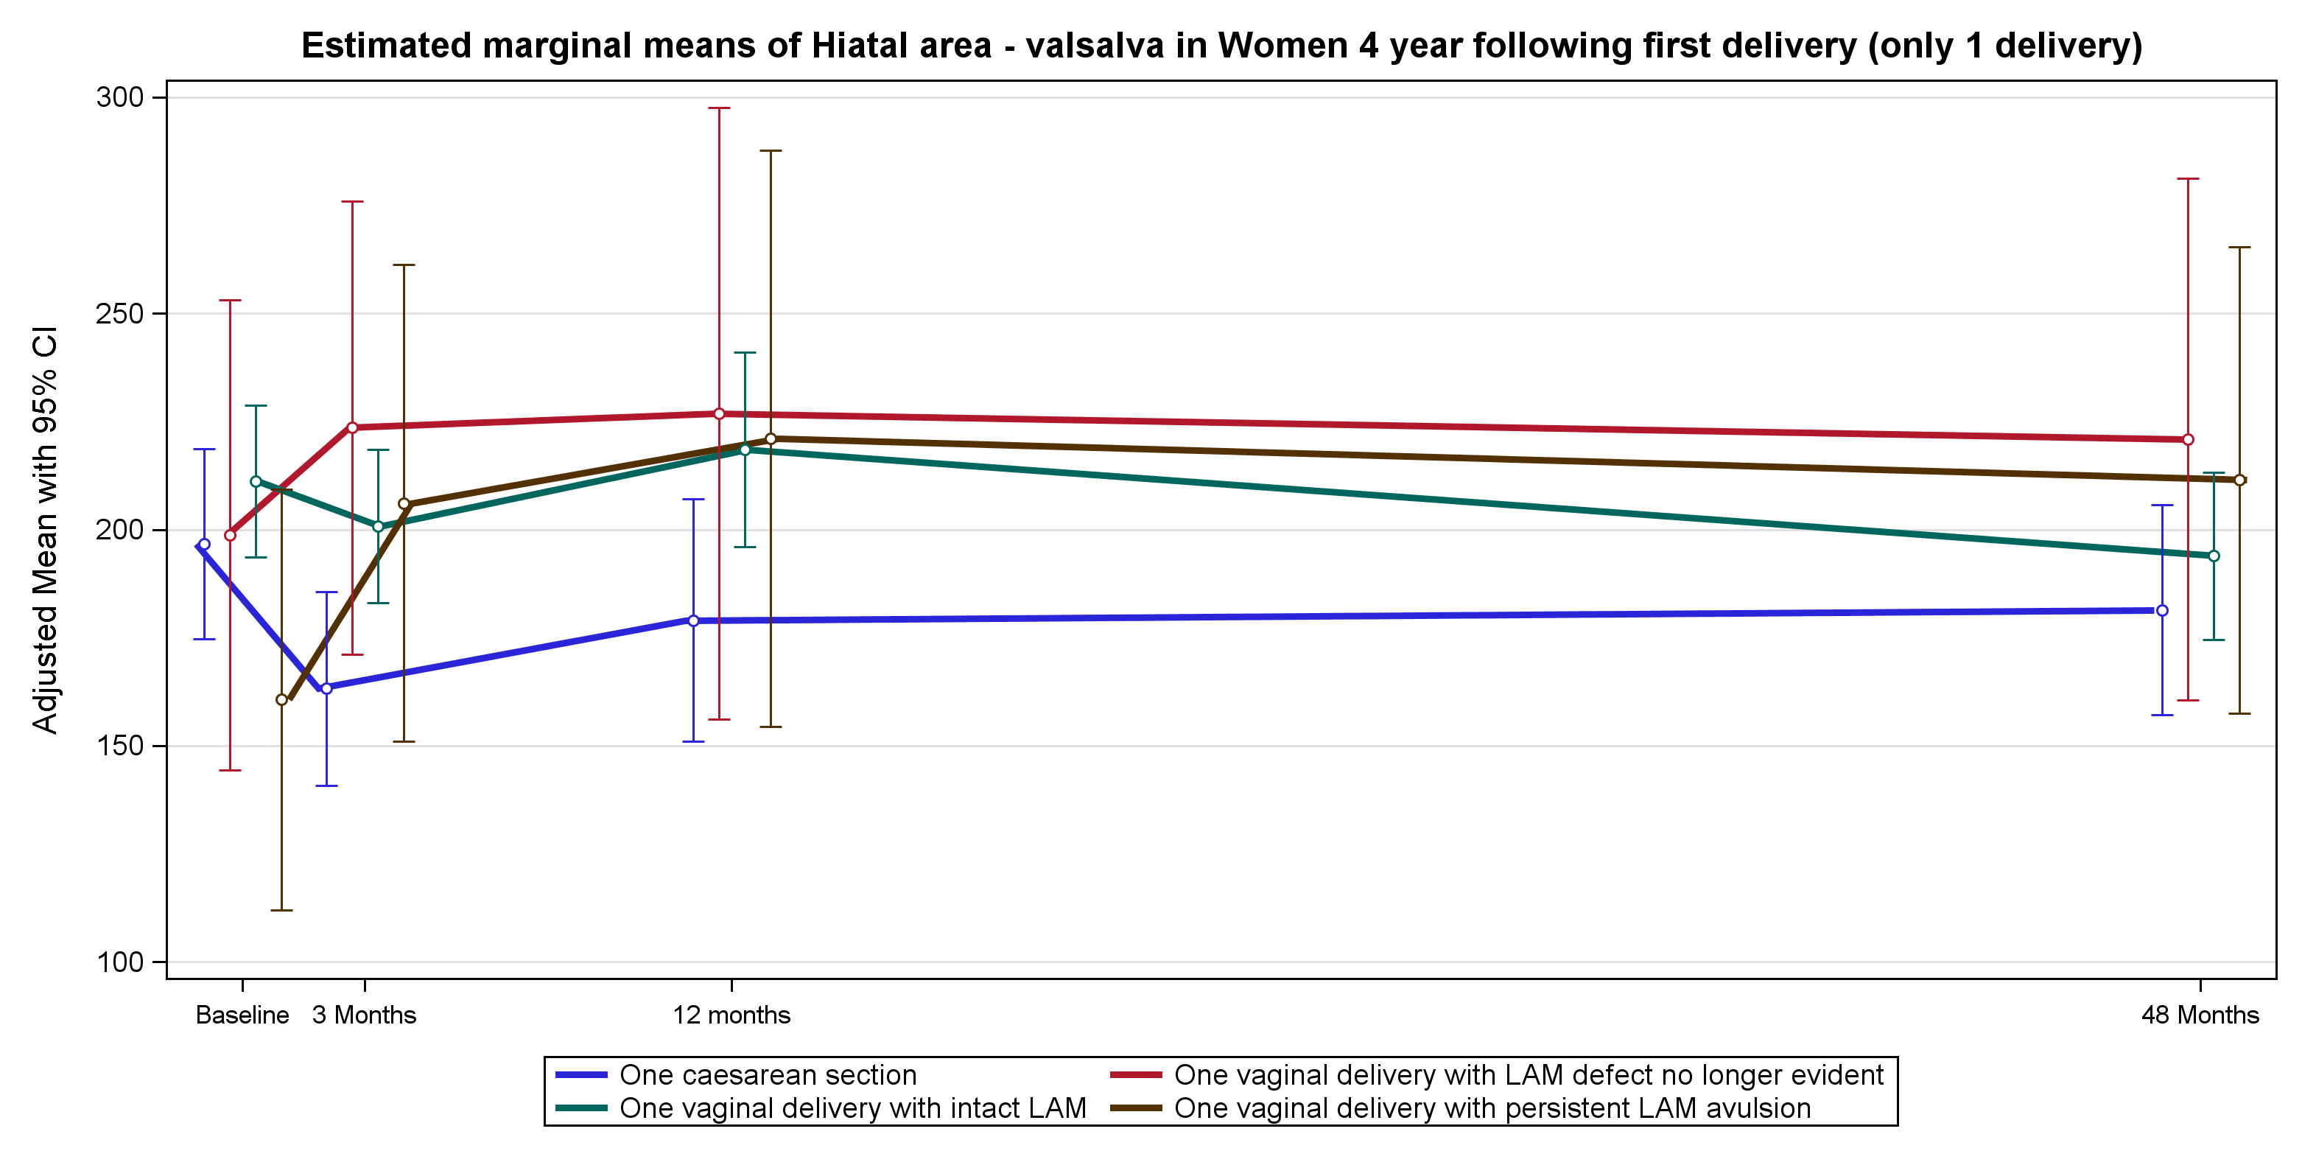
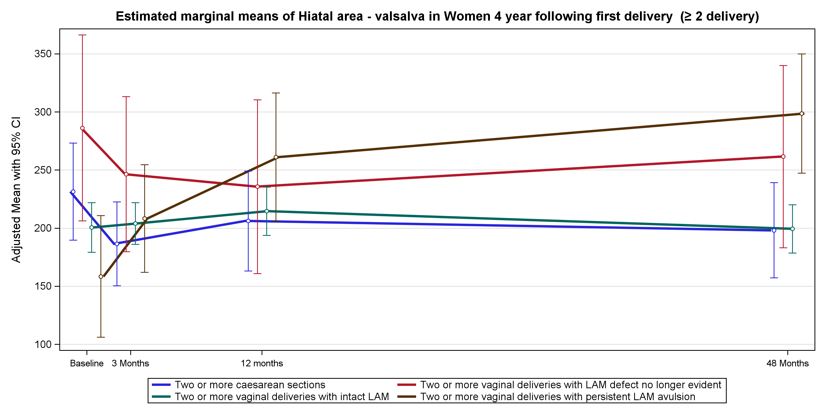
K Hiatal area at Valsalva

