Slide 1
Figures Prevalence and duration of gastrointestinal symptoms in the decade before diagnosis of Inflammatory Bowel Disease; a nationally representative cohort study in the UK, 1998-2016

Slide 2
a.
b.
Figure 1: Excess prevalence of gastrointestinal symptoms in the 10 years before diagnosis of CD
Abdominal/Perianal Pain
Diarrhoea
Rectal Bleeding
All gastrointestinal symptoms
c.
d.
Symptoms among Controls
Excess symptoms before Crohn’s Disease

Slide 3
a.
b.
Figure 1: Excess prevalence of gastrointestinal symptoms in the 10 years before diagnosis of CD
Abdominal/Perianal Pain
Diarrhoea
Rectal Bleeding
All gastrointestinal symptoms
Earache (Control Symptom)
c.
d.
e.
Symptoms among Controls
Excess symptoms before Crohn’s Disease

Slide 4
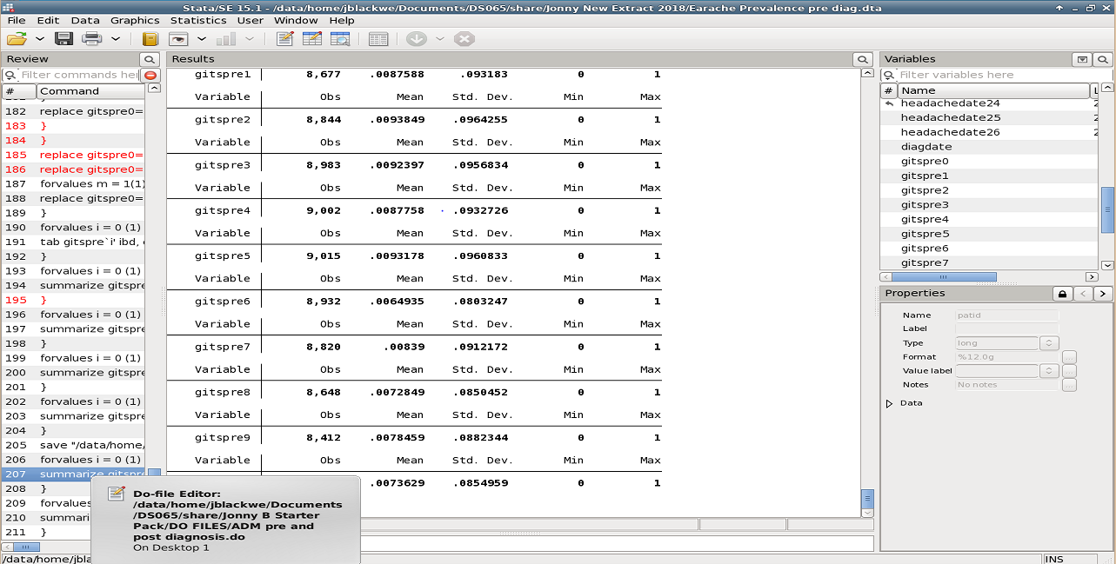

Slide 5
a.
b.
Figure 2: Excess prevalence of gastrointestinal symptoms in the 10 years before diagnosis of UC
Abdominal/Perianal Pain
Diarrhoea
Rectal Bleeding
All gastrointestinal symptoms
c.
d.
Symptoms among Controls
Excess symptoms before ulcerative colitis

Slide 6
a.
b.
Figure 2: Excess prevalence of gastrointestinal symptoms in the 10 years before diagnosis of UC
Abdominal/Perianal Pain
Diarrhoea
Rectal Bleeding
All gastrointestinal symptoms
Earache (Control symptom)
c.
d.
e.
Symptoms among Controls
Excess symptoms before ulcerative colitis

Slide 7
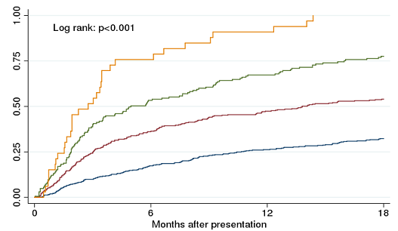
Figure 3: Probability of specialist review after presentation with chronic GI symptoms according to era of presentation
Chronic GI symptoms – Individuals presented to their GP with gastrointestinal symptoms twice within a 6 month period , where the presentations were at least 6 weeks apart.
Specialist review – Outpatient appointment with a gastroenterologist, paediatric gastroenterologist or colorectal surgeon
Notes:
RP Suggest introducing dots and dashes etc as well as colour for those watching in black and white. You can also add this to the legend and get rid of the box below
It looks a bit funny and fuzzy can we improve graphic

Slide 8
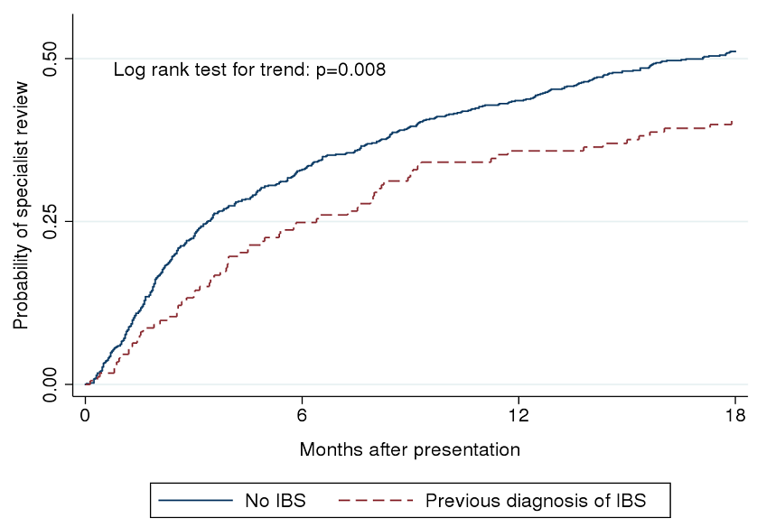
Figure 4: Probability of specialist review after presentation with chronic GI symptoms in individuals with and without a previous diagnosis of IBS
IBS – Irritable bowel syndrome
Chronic GI symptoms – Individuals presented to their GP with gastrointestinal symptoms twice within a 6 month period , where the presentations were at least 6 weeks apart.
Specialist review – Outpatient appointment with a gastroenterologist, paediatric gastroenterologist or colorectal surgeon
Notes:
DO you need number at risk for this graph too

