Slide 1
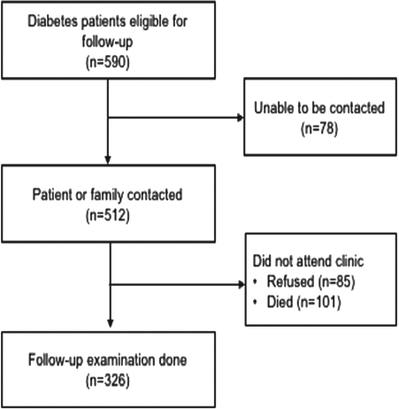
Figure 1 Flow chart of study participant follow-up.
Notes:
Figure 1 Flow chart of study participant follow-up.
Unless provided in the caption above, the following copyright applies to the content of this slide: © The Author(s) 2019. Published by Oxford University Press on behalf of Royal Society of Tropical Medicine and Hygiene. All rights reserved. For permissions, please e-mail: journals.permissions@oup.com.This article is published and distributed under the terms of the Oxford University Press, Standard Journals Publication Model (https://academic.oup.com/journals/pages/open_access/funder_policies/chorus/standard_publication_model)

